Slide 1
Cultural Appropriation & Law
Photo by Meg Jerrard on Unsplash
Dr Marie Hadley (Lecturer, Newcastle Law School, University of Newcastle)
Aboriginal and/or Torres Strait Islander peoples should be aware that this presentation contains the names of people who have passed away.
Notes:
I acknowledge the Traditional Custodians of the land on which I live and work, the Awabakal people, and pay my respects to their Elders past, present, and emerging. I extend that respect to Aboriginal and Torres Strait Islander peoples here today.

Slide 2
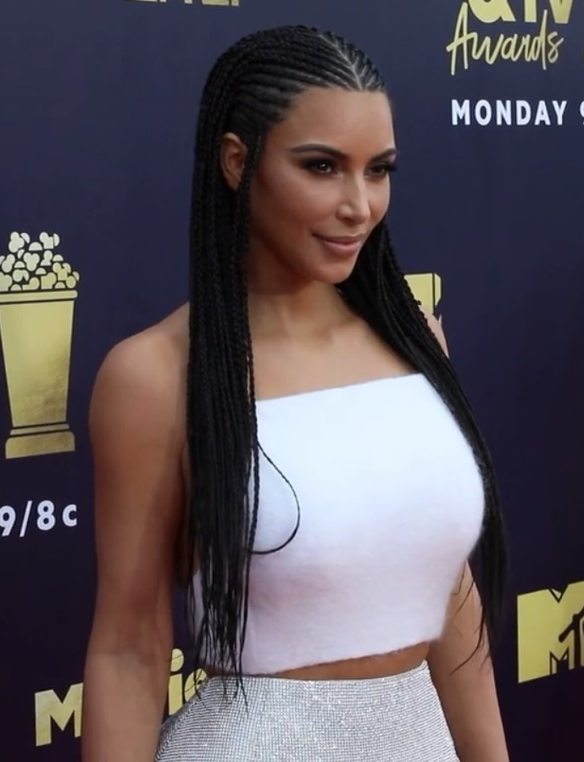
Outline
1. What is cultural appropriation?
2. Cultural appropriation & law:
Copyright law
Consumer law
3. Law’s Complicity in Cultural Harm
4. Practical considerations: navigating this terrain
Kim Kardashian & Kris Jenner MTV Awards © Nicole Alexander CC-BY 3.0 License. Image cropped

Slide 3
Part I: What is Cultural Appropriation?
Occurs when a cultural outsider takes what is perceived to be cultural property belonging to another culture
“Cultural property” is broadly defined and includes tangibles and intangibles
“Appropriation” is broadly defined and includes taking, imitating, seeking inspiration from, exploiting
Virtually any unauthorised dealing with any aspect of culture can trigger a cultural appropriation claim – the relationship between the cultural insider vs cultural outsider is most definitive.
“Style Appropriation”: an artist adopting an art form or style developed by members of another culture
Mike Tyson 2019 © Glenn Francis CC-BY-SA 4.0 License. Image cropped

Slide 4
Cultural Appropriation & Law
The language of theft and possession are manifest in allegations:
It is astounding that a Pakeha tattooist who inscribes an African American’s flesh with what he considers to be a Maori design has the gall to claim... That design as his intellectual property.
The tattooist has never consulted with Maori, has next had experience of Maori and originally and obviously stole the design that he put on Tyson.
The tattooist has an incredible arrogance to assume he has the intellectual right to claim the design form of an indigenous culture that is not his.
Professor Ngahuia Te Awekotuku
Image by falco from Pixabay

Slide 5
Appropriation can signal a legal violation or where the law is inadequate, an unmet legal need.
However, this markedly oversimplifies what claims are and the stability of the property at their heart
In addition to formulating any distinct legal demands
Claims can have a performative quality – alleging appropriation is a resistant activity; an activity that resists systemic oppression; and
Claims are fundamentally unstable – they invoke a conception of culture, its memberships and properties that ignores a mixing, sharing, and internal contestation
Evidentiary implications

Slide 6
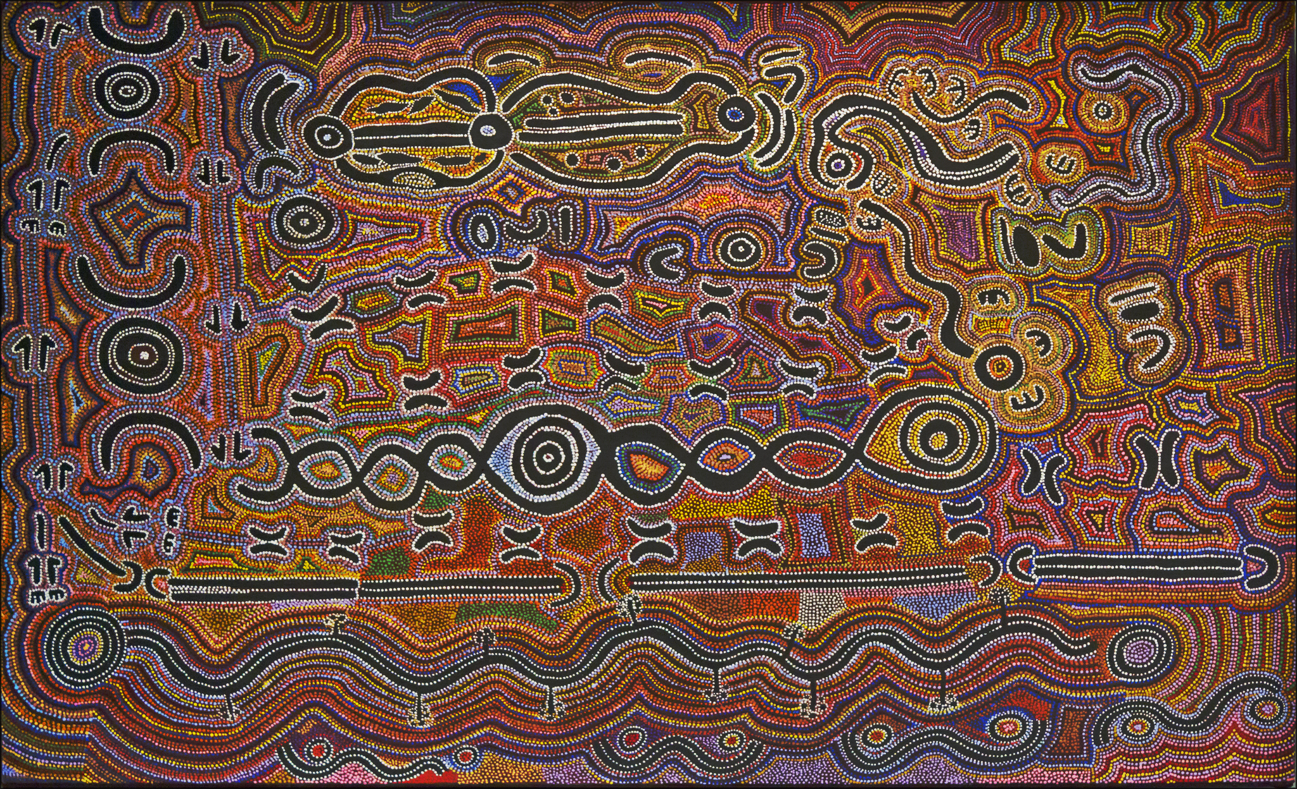
Part 2: Australian Law and Aboriginal & Torres Strait Islander art styles
Any Questions so far?
Aboriginal Religious Art © dun_deagh CC BY-SA 2.0 License

Slide 7
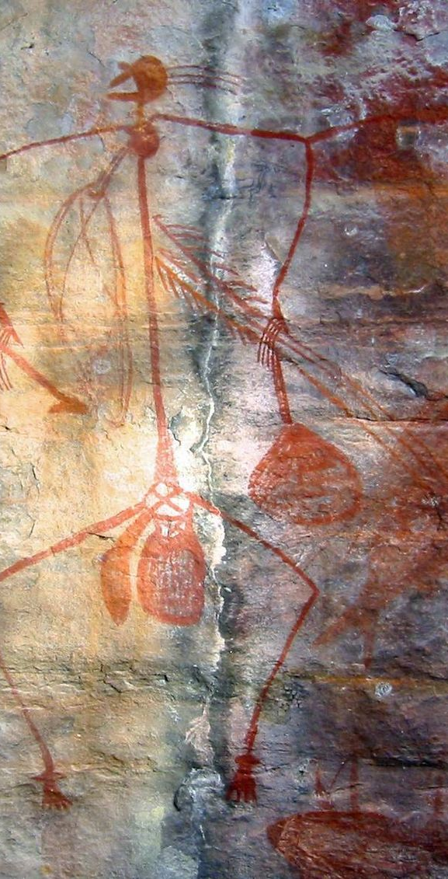
Copyright law
In the 1980s (and perhaps earlier), the originality of Aboriginal art was questioned due to its relationship with pre-existing tradition. See e.g. the Working Party on Aboriginal Folklore (1981)
Rising recognition of Aboriginal art as fine art during the 1980s: cultural tourism, overseas exhibitions
By around 1990 – recognised as having equal status with other artworks under the Copyright Act.
Aboriginal Rock Art, Ubirr Art Site, Kakadu National Park, Australia © Thomas Schoch CC-BY 3.0 License

Slide 8
Key cases
Yumbulul v Reserve Bank of Australia (1991): Terry Yumbulul > Aboriginal Artists Agency> Reserve Bank $10 note. Primarily a M&D conduct case. But also considered: did have the right to assign reproduction rights given they were vested in the elders of the Galpu clan?
M* & Others v Indofurn (1994) (the “Carpets Case”): Aboriginality is a ‘relevant matter’ that the court may take into account when assessing damages for copyright infringement (s 115(4)(iv). Damages can be awarded for ‘culturally based harm’.
Bulun Bulun v R & T Textiles (1998): Magpie Geese and Waterlillies at the Waterhole/fabric appropriation. ‘Copyright is entirely a creature of statute’. Communal rights arising from customary law do not satisfy the criteria for joint authorship which requires collaboration – use of ritual knowledge & community’s oversight and authority over reproduction ‘too ephemeral’. Relationship between artist and community can be a source of fiduciary obligations (a duty to protect the ritual knowledge which the artist had been permitted to use under customary law). These are not proprietary rights.

Slide 9
Customary law & cultural significance of art is part of background facts – but not recognised as a standalone source of rights
So, while equal protection for Aboriginal and Torres Strait Islander artists under copyright law – there are gaps in protection, particularly due to copyright’s time duration, material form requirement, and preference for individual rights
Violations of customary law are not necessarily violations of copyright law
Art styles, iconography, and ancient imagery all fall into the public domain and are free to be appropriated without restriction
I will come back to what this means for law’s complicity in cultural harm…
Image by esther1721 from Pixabay

Slide 10
Consumer law
Approximately 80% of all Aboriginal-style art products sold in souvenir shops is fake and imported.
ACL s 18 ‘prohibits a person, in trade or commerce, from engaging in conduct that is misleading or deceptive or is likely to mislead or deceive’
Substantial penalties are available under the ACL
prevents the fraudulent marketing of arts and crafts featuring Aboriginal-inspired imagery or painted in an Aboriginal style as “Aboriginal”
Aboriginal Rock Art, Ubirr Art Site, Kakadu National Park, Australia © Thomas Schoch CC-BY 3.0 License

Slide 11
Key cases
Dreamtime Creations (2009): fake Indigenous persona ‘Ubanoo Brown’, fake certificates of authenticity ‘Authentic Aboriginal Painting, ‘Aboriginal Fine Art Canvas’, stickers affixed that said ‘Traditional Hand Painted Aboriginal Art’, ‘Authentic Aboriginal Art’. S 52 TPA
Nooravi [2008] (T/as Doongal Aboriginal Art and Artefacts): false representation that artists were of Aboriginal descent. False certificates of authenticity. S 52 TPA.
Birubi Art [2018]: false/misleading representations that the products were made in Australia and/or were handpainted by Aboriginal artisans (made in Indonesia). ‘Authentic Aboriginal art’ ‘Hand Painted’. $2.3 million penalty – general deterrent. breaches of s 18, 29(1)(a) and (k), 33 ACL.

Slide 12
Photograph courtesy of the ACCC

Slide 13
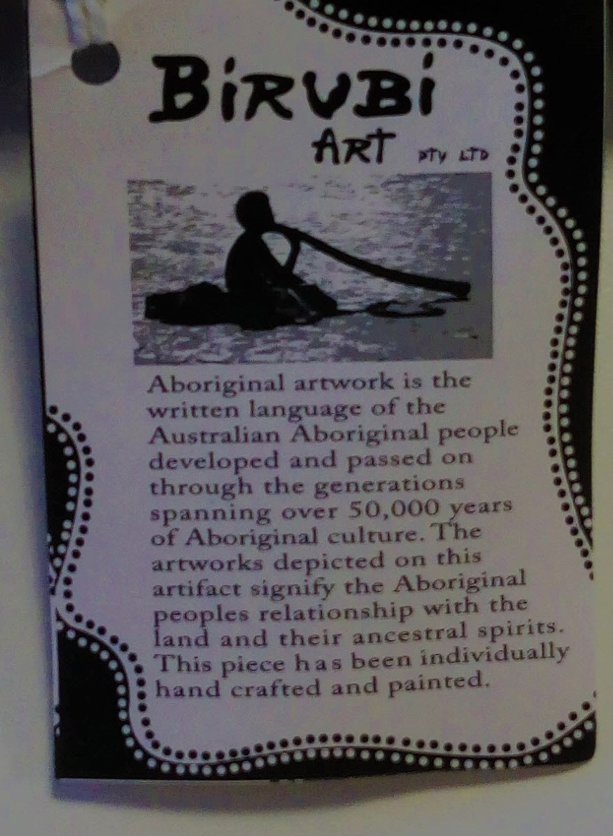
Key takeaways
The product must specifically claim to be authentic
If made overseas, it must indicate its overseas origin
The law prohibits false labelling – not the use of Indigenous styles and themes generally.

Slide 14
Reform Proposals to disrupt the market for “Fake Art”
Competition and Consumer Amendment (Exploitation of Indigenous Culture) Bill 2017 (Katter Bill)
The Prevention of Exploitation of Indigenous Cultural Expressions Bill 2019 (Hanson-Young Bill).
Both seek to restrict the sale of “Indigenous cultural expressions”, that is defined to include an expression of Indigenous that is “derived from, or has a likeness or resemblance to, one of more indigenous cultural expressions.’, where there is no agreement with the relevant Indigenous artist or community
Katter’s Bill focuses on imported products (productss must be made in Australia to be sold)
Hanson-Young’s Bill is more expansive, e.g. amendments to the unfair terms regime to include “Indigenous cultural expression contracts”

Slide 15
Neither Bill has progressed
But - the Hanson-Young Bill was referred to the Senate Environment and Communications Legislation Committee for consideration in 2019.
Senate Committee Report (2020): the definitions proposed were too broad + more consultation needed.
In principle support for a sui generis regime – but the nature of what that legislation should address left unclear.
Photo by Social Estate on Unsplash

Slide 16
SUMMARY
Copyright law doesn’t protect art styles from appropriation
Consumer law doesn’t protect art styles from appropriation
Any questions?

Slide 17
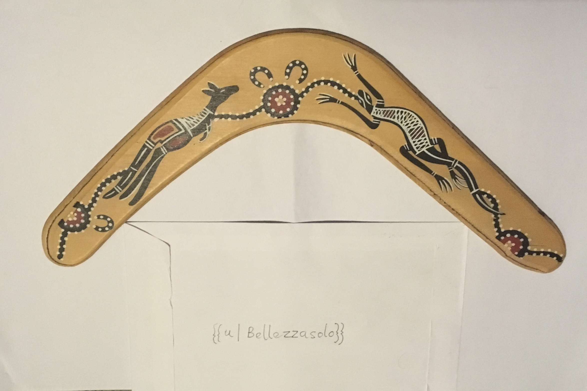
Part 3: What is the effect of law’s complicity in cultural appropriation?
Painted Boomerang© Bellezzasolo CC-BY-SA 4.0 License.

Slide 18
Loss of cultural autonomy
rights are wielded by third parties = less cultural control over the conditions in which culture is represented and exploited is undermined (affecting cultural integrity and well-being).
Cultural distortion and dilution: stylised art can enter into the cultural account by being misrecognised as authentic – having a corrosive effect on culture & affecting intergenerational transmission of culture
Insider artists can feel constrained or undermined when producing art

Slide 19
Economic harm
Profits accruing to cultural outsiders & absence of royalty payments
Interference with Indigenous artists leveraging culture to secure their own economic and/or cultural goals
Income stream from art can alleviate poverty and support cultural continuity
Distorts markets particularly souvenir markets
Productivity Commission study of the different markets for Aboriginal and Torres Strait Islander visual arts and crafts is now underway (will assess financial impacts of fake art)

Slide 20
Offence
Strikes at core values & sense of self; commercial appropriations particularly problematic
“it takes the core from inside you, it just really dampens the spirit because you’re telling your true story, and here are people taking patterns and colour just for the sake of creating a fake image so they can make money….
They’re stealing, they’re insulting, you name it. They’re doing everything wrong.
Torres Strait Islander linocut artist, Laurie Nona

Slide 21
Part 4: Practical considerations: navigating this terrain
1. What are our responsibilities here? Think/reflect/engage
2. Check for Protocols: voluntary, standard setting instruments
Aboriginal Religious Art © dun_deagh CC BY-SA 2.0 License

Slide 22
Australia Council for the Arts Protocols
A series of protocols for different industries including music, writing, and the performing arts.
Practical guides e.g. need to obtain consent, community contacts
Not clear how broadly they are implemented

Slide 23
Other Protocols
Indigenous Art Code:(voluntary) membership is open to all Indigenous artists and their art dealers. Includes general standards of conduct for dealers. Nb: No prosecution under the code for unethical dealers (but can be suspended from membership to the Code)
NAVA Code of Practice: Best practice standards for the visual arts sector. Use of Indigenous designs (or their close equivalent) without permission is not acceptable. Currently the full code is under revision.

Slide 24
The power of the court of public opinion….
Given the legal position, you do not have to follow protocols, but you/your clients need to think carefully about this.
As performative utterances, cultural appropriation claims have power – even when they are not supported by formal legal rights. They do something.
Starting point: Assume alignment of interests.
Respect = win/win
Photo by Firmbee.com on Unsplash

Slide 25
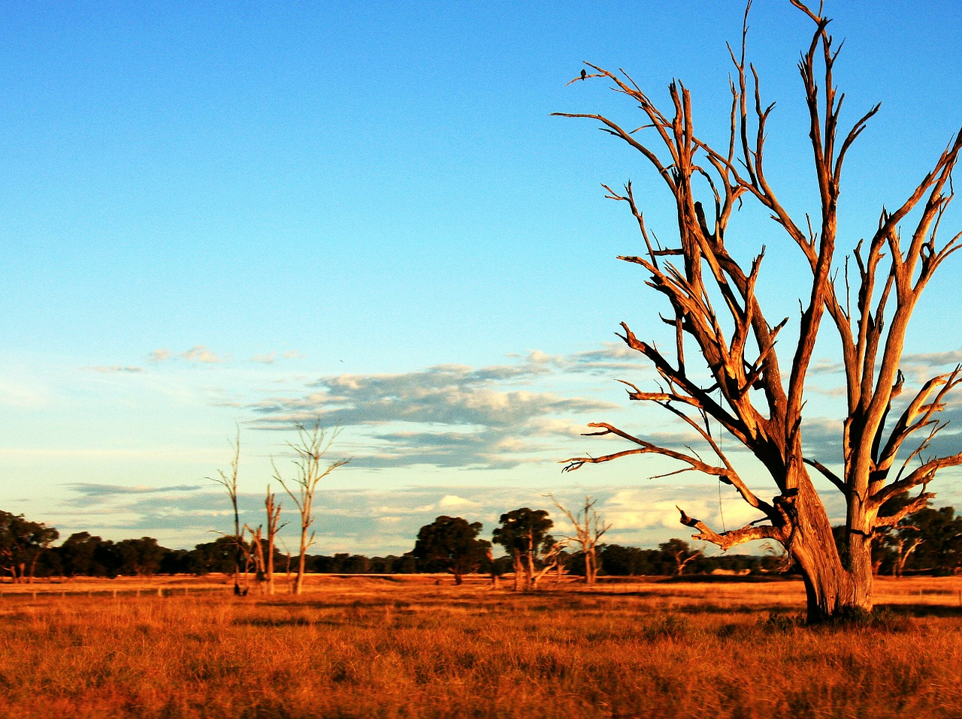
Further Reading
On cultural appropriation: Loretta Todd, Notes on Appropriation (1990) 16(1) Parrallogram
On cultural appropriation and copyright law: see my papers on SSRN
Protocols: Australia Council Visual Arts Protocols
On inauthentic Aboriginal-style art and craft and consumer law:
Stephanie Parkin, ‘The theft of culture and inauthentic art and craft: Australian Consumer Law and Indigenous intellectual property’ (Masters of Philosophy thesis, QUT, 2020)
On respectful engagment with Indigenous peoples and communities and ICIP:
Terri Janke, True Tracks: Respecting Indigenous Knowledge and Culture (NewSouth Publishing, 2021)
TrueTracks Workshops
Image by Rossco from Pixabay

