Slide 1
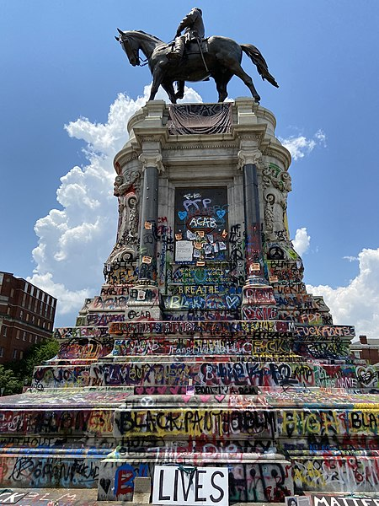
What the Vandalism of Public Art Statues in Australia Tells Us About the Racial Investments of Copyright and the Moral Right of Integrity
Defaced Lee Statue 2020 © Mk17b. CC BY-SA 4.0 License
Marie Hadley, Sarah Hook, Nikolas Orr
LSA 2021
We pay our respects to the traditional owners of the lands on which we live and work: the Awabakal, Worimi, Darug, Eora, Dharawal and Wiradjuri peoples, as well as the traditional owners on which this conference is being held.
We pay our respects to owners past, present and emerging.

Slide 2
Does IP regulation of public spaces, through the rights that attach to public artworks, foreclose public discourse around racial injustice?
Photo by Tony Zhen on Unsplash

Slide 3
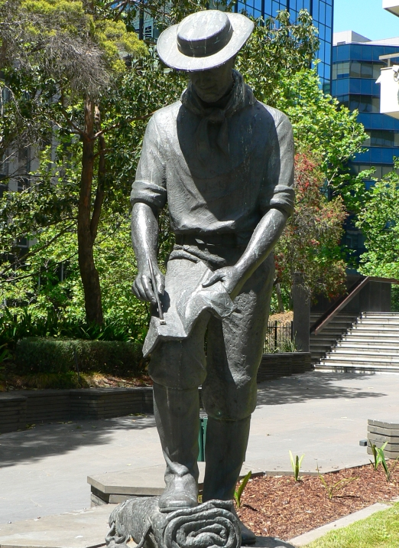
Ideological vandalism in Australia
#BLM influential in local politics > 2017
Statue vandalism in 2020
Earlier “Change the Date” statue activism
Anti-colonial/anti-racist protest action involving statues since at least 1990s, including public trial of John Batman
Statue of John Batman on former National Mutual Plaza Collins Street 2006 by Biatch via Wikimedia

Slide 4
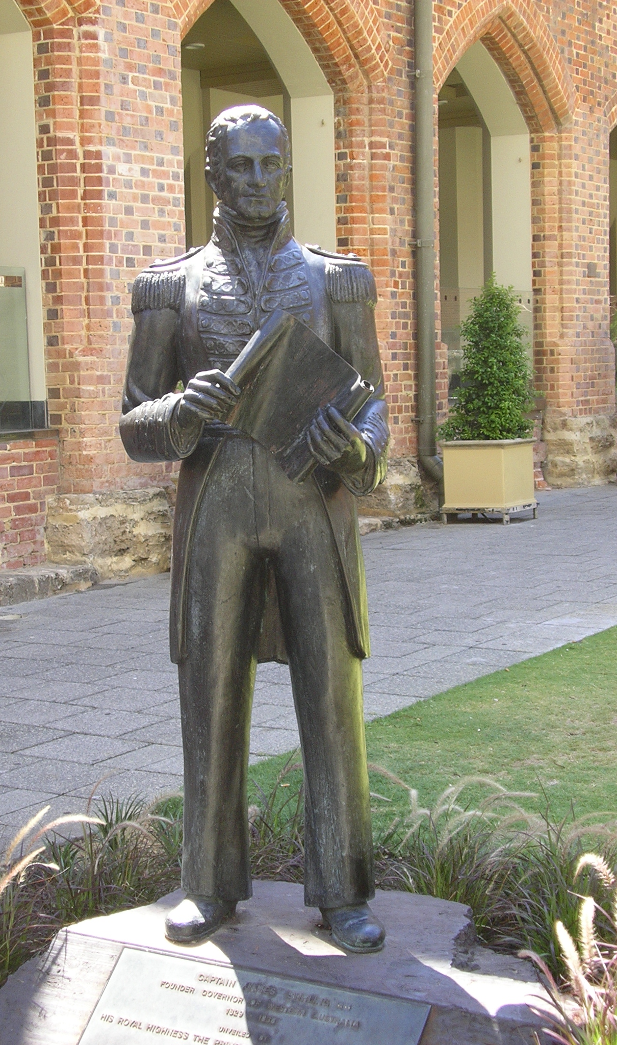
The problem with statues
Commemoration and community values
Physical commons: but who is the “public”?
Statues as a focal point for disidentification
Public art – James Stirling 2011 © Moondyne. CC-BY-SA 3.0 License via Wikimedia commons

Slide 5
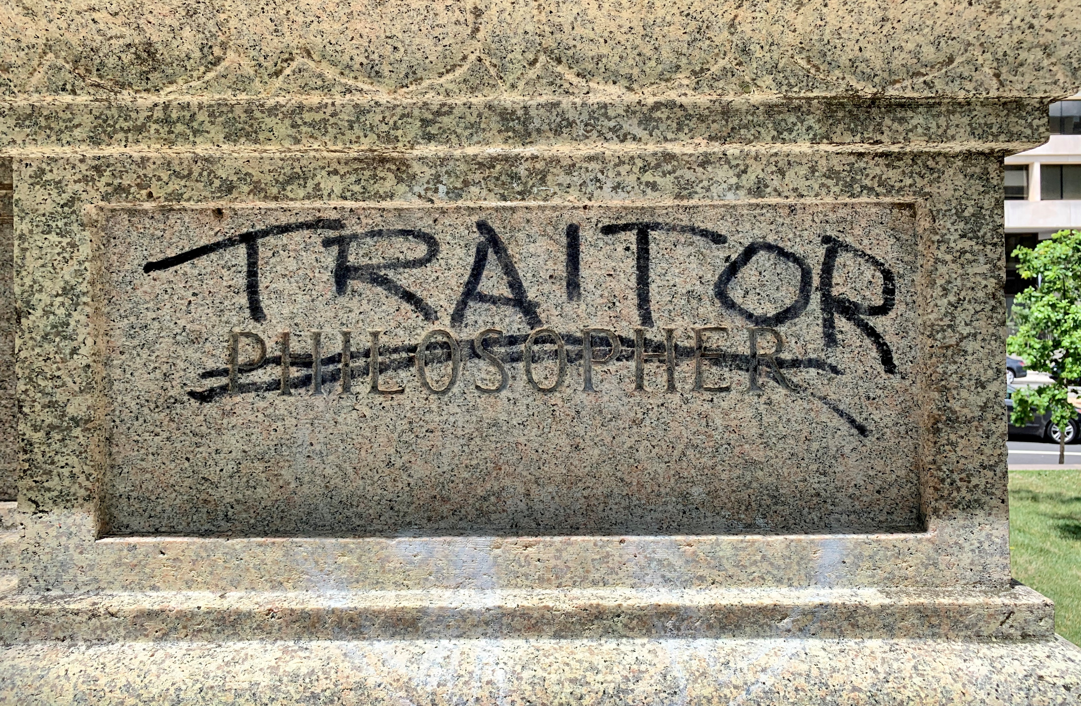
The intervened sculpture
The physical intervention results in a new work – a counter-monument – that has transformative potential
Albert Pike Memorial Vandalism © AgnosticPreachersKid. CC-BY-SA 4.0 License

Slide 6
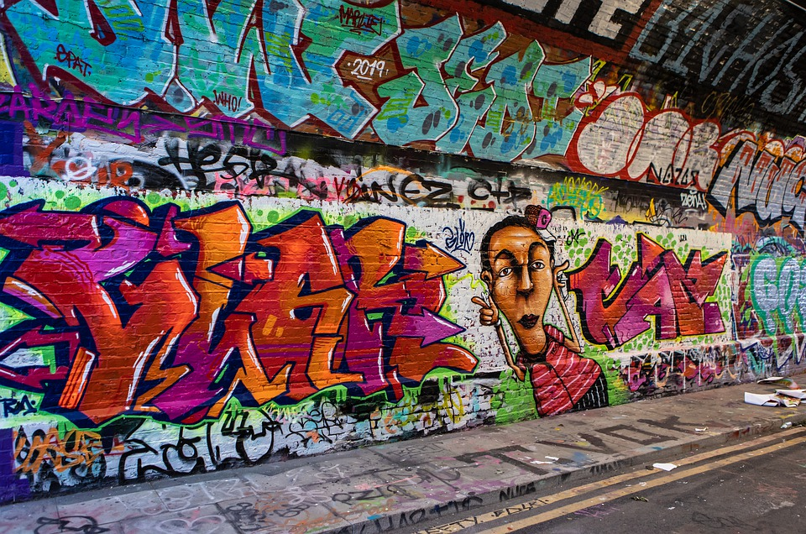
Legal regulation of vandalism
Criminal Law:
Encounters often unreported
Deterrence unlikely to work
Copyright
Artistic work protected by Copyright
No infringement of right to copy, reproduce, or communicate
No right to adaptation as compared with US derivative right
Politically neutral????
Image by TheOtherKev on Pixabay

Slide 7
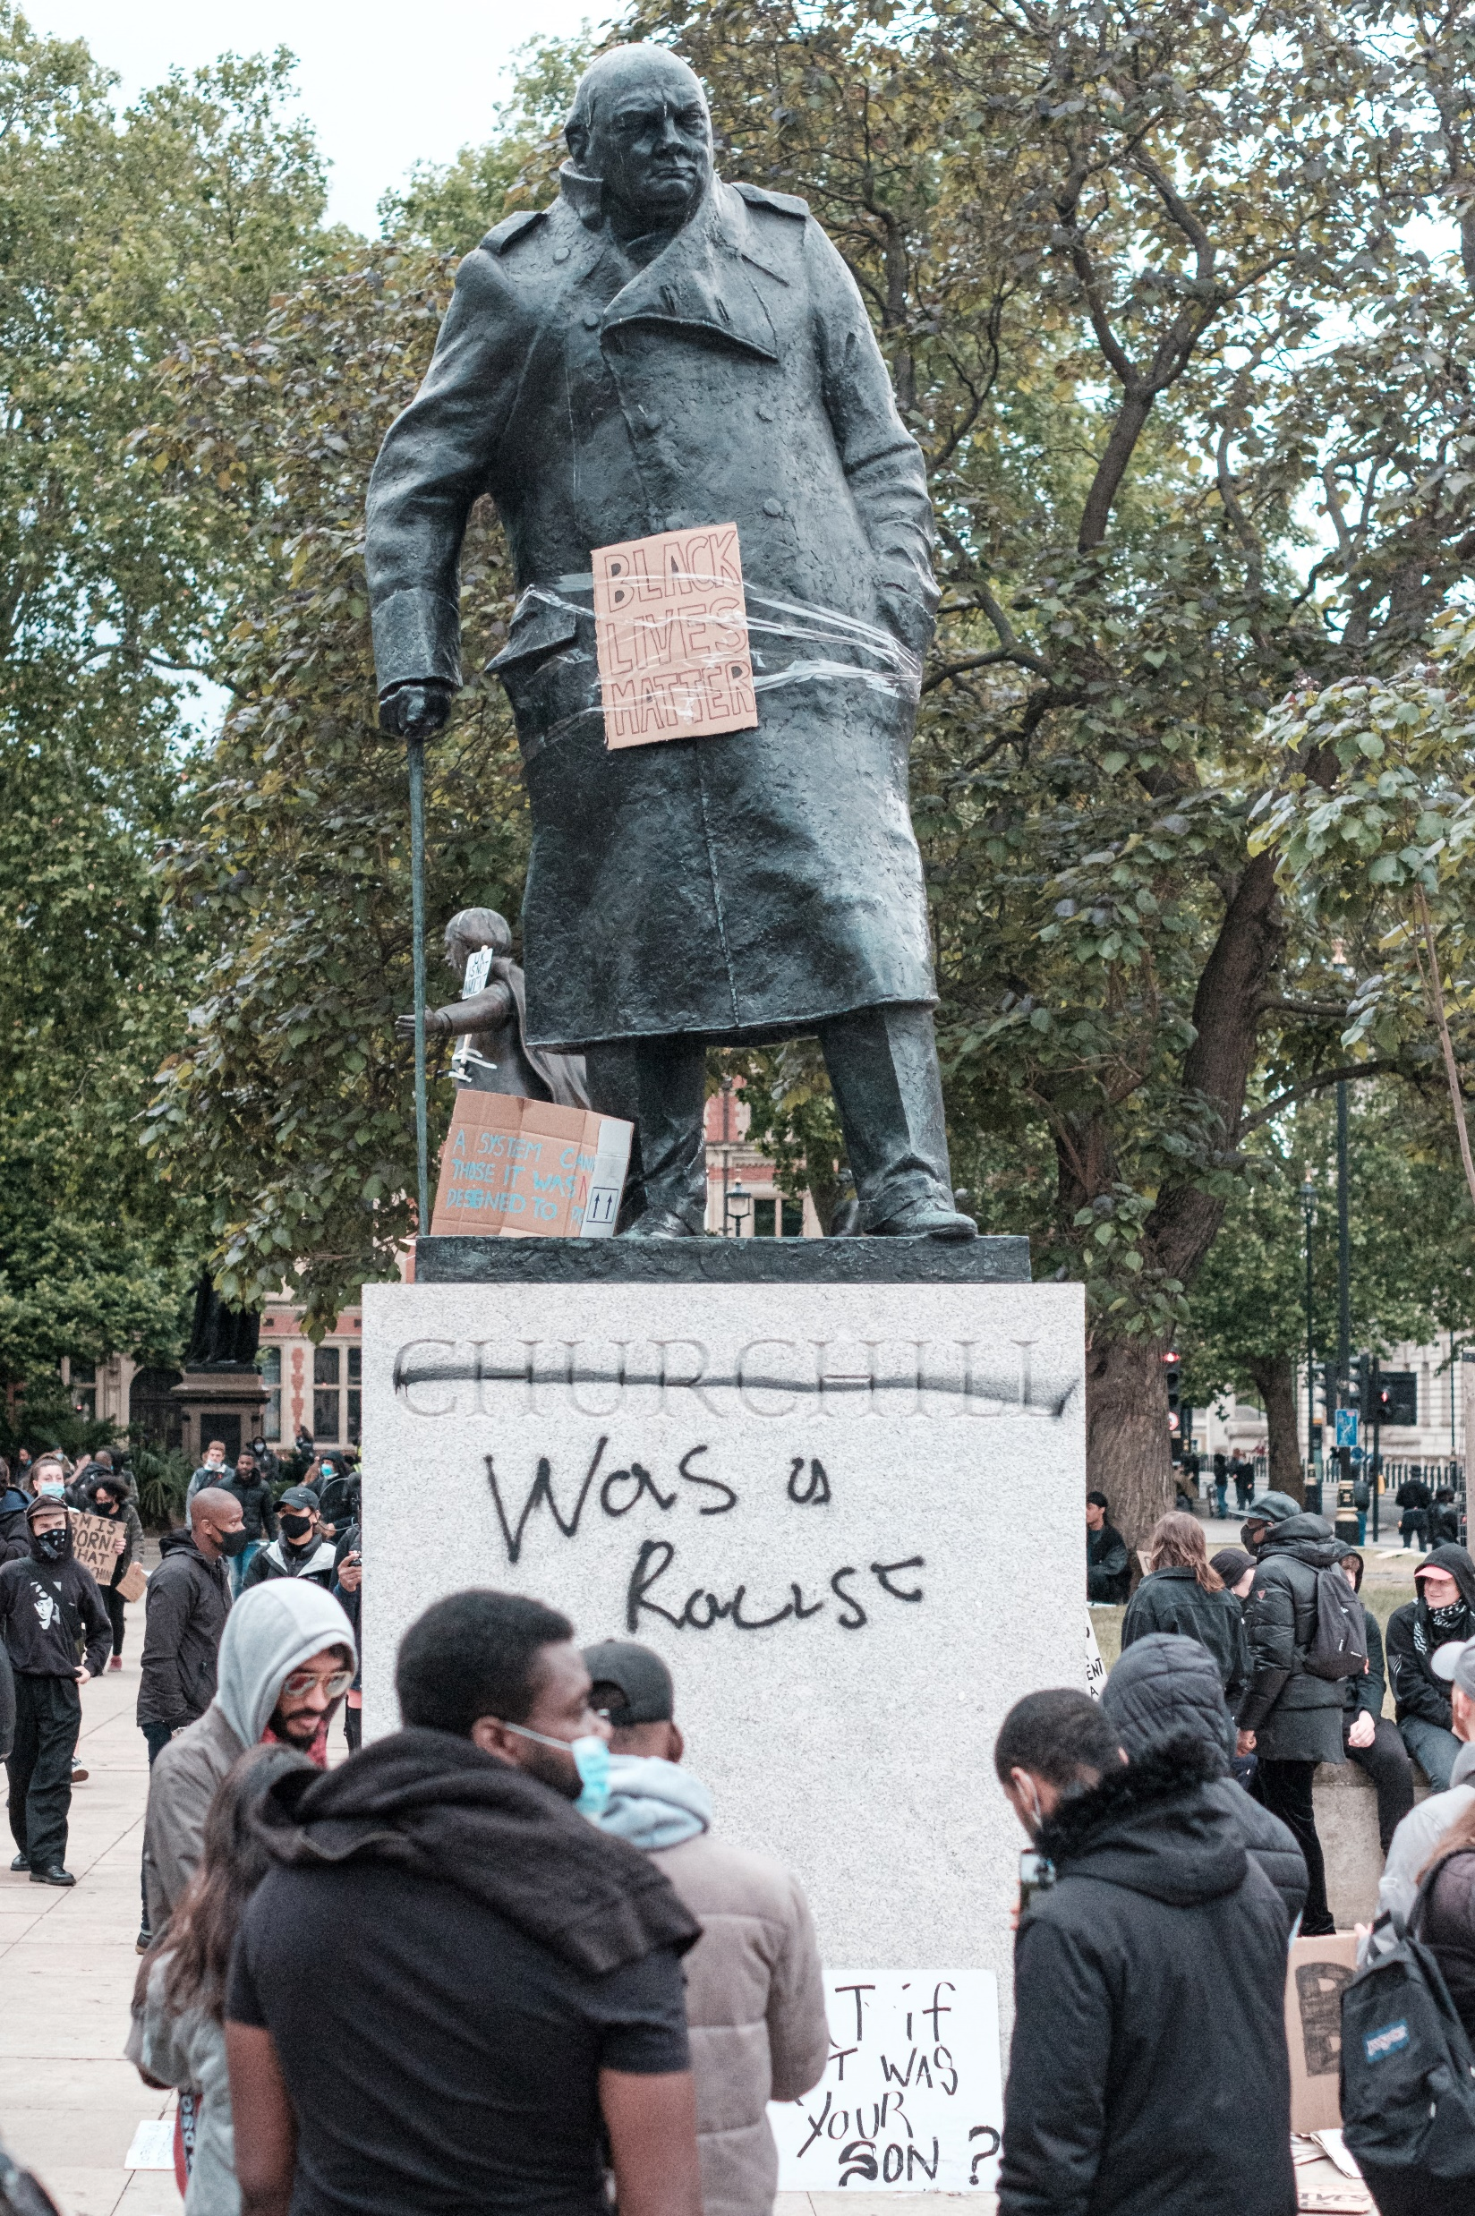
Moral Rights vs Free Political Speech
Australia- no Constitutional free speech only a weak implied. Freedom of political communication which can be burdened if appropriate
Moral right of integrity: works as embodiments of an artist’s personality
Self perception in a work = damages for ‘injured feelings’
Does not allow balance between public and private interests
Creative destruction = political speech should not be foreclosed by over-regulation based on an artist’s feelings
Photo by Ehimetalor Akhere Unuabona on Unsplash

Slide 8
Contact details
Marie.Hadley@newcastle.edu.au
T: @DrMarie_IP
S.hook@westernsydney.edu.au
T: @DrSarahHook
nik.orr@newcastle.edu.au
T: @nikolas_orr
Image by LS-Foto from Pixabay

