Slide 1
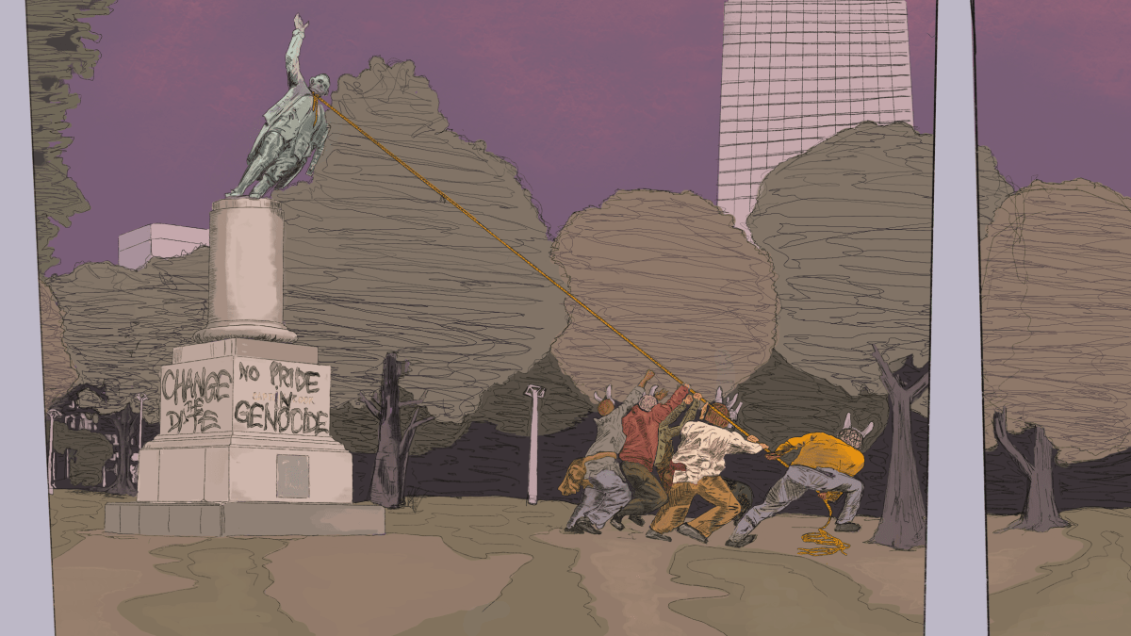
Art as method: talking back to law’s prioritisation of racist statues in settler colonial states
Dr Marie Hadley, Centre for Law and Social Justice, University of Newcastle (Australia) with Travis De Vries
T: @DrMarie_IP
Cook Falling (Tear it Down) by Travis De Vries, photograph reproduced with permission from the artist

Slide 2
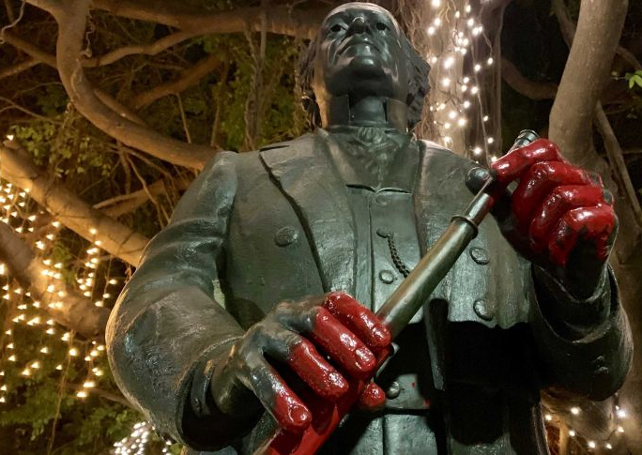
An art, law, justice project
Journal article on the IP implications of graffiti on copyright public art statues of colonial figures
Creation of a digital artwork that critically engages with the article/its themes
Student reception of the De Vries artwork and its use as a teaching tool
Photograph by Sofie Wainwright © 2020, photograph reproduced with permission from ABC - Library Sales

Slide 3
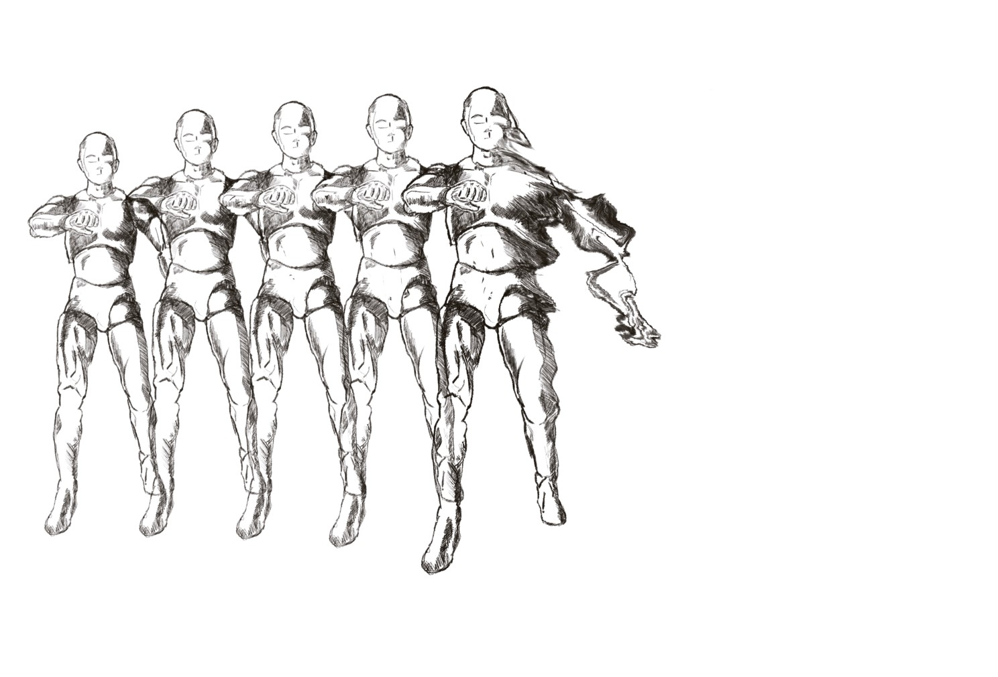
A Collaboration with Travis De Vries: Method
Two practice-based interventions:
the creation of a digital artwork; and
reflection upon the art-making process.
Work in progress Sketch for Entropy Awakening, reproduced with the permission of the artist, Travis De Vries

Slide 4
Entropy Awakening, Travis De Vries

Slide 5
Dialogue

Slide 6
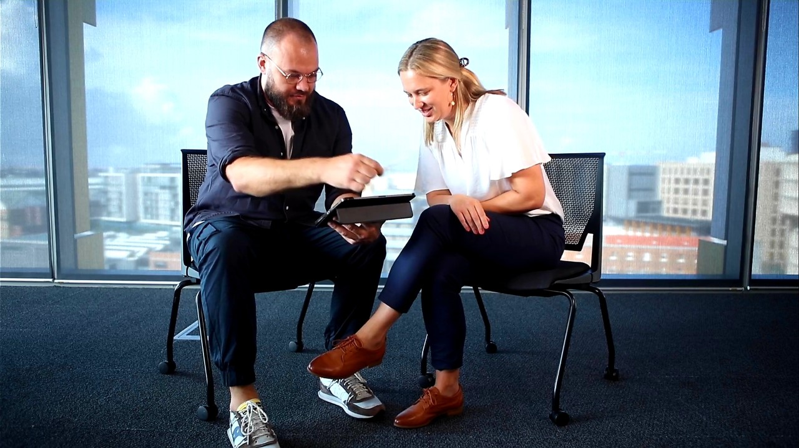
Self-reflection

Slide 7
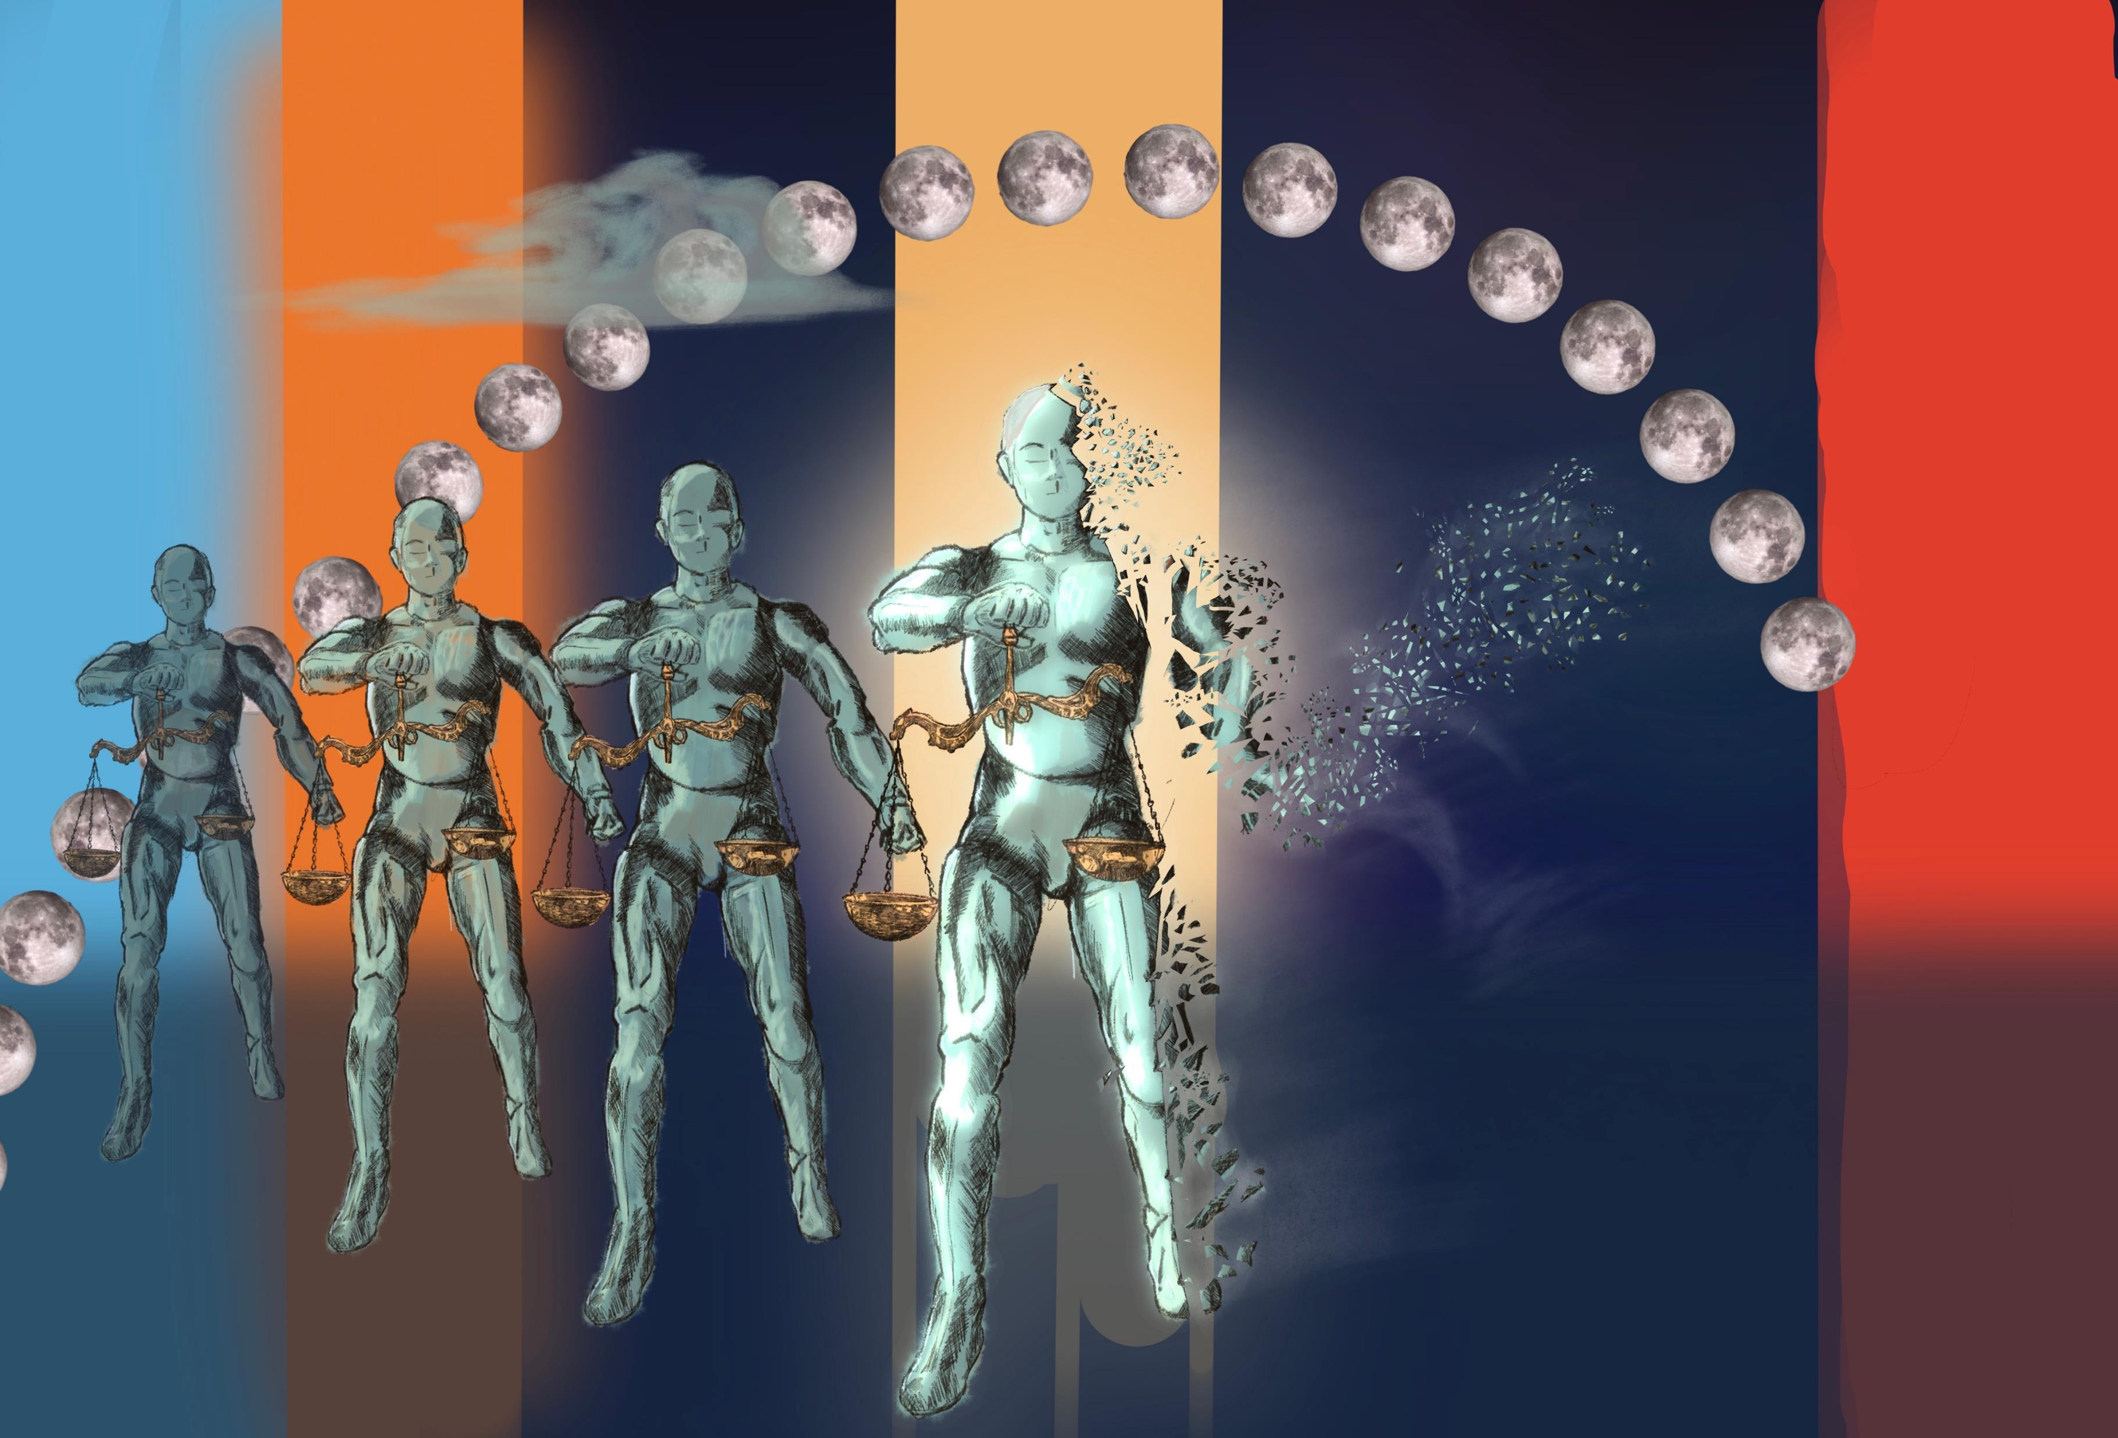
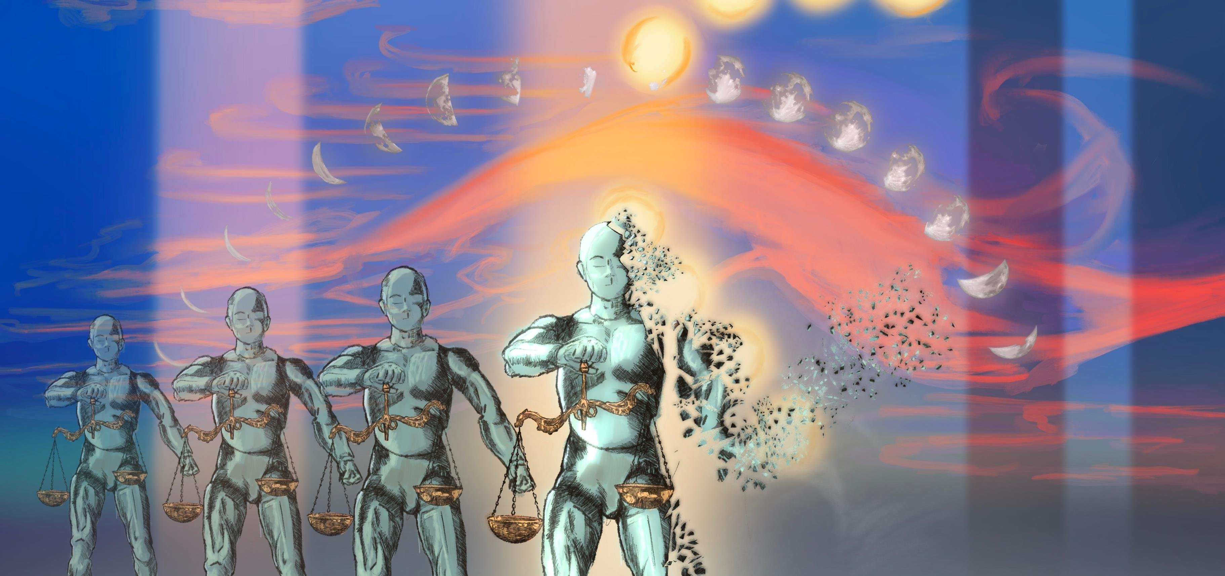
Findings
Artwork
Research Relationship
Creative Process (my role)
Looking forward
Research Process

Slide 8
What’s next?
Thank you!
E: Marie.Hadley@newcastle.edu.au
T: DrMarie_IP
Travis’ website: Travisdevries.com
T: @TraveeDee

