Slide 1
Objections to the Public Performance of Musical Works at Political Rallies as an IPR Claim
Marie Hadley
Newcastle Law School, University of Newcastle
Joel Cooper
Research Intern, Newcastle Law School, University of Newcastle

Slide 2
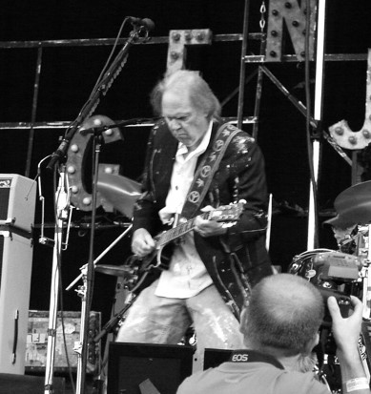
Music/Law/Politics
When an artist objects to the unauthorised use of one of their songs by a politician or at a political event or rally:
What rights do they hold?
If rights are held, are they infringed by the public performance?
Regardless of the formal legal character or status of claims, what is the effect of these objection on the use of the work?
Neil_Young_2008 (2008) © snikwas CC BY-2.0 License via Wikimedia Commons

Slide 3
Copyright in songs: 17 USC
Sound recording (fixed performance of the song)
Qualified and limited public performance right
A live performance of a recording will not infringe the public performance right associated with sound recordings
Musical work (song’s compositional elements)
Public performance right
Use of music on loudspeakers at a rally will satisfy the test for infringement, where consent is absent (ie no licence)
No moral rights for creators of musical works in the US

Slide 4
Researched Objections
The Village People, ‘YMCA’ (2020-21, Donald Trump)
John Fogerty, ‘Fortunate Son’ (2020, Donald Trump)
Neil Young, ‘Devil’s Sidewalk’ (2020, Donald Trump)
Eddy Grant, ‘Electric Avenue’ (2020, Donald Trump)
Leonard Cohen, ‘Hallelujah’ (2020, Donald Trump)
Linkin Park, ‘In the End’ (2020, Donald Trump)
Tom Petty, ‘I Won’t Back Down’ (2020, Donald Trump)
Panic! At the Disco, ‘High Hopes’ (2020, Donald Trump)
Pharrell Williams, ‘Happy’ (2018, Donald Trump)
Rihanna ‘Don’t Stop the Music’ (2018, Donald Trump)
The Rolling Stones, ‘You Can’t Always Get What you Want’ (2016-20, Donald Trump)
Queen, numerous (2016-2020, Donald Trump)
Elton John, ‘Tiny Dancer’; ‘Rocket Man’ (2016, Donald Trump)
Adele, ‘Rolling in the Deep’ (2016, Donald Trump)
Aerosmith, ‘Dream On’; ‘Living on the Edge’ (2015-18, Donald Trump)
R.E.M, ‘It’s the End of the World as we Know It’ (2015, Donald Trump)
Jackson Browne, ‘Running on Empty’ (2008, John McCain)
Sting, ‘Brand New Day’ (2000, George W Bush)
Bobby McFerrin, ‘Don’t Worry be Happy’ (1988, George HW Bush)
Bruce Springsteen, ‘Born in the USA’ (1984, Ronald Reagan)
** Eddy Grant and Jackson Browne were ultimately excluded from the sample as the uses didn’t involve live performance at an event.

Slide 5
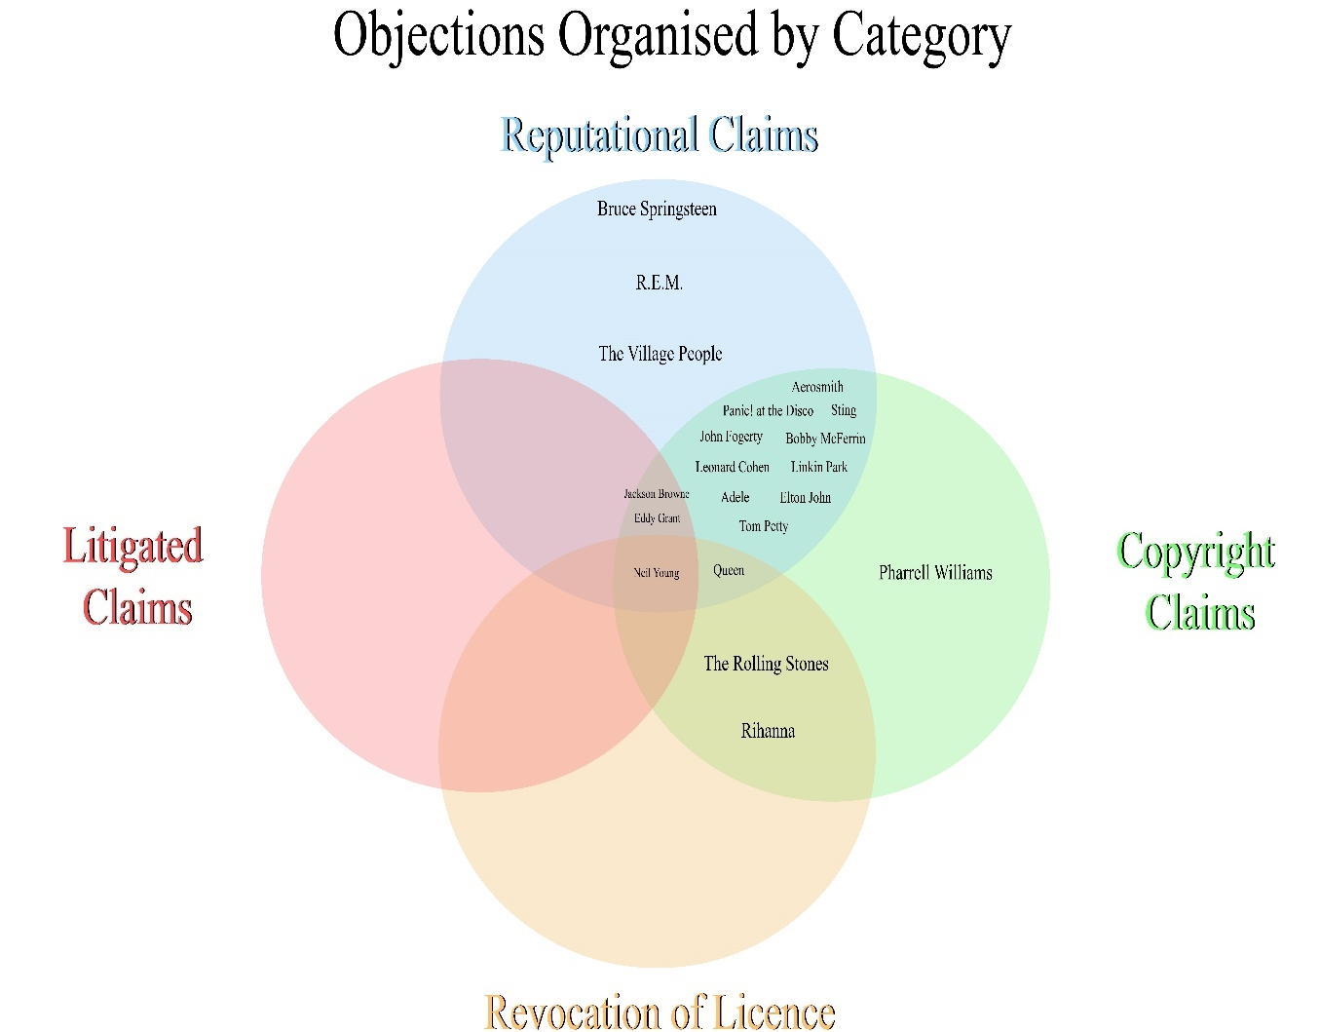

Slide 6
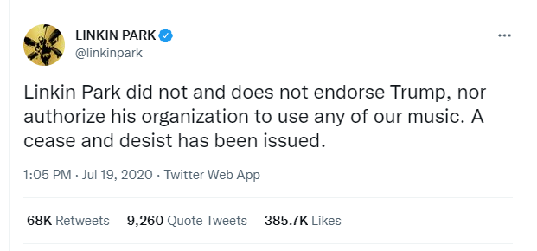
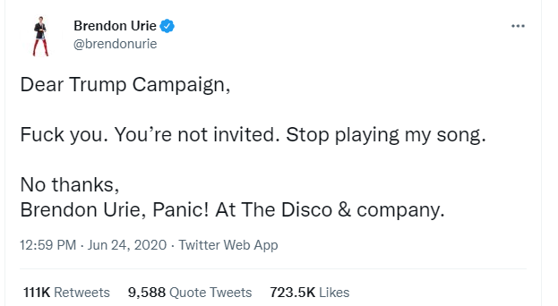
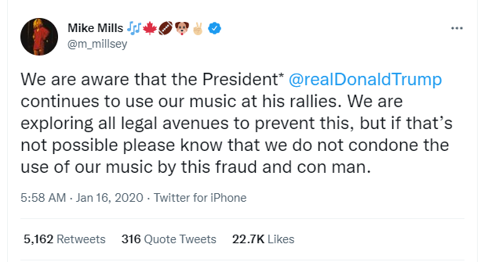
Reputation Claims

Slide 7
Copyright Claims

Slide 8
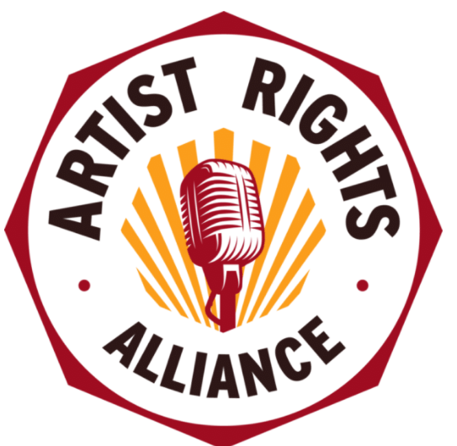
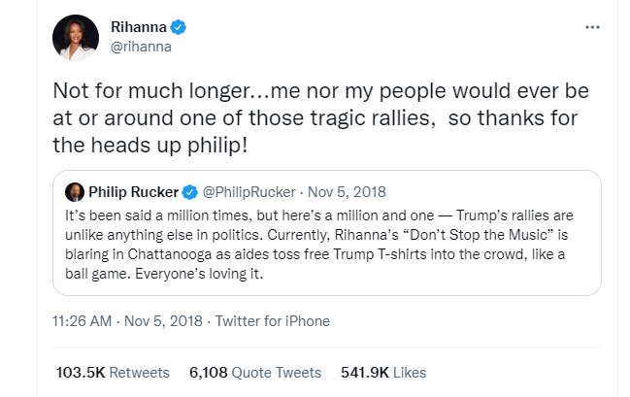
Revocation of licence

Slide 9
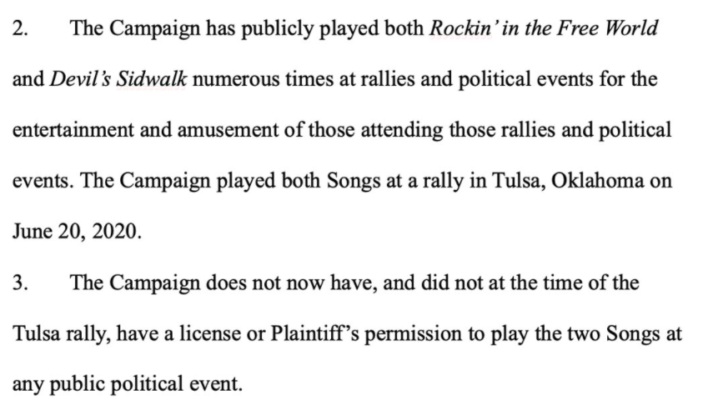
Litigated Claims

Slide 10
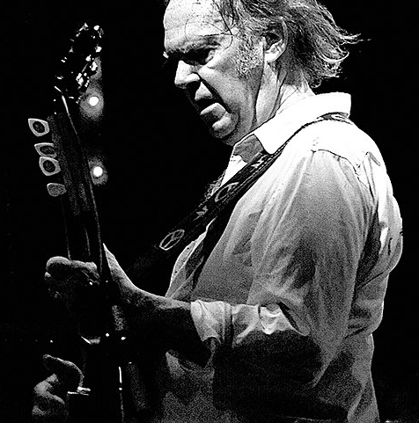
Final Thoughts
Neil Young 2008 Firenze 02 (2008) © Andrea Barsanti CC BY-2.0 License via Wikimedia Commons

