Slide 1
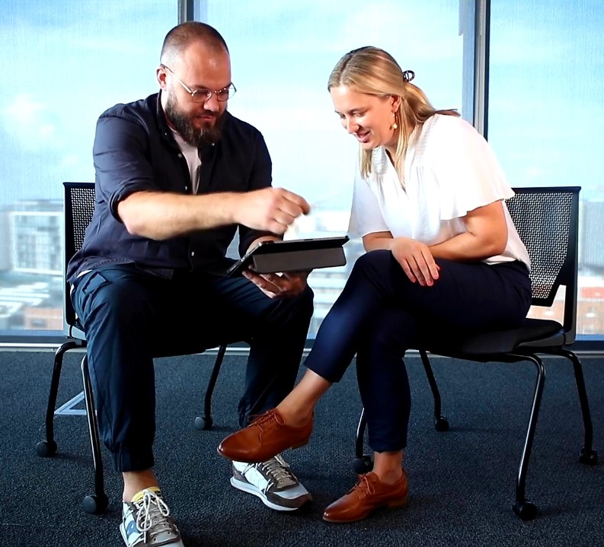
Visual and material methods
Dr Marie Hadley with Travis De Vries and Adam Manning
Centre for Law and Social Justice, University of Newcastle
T: @DrMarie_IP
7 October 2022

Slide 2
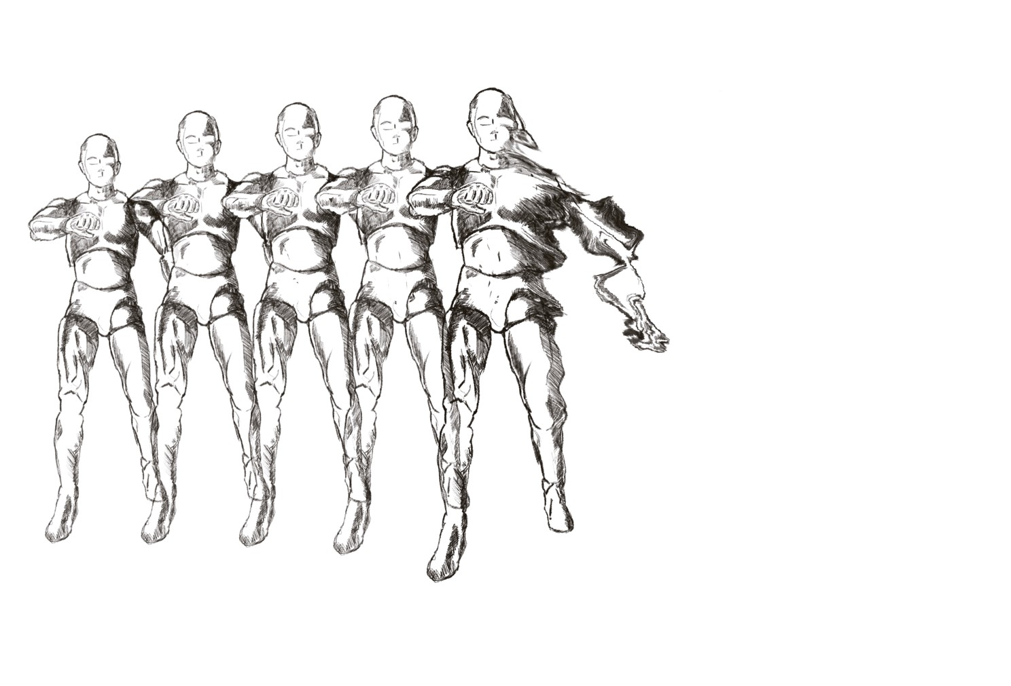
An art, law, justice project
Law journal article (doctrinal method; output)
Creation of a digital artwork that critically engages with the article (practice based method)
Student reception of the Travis De Vries artwork and its use as a teaching tool (qualitative research)
Exhibition based on the artwork/its central concept (extension of practice-based research; non-traditional output)
Sonic response to the art/research by percussionist Adam Manning (practice based method)
Audience reception of the Exhibition (qualitative research)

Slide 3
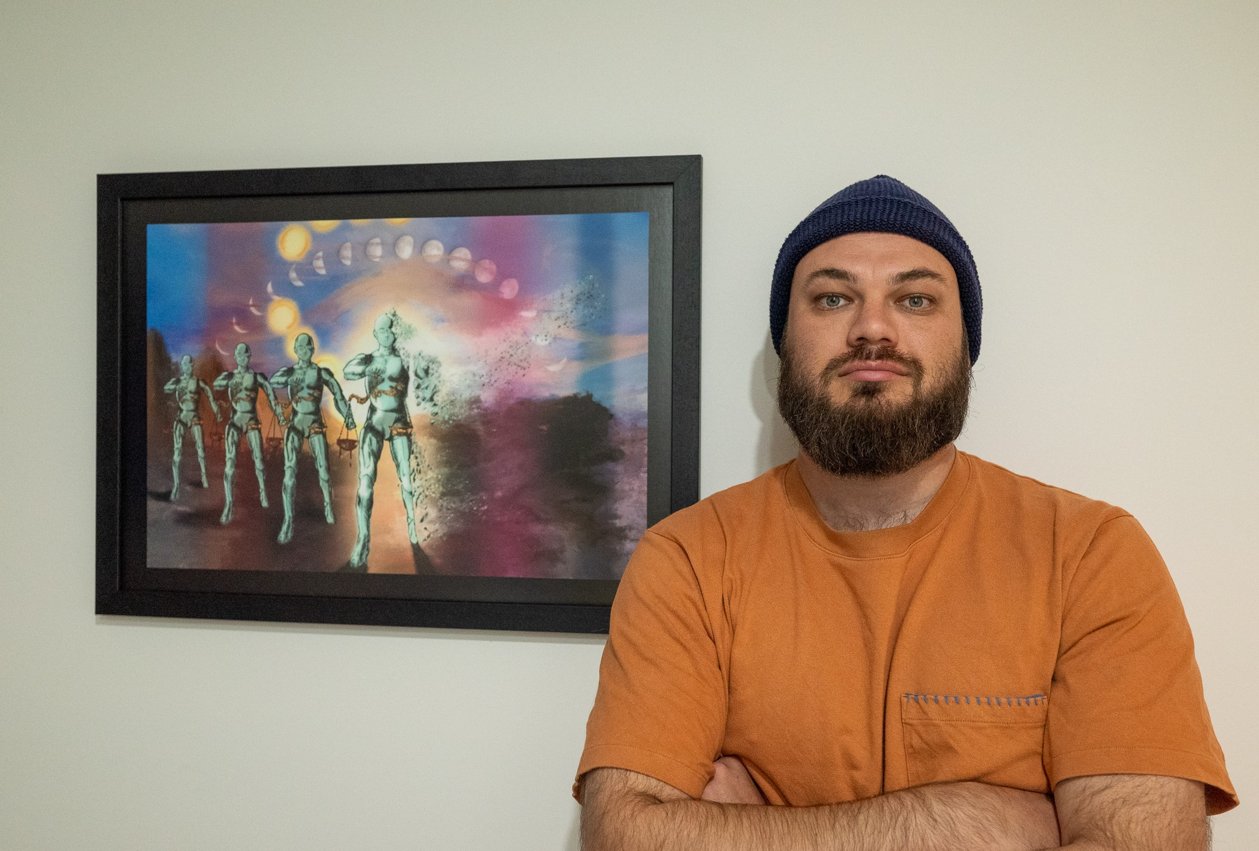
Practitioner Based Enquiry Method
the creation of a digital artwork; and
reflection upon the art-making process.
Image Credit: Jade Goodwin

Slide 4
Making the art object
Entropy Awakening, Travis De Vries

Slide 5
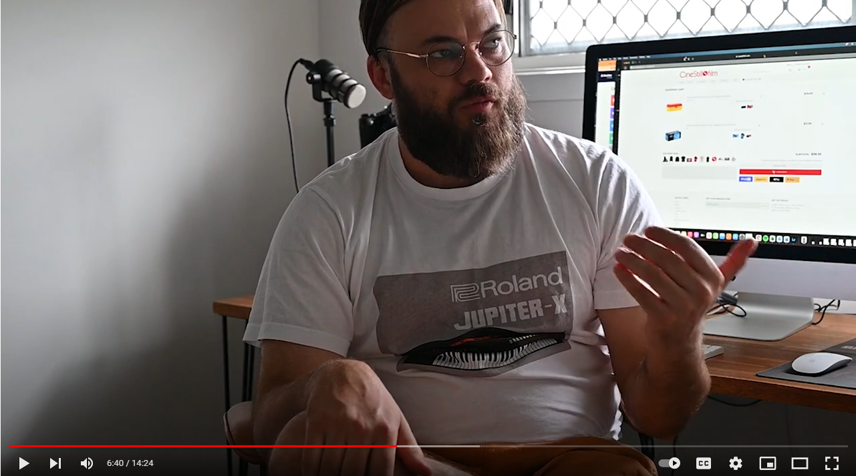
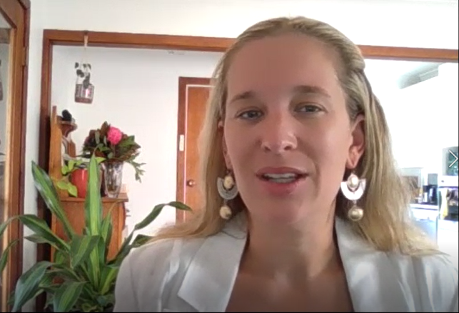
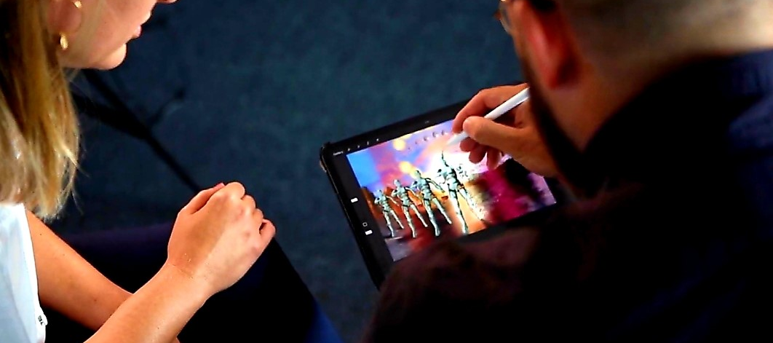
Dialogue & Self-reflection
Dialogue & Self-reflection
You can see the ‘Charting Creation’ videos at <mariehadley.com/entropy_awakening/>

Slide 6
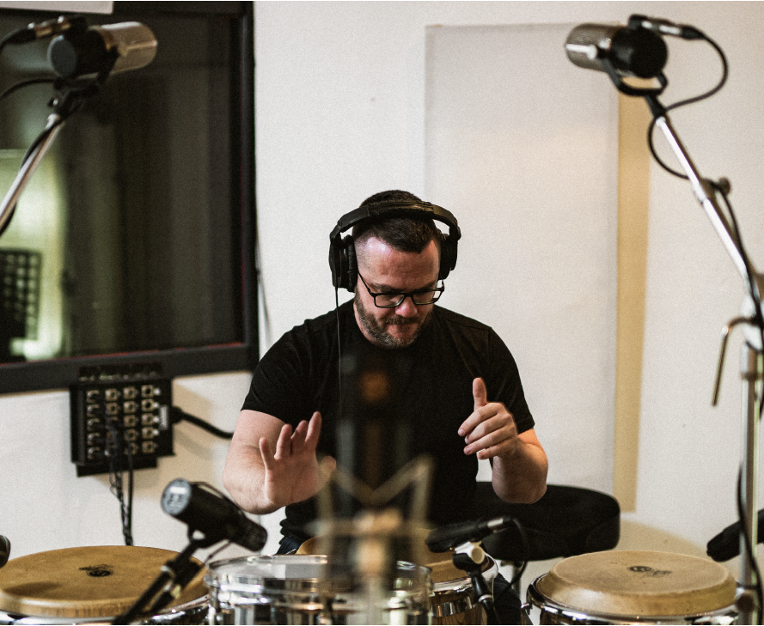
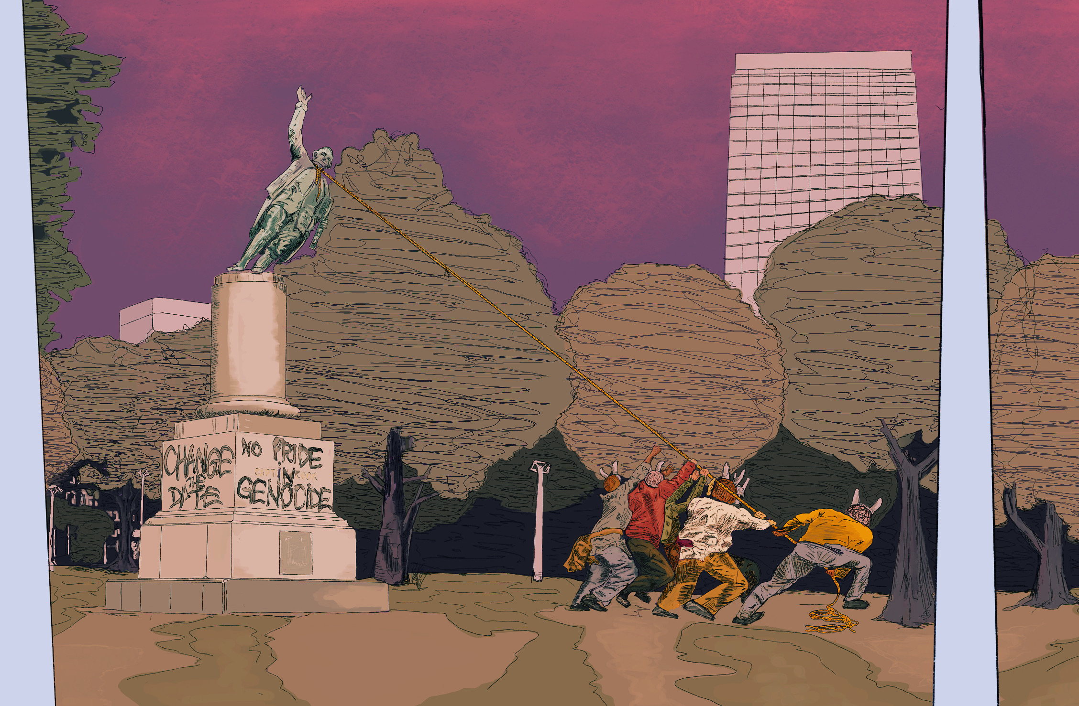
Sonic Responses

Slide 7
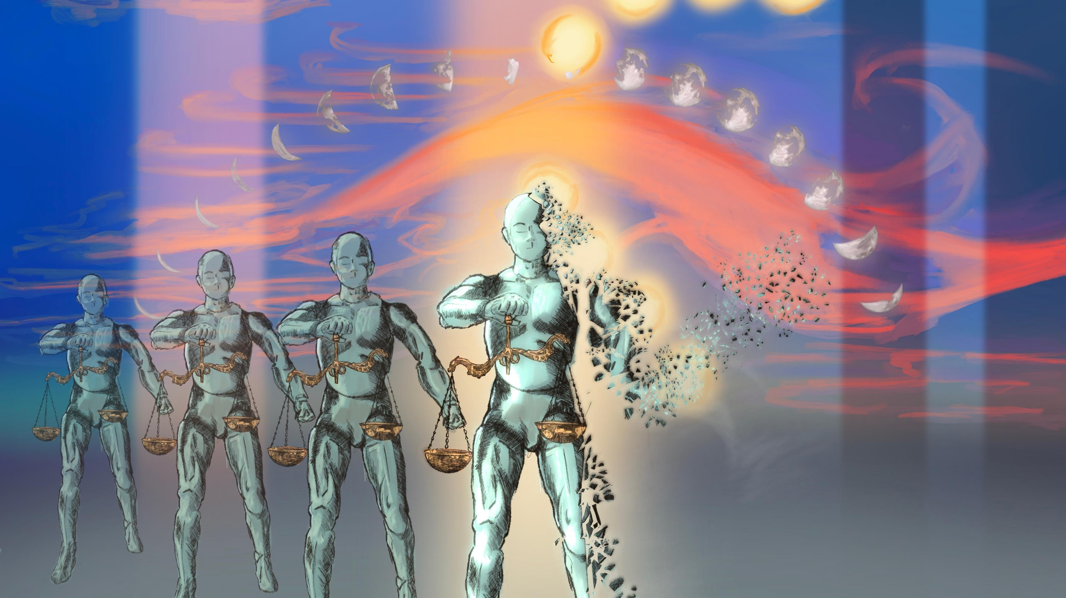
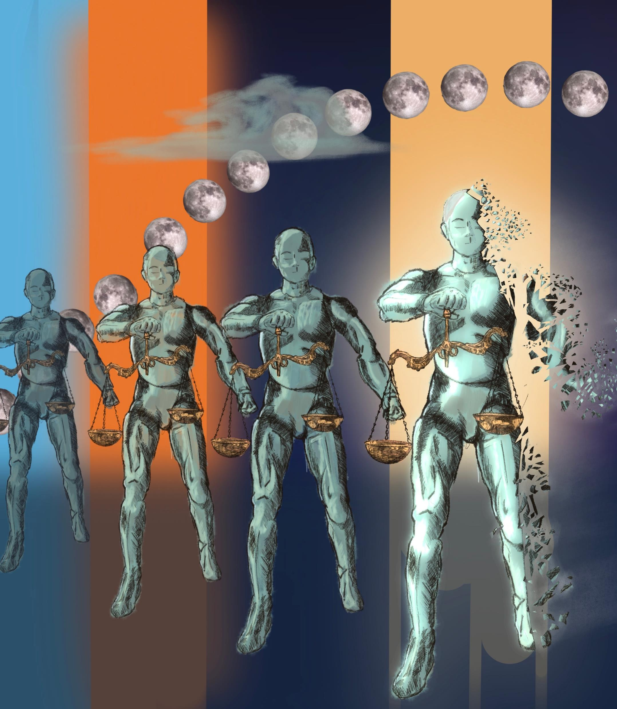
Ethical Considerations
Funding
External Collaborations
Research Process
Co-researchers &
Co-design

Slide 8
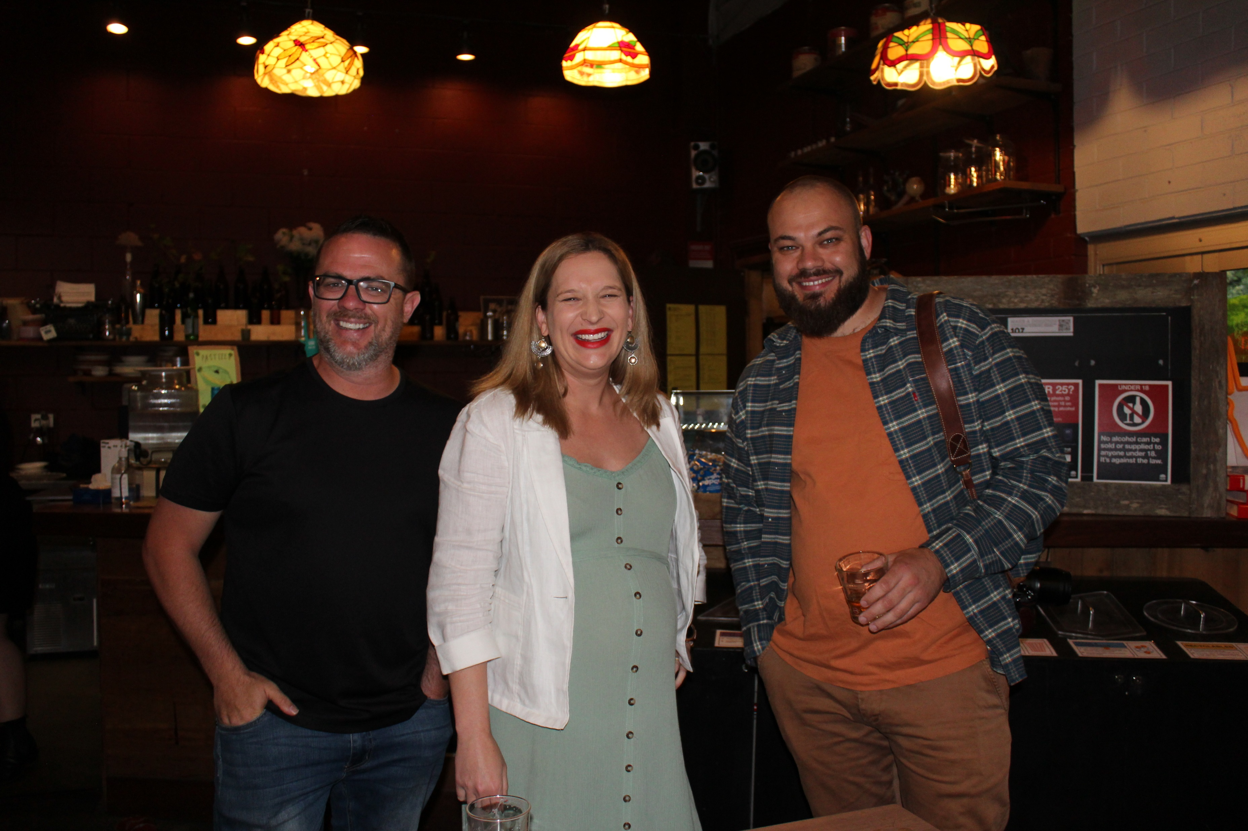
For further reading on the Practitioner Based Enquiry method see Phillip McIntyre, ‘Creative Practice as Research: ‘Testing Out’ the Systems Model of Creativity through Practitioner Based Enquiry’ <https://nova.newcastle.edu.au/vital/access/%20/manager/Repository/uon:2820>
For more information about this research project see <https://mariehadley.com/project_alj/>
Any questions? Feel free to contact me: marie.hadley@newcastle.edu.au

