Slide 1
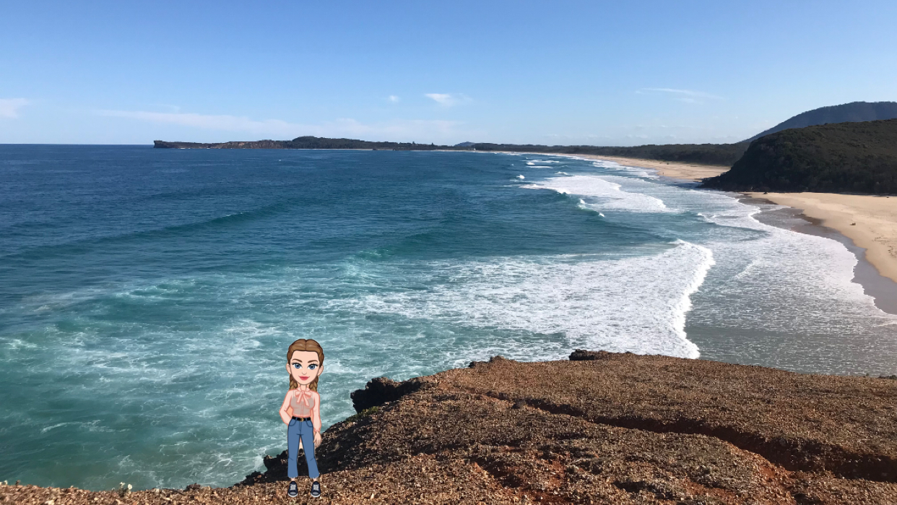
Connecting through Creativity in the Pandemic Virtual Classroom: A Flat Stanley Project for Law Students
Dr Donna McNamara and Dr Marie Hadley
Newcastle Law School, University of Newcastle, Australia

Slide 2
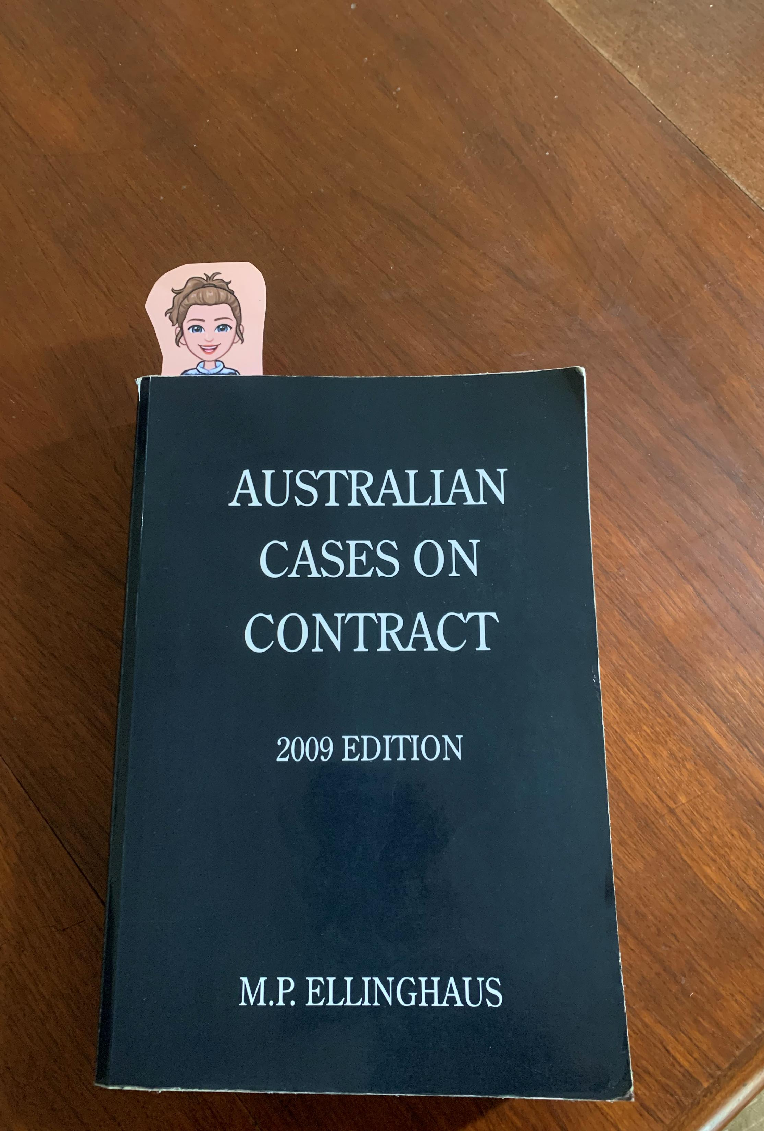
The pandemic classroom
Shift to online synchronous classes for the whole semester in Semester 2, 2021
3 month lockdown
Student engagement in online classes dipped, morale low
Challenge: how to connect with students and improve engagement in class and support wellbeing?

Slide 3
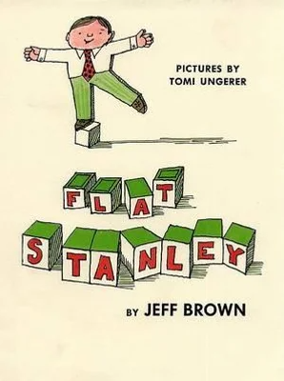
A Flat Stanley Project for Law students
What is a Flat Stanley Project?
What did we do?

Slide 4
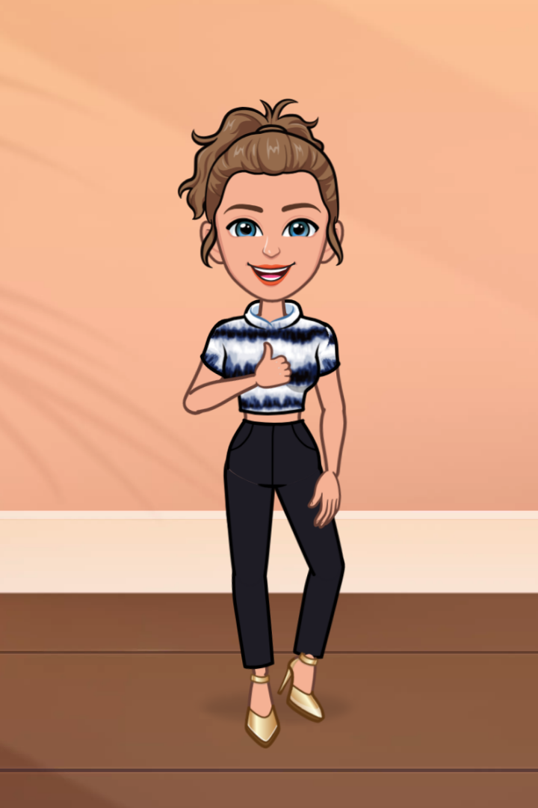

Slide 5
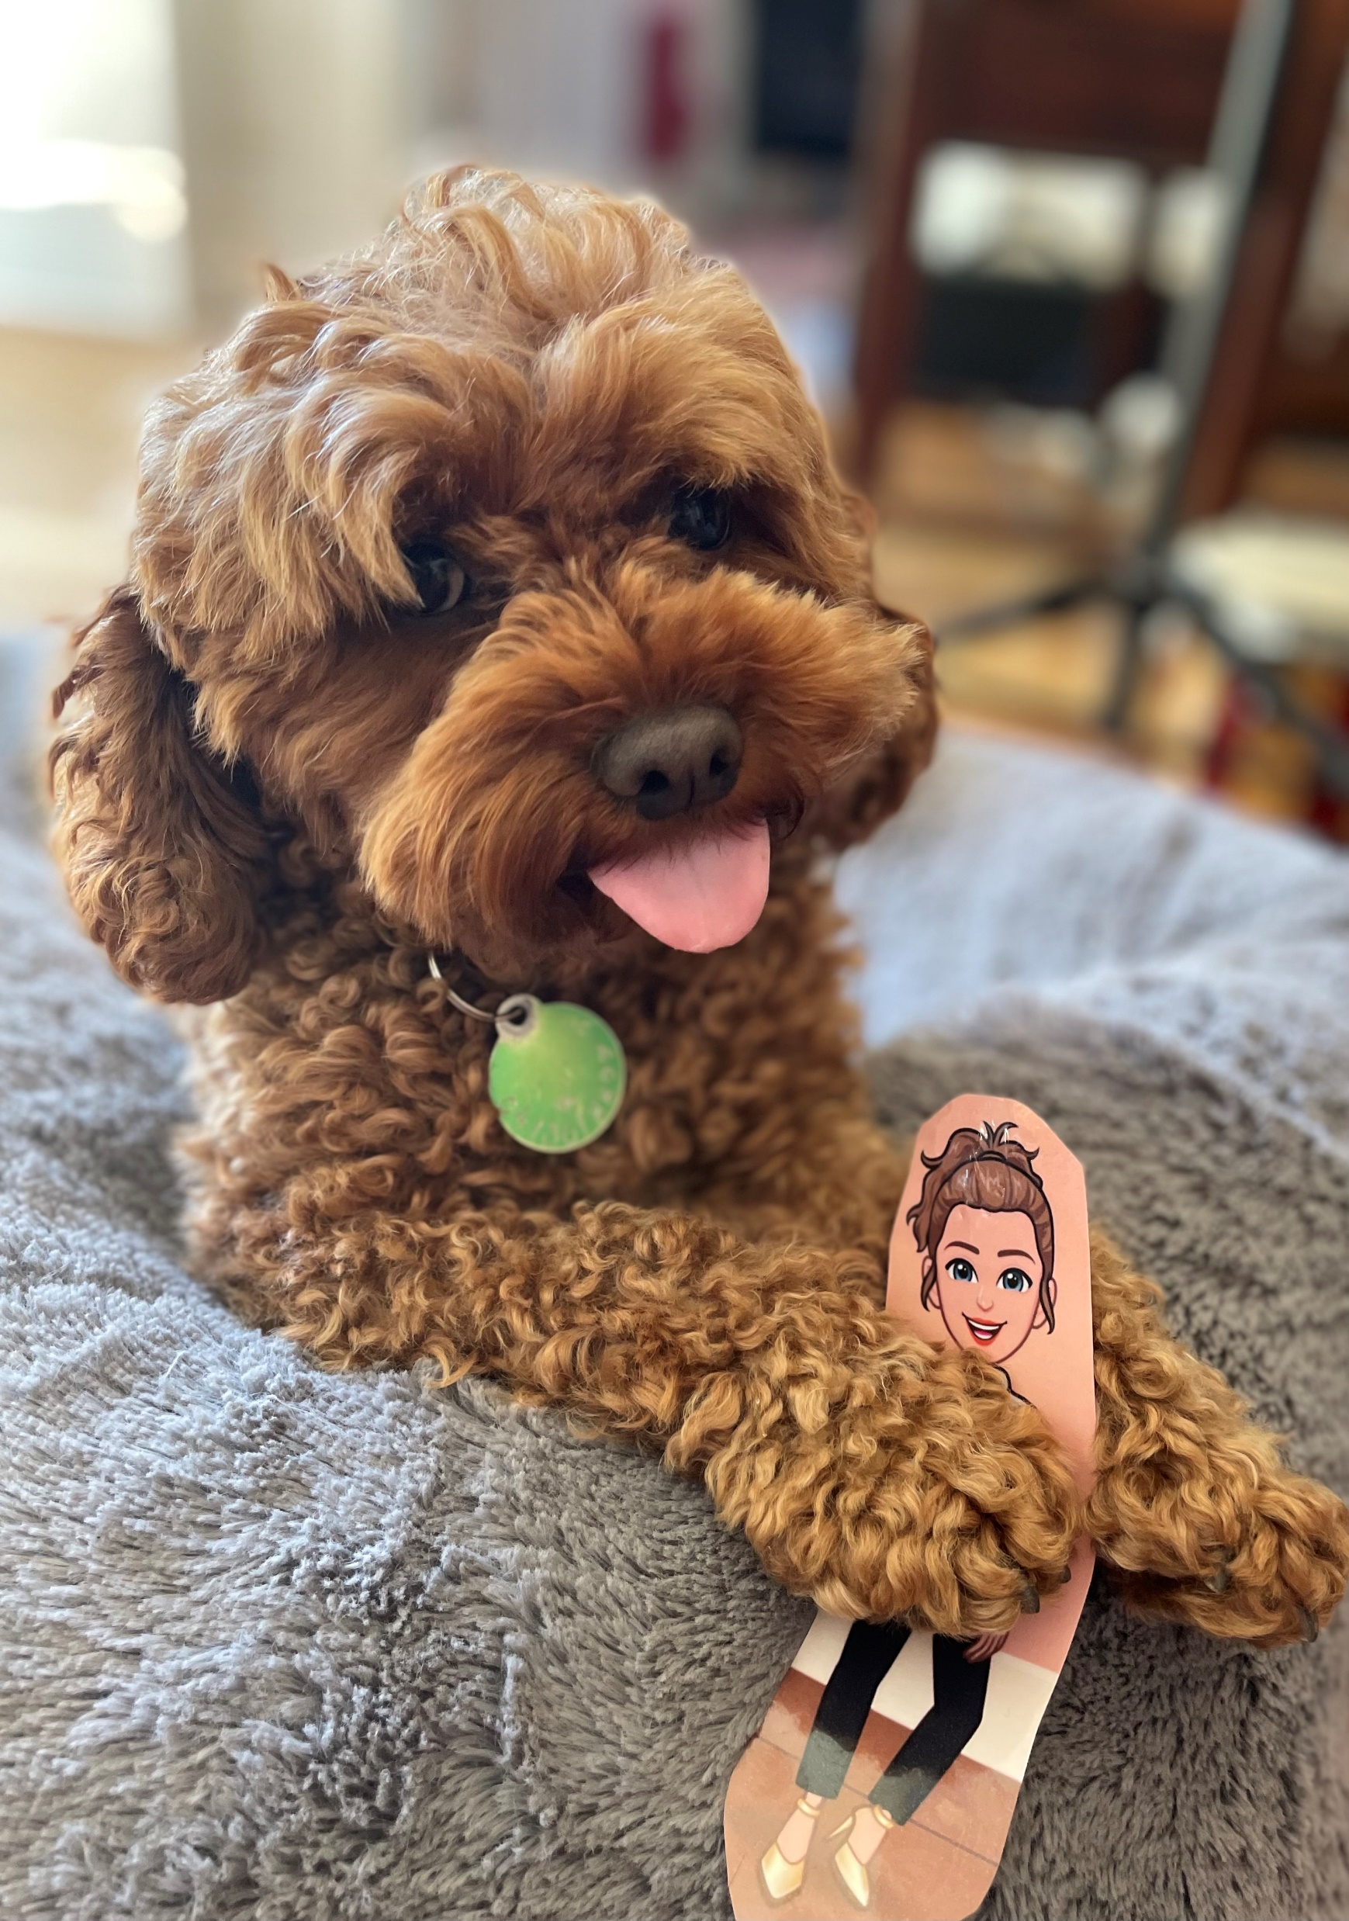
Participation
36 students signed up before the competition opened
Ultimately had 53 entries
We had a public vote for Best Overall Photograph: approximately 200 people voted.

Slide 6
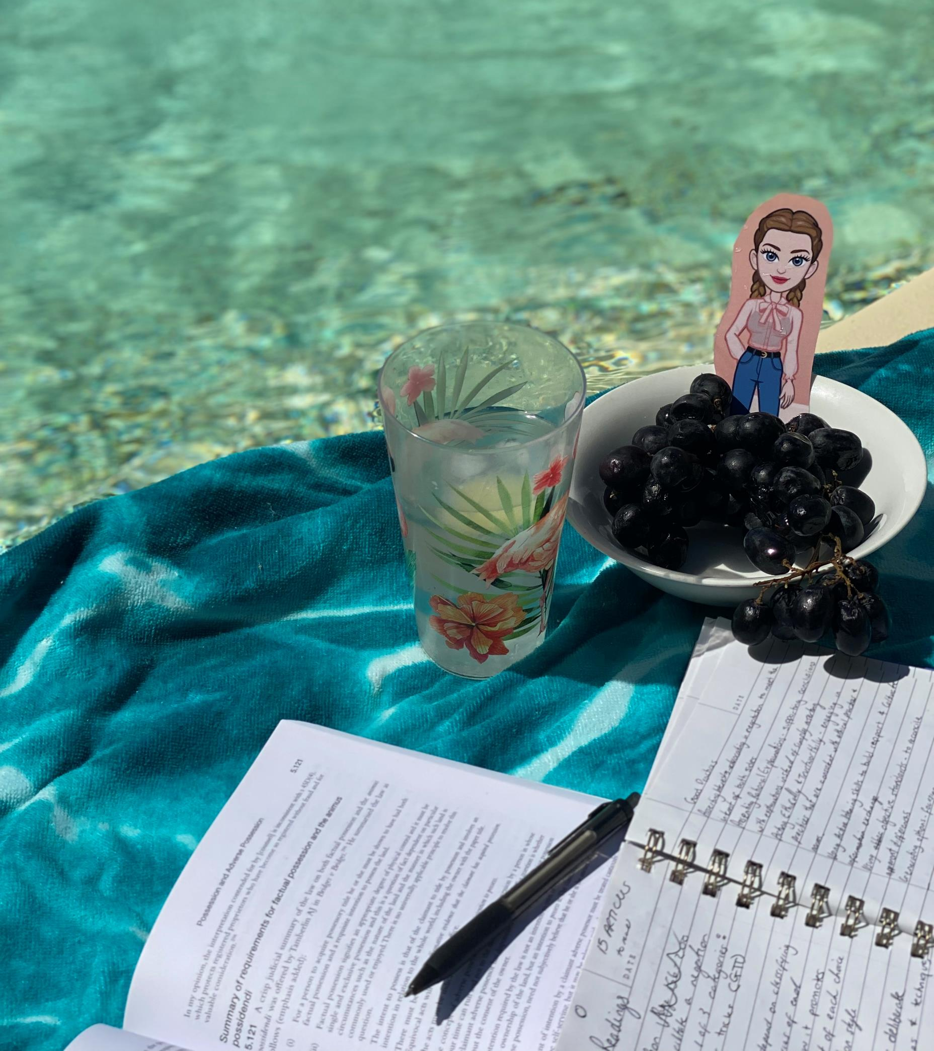
Outcomes
Some fantastic imagery
Students reported enjoying the activity
Use of the images on the following week’s powerpoint slides – lightened the mood in class

Slide 7
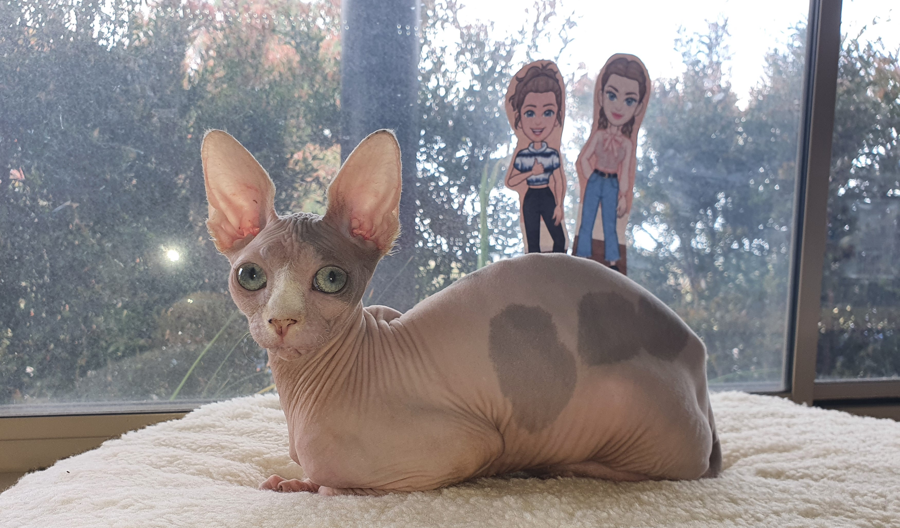
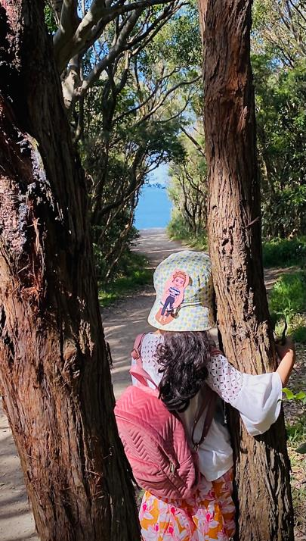
Less anticipated benefits
“I wanted to thank you both for organizing the photo contest.
It did bring in much fun and excitement during the semester break in lockdown which would have been otherwise very average. My kids were both so excited and it got our whole family together out and about doing fun adventurous things.”

Slide 8
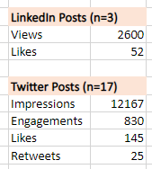
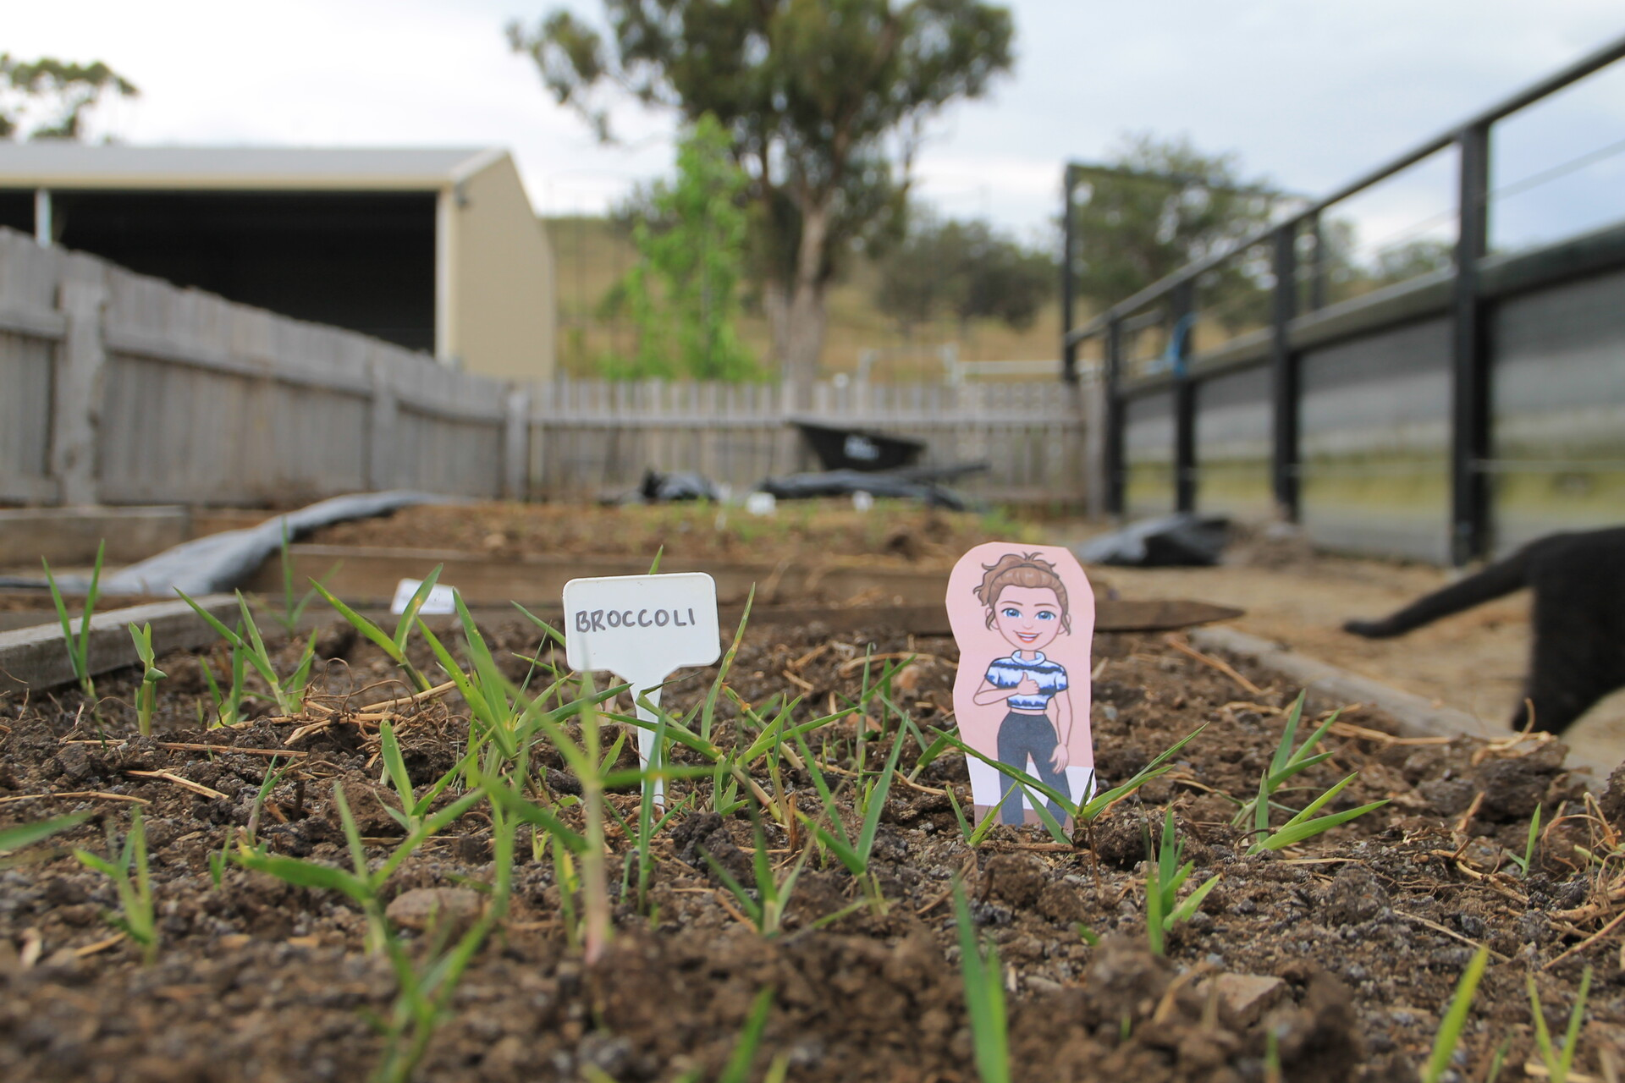
#Flatlecturer
Some students (entrants and non-entrants) engaged online with each others’ images
Connecting the Law School to the community

Slide 9
Implications

Slide 10
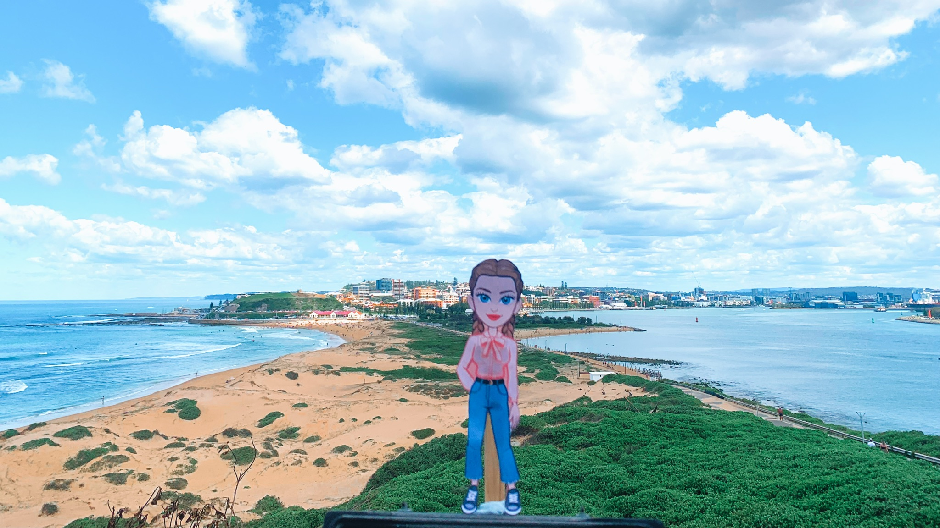
Distance learning – engagement and connection
Visual learning activities and/or assessments

Slide 11
Contact us: T: @DrMarie_IP; @writing_legal E: marie.Hadley@newcastle.edu.au T: @McNamara_DM E: donna.mcnamara10@newcastle.edu.au

