Slide 1
Innovative Curriculum and Assessment Design Using a Team Approach
Kevin Sobel-Read, Ann Apps & Marie Hadley

Slide 3
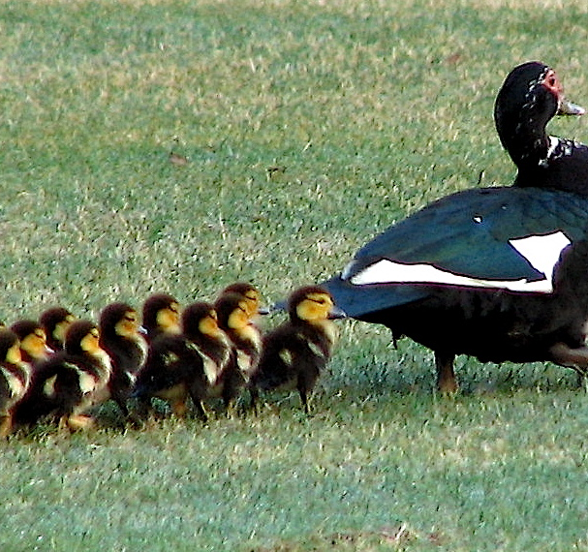
Embedding skills in the Contracts curriculum
Contracts is a core course in LLB and JD programs
Two sequential 10 unit courses Contracts I and Contracts II
Around 170 students (3rd year LLBs and 1st year JDs)
Is a challenging course for many – as emphasis is on judicial reasoning rather than statutory intepretation
Scaffolded approach to independent learning.
This Photo by Unknown Author is licensed under CC BY-SA-NC

Slide 4
Embedding skills in the Contracts curriculum
3 assigned skills embedded in 3 separate modules
Workshop weeks on skills development (and weekly class tasks)
The assessment tested the module content and the designated skill
Generous weightings in the rubric for the skill (ie the Module 3 skill was referencing, Assessment 3 referencing weighting= 30% )
This Photo by Unknown Author is licensed under CC BY-SA

Slide 5
Our teams approach...
We divided the course into 3 Modules
The team member was responsible for course coordination, course materials, assessment design, teaching all the seminars & marking for their module
Gave each other moral support but also a lot of space
Touched based on overarching administrative issues i.e. mandatory attendance
Kept each other informed of at risk of failure students

Slide 6
Benefits
The modules ran autonomously –we didn’t need to be on top of each other’s modules
Efficiency and minimisation of administrative headaches – students knew who to approach and when
Solid linking of skills to content to assessment to learning outcomes
Consistency and control over our own modules
We could play to our skills, interests, strengths in skills selection and assessment choice

Slide 7
Limitations
We each have a different teaching style so students had to be flexible Students compare us (“why don’t you start class with music like Kevin, Marie?”)
Students expect us to have the same values and approach to things like extension requests, coming late to class, response time to emails
Intense workload during our ‘on’ time
What happens if a team member gets sick?

Slide 8
Hot Tips
Play to each team members’ strengths
Give each other room to breathe – but ask for support when you need it
Have coherency between skill, marks weightings, and learning outcomes
Foreshadow course structure to manage student expectations
Individually set boundaries at outset of module (eg around email communications, seeking extensions etc)

