Slide 1
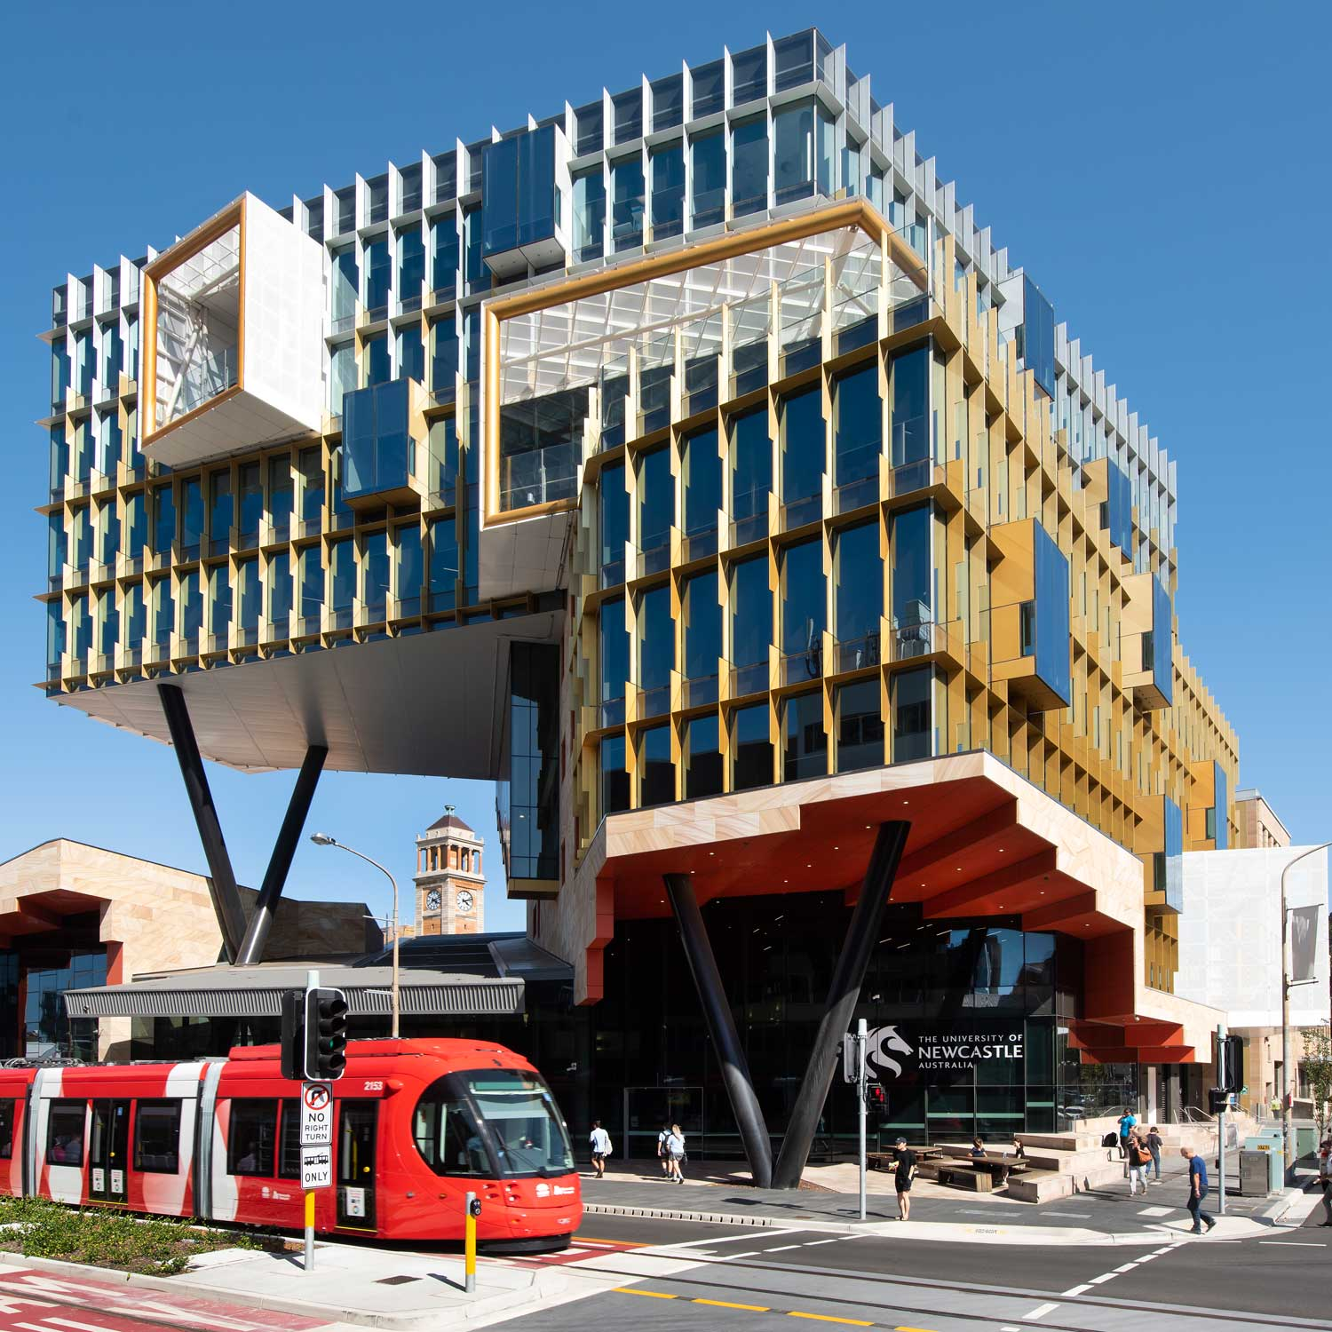
Indigenisation and Justice in Law Curricula: How?
Kevin Sobel-Read
Marie Hadley (T: @DrMarie_IP)

Slide 2

Newcastle Law School: a snapshot
________________________
LLB program & JD program
  LLB has Embedded Hons
Focus on practical training and skills-learning
  https://www.newcastle.edu.au/__data/assets/pdf_file/0007/650473/Law-School-Skills-Map_Digital.pdf
Student cohort
  Regional & First in family
  Highest proportion of Aboriginal and Torres Strait Islander students of any Law School in AustraliaAT MAKES OUR

Slide 3
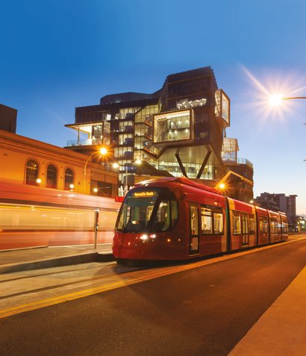
Indigenisation Projects in the NLS
________________________
Long history of Indigenisation:
  Sporadic
  Piecemeal changes, typically to course content
  Challenges including resistance on workload grounds
Current Curricular Justice Project Aims:
  Meaningful
  Manageable
  Sustainable

Slide 4

Getting started: Our Process
  What would the dream curriculum look like?
    What skills would it involve?
    What content?
    What can we do?
  What graduate attributes would we want our students to walk away with?
    Who do we want them to be?
    What does a culturally competent lawyer look like? What do they know?

Slide 5
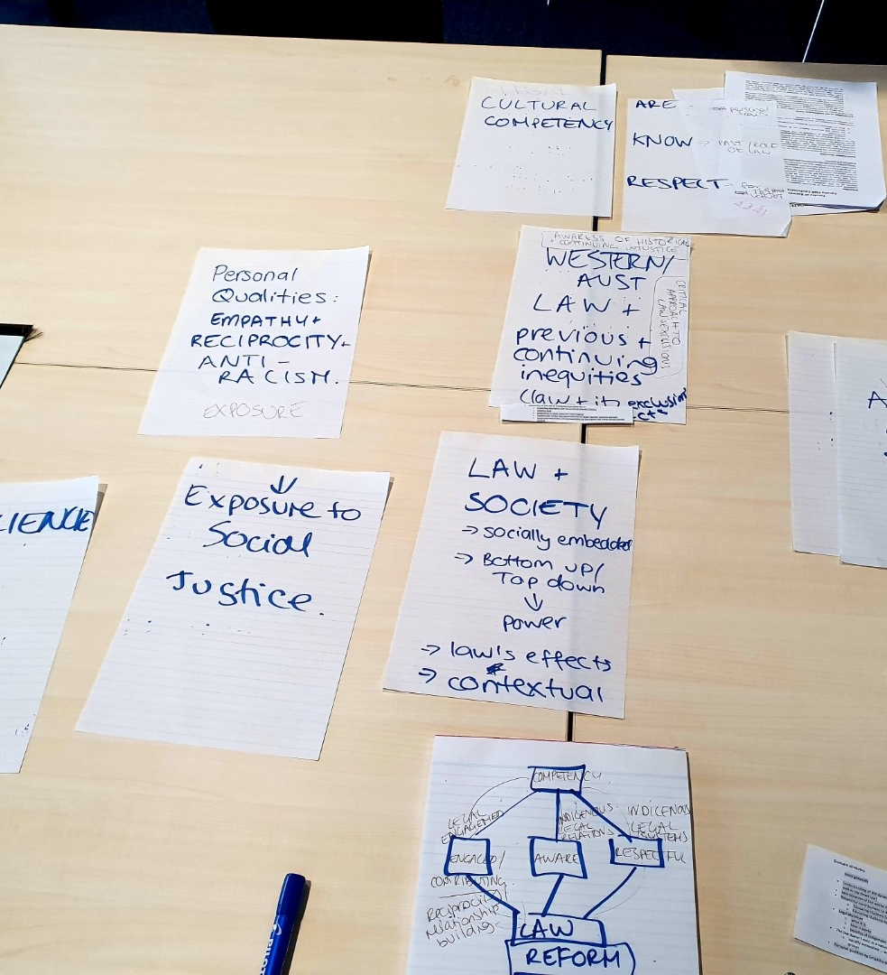
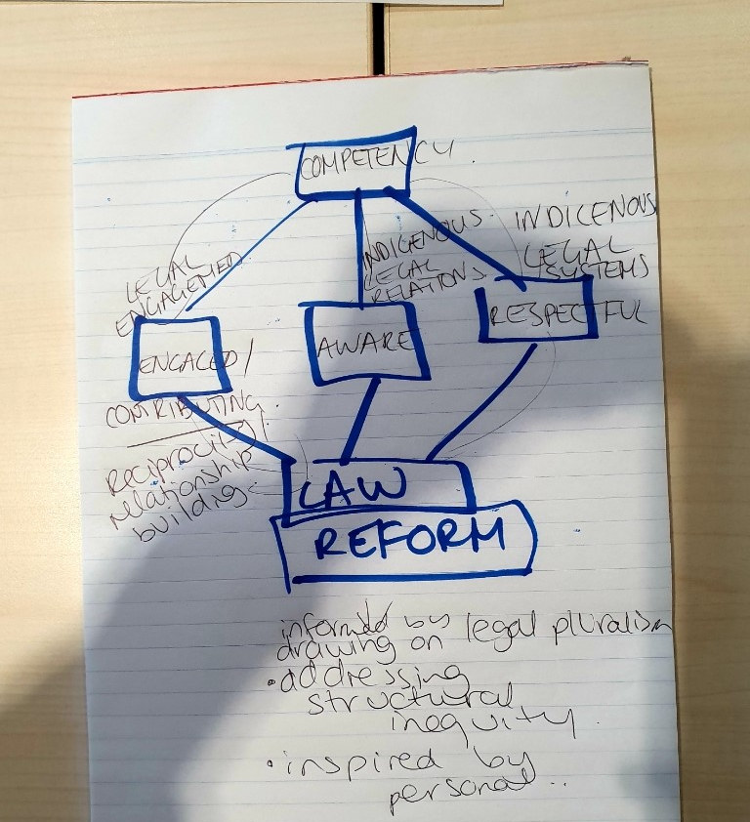

Slide 6
COLLABORATION
C
O
N
T
E
N
T
Recognising, Respecting and Valuing Indigenous Peoples’ Legal Systems, Knowledges, and Experiences
C
O
N
T
E
X
T
Aboriginal and Torres Strait Islander Legal & Knowledge Systems
Western Law’s Exclusions and Injustices
Lawyering Ways of Thinking, Doing, and Being
GOAL: Understanding and appreciating the ongoing value and vitality of Indigenous legal systems and knowledges
GOAL: Understanding and appreciating the role of law in oppressing Aboriginal and Torres Strait Islander peoples, and as an avenue for empowerment
GOAL: Understanding and appreciating the role of lawyers in replicating and/or challenging existing inequities in the Australian legal system and possibilities for contributing to future change
Law Reform Capstone Assessment → Open Access Database
RECIPROCITY
CLASSROOM PEDAGOGY

Slide 7
Aboriginal and Torres Strait Islander Legal & Knowledge Systems
Conceptual framework:
Legal Pluralism
Multiple legal systems can and do exist at the same time in the same place
Evidentiary Lens:
Sovereignty/self-governance pre-contact
Disruption and Adaptation Ongoing vitality of Indigenous legal and knowledge systems
Methodology:
Centring Indigenous perspectives
GOAL: Understanding and appreciating the ongoing value and vitality of Indigenous legal systems and knowledges

Slide 8
Western Law’s Exclusions and Injustices
Conceptual framework:
Law & Society
Structural inequality
Contextual
Top-down and bottom-up relationships between law and power
Evidentiary Lens:
Top-down oppression, including:
Terra nullius, Stolen Generation, incarceration, wage theft
Bottom-up activism, including:
Mabo/constitutional developments, Taylah Gray activism
Methodology:
Critical Thinking
GOAL: Understanding and appreciating the role of law in oppressing Aboriginal and Torres Strait Islander peoples, and as an avenue for empowerment

Slide 9
Lawyering Ways of Thinking, Doing, and Being
Conceptual framework:
Self awareness & social justice
Evidentiary Lens:
Role of lawyer in contemporary practice
Role of lawyer in contemporary society
Methodology:
Critical reflexivity
GOAL: Understanding and appreciating the role of lawyers in replicating and/or challenging existing inequities in the Australian legal system and possibilities for contributing to future change

Slide 10
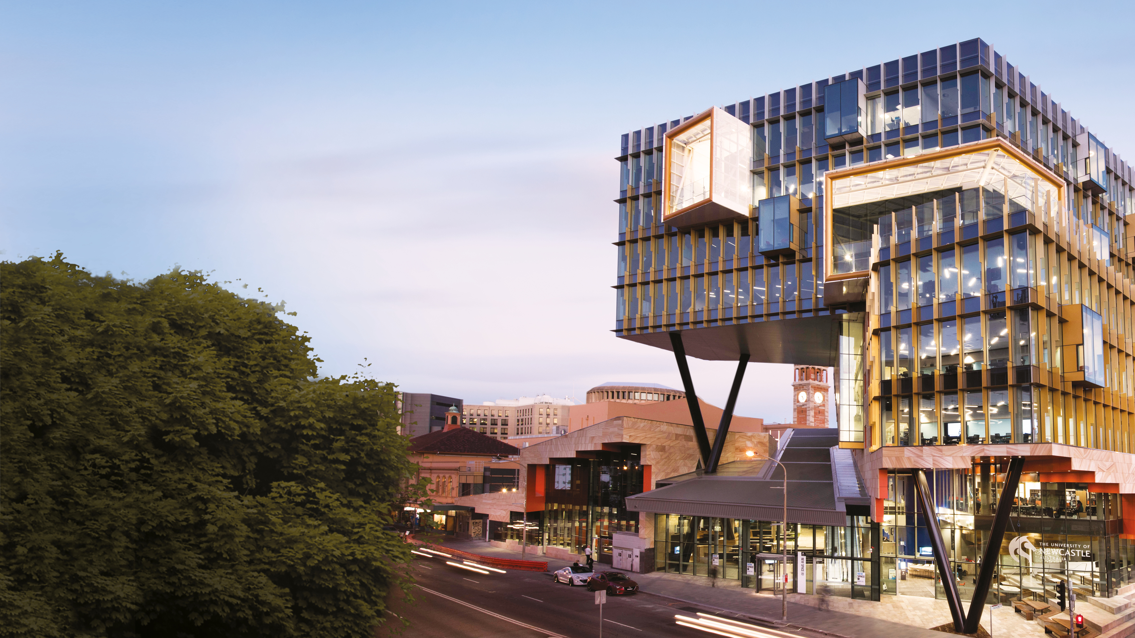
Feedback & Questions:
kevin.sobel-read@newcastle.edu.au
marie.hadley@newcastle.edu.au
Mr Joseph Wenta
Ms Sher Campbell
Kelsey Gray
Notes:
FS team member – Tyler
Welcome students, introduce the staff members.
Presentation will be presented by Ms Sher Campbell and Mr Joseph Wenta, from Newcastle Law School.
Kelsey Gray (current student ambassador).
Mel Ryan (program adviser) and myself, answering questions that are coming through.

