Slide 1
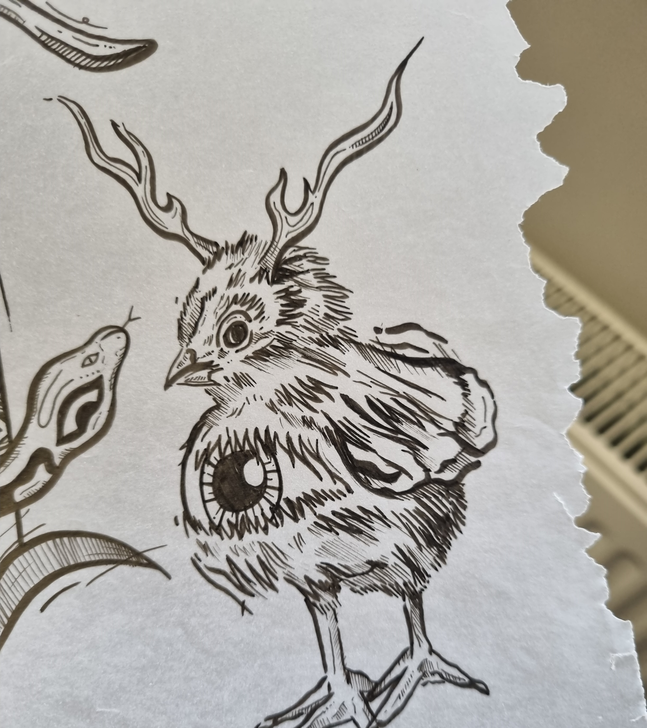
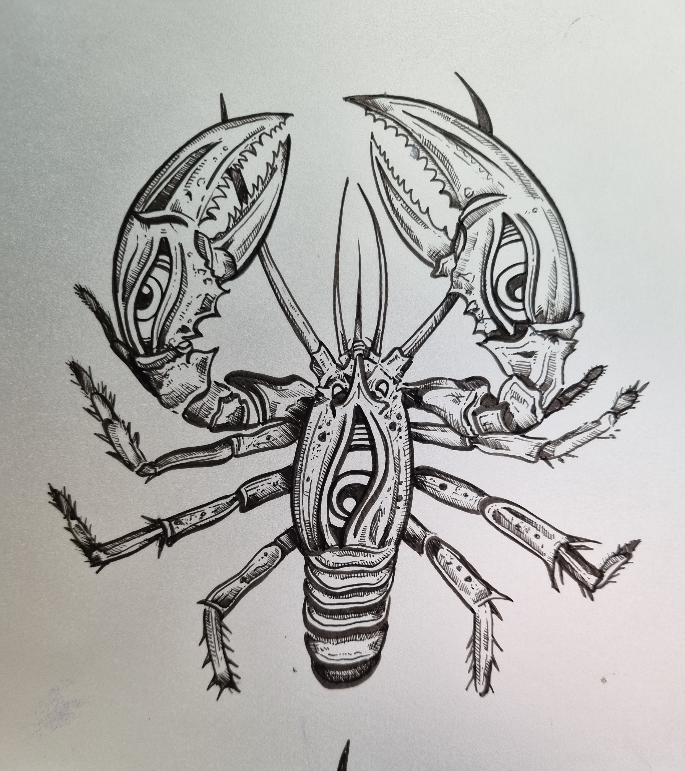
Artist-Academic Collaborations: Lessons from the Field
Dr Marie Hadley
University of Newcastle, Australia
Images by Adam McDade

Slide 2
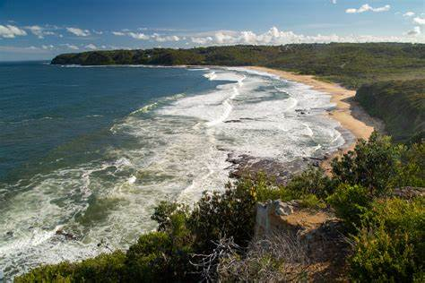
Who am I?
My research focuses on
copyright law
controversies involving visual imagery & copyright
graffiti, public art, tattoo
artistic practices & creative process
relationship between law and society
socio-legal methods
I want to understand
how people think about law
what people expect law to do for them
what insights are generated from approaching issues / controversies / problems in different ways
My academic background:
Social Science (Sociology major) (2006)
LLB (2008)
PhD (2010-2019)

Slide 3
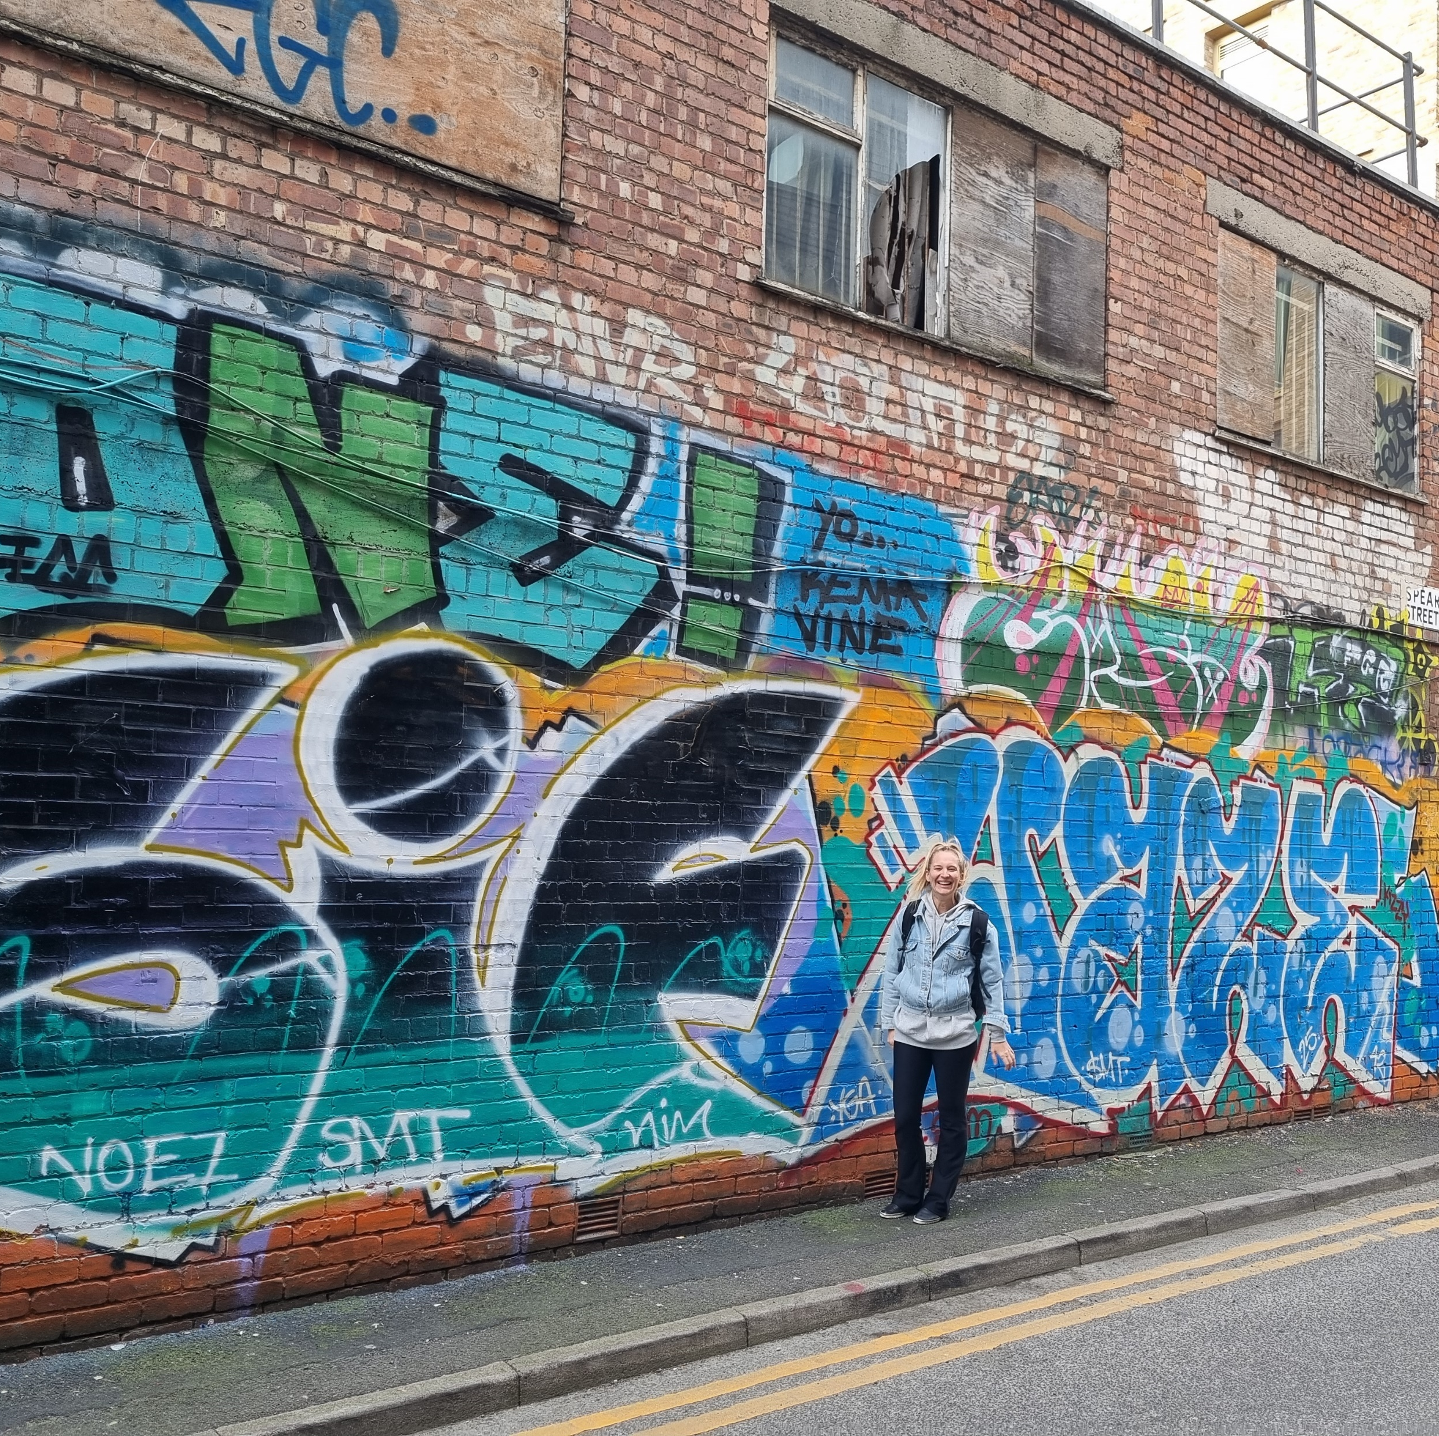
Who am I really?
I am curious
I am stubborn
I love learning
I find code-switching hard
Swim, swim, swim and be happy

Slide 4
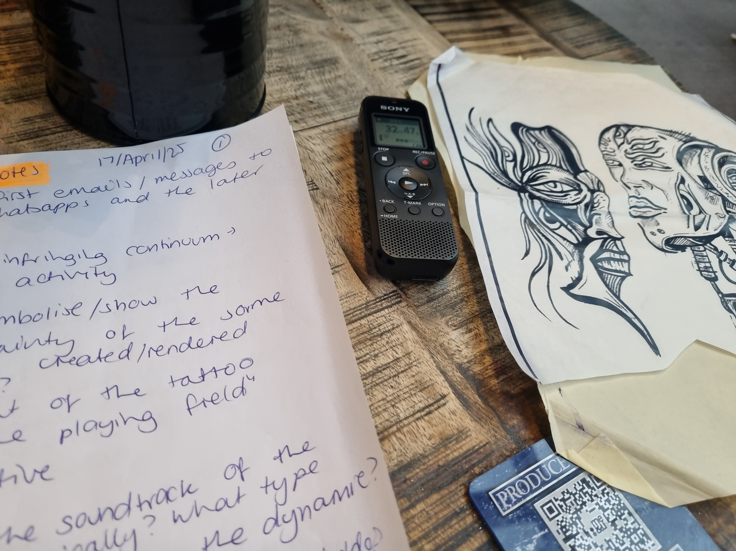
Plan
3 projects involving artists as participants and/or research collaborators
(that represent a sliding scale of collaboration)
Tips for successful collaboration
Why you might like to do this type of work, and its challenges

Slide 5
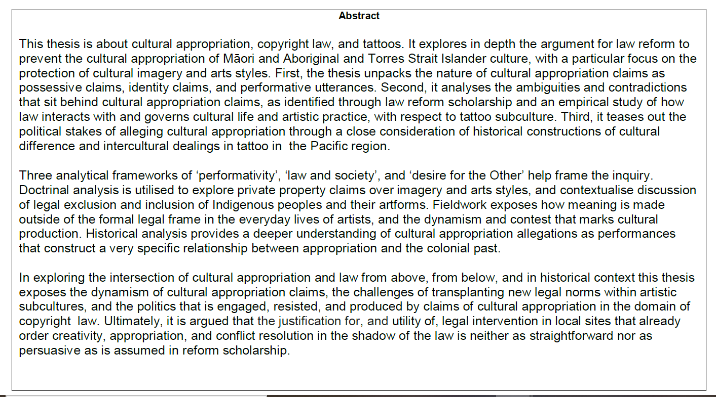
Project 1: Artists as research participants

Slide 6
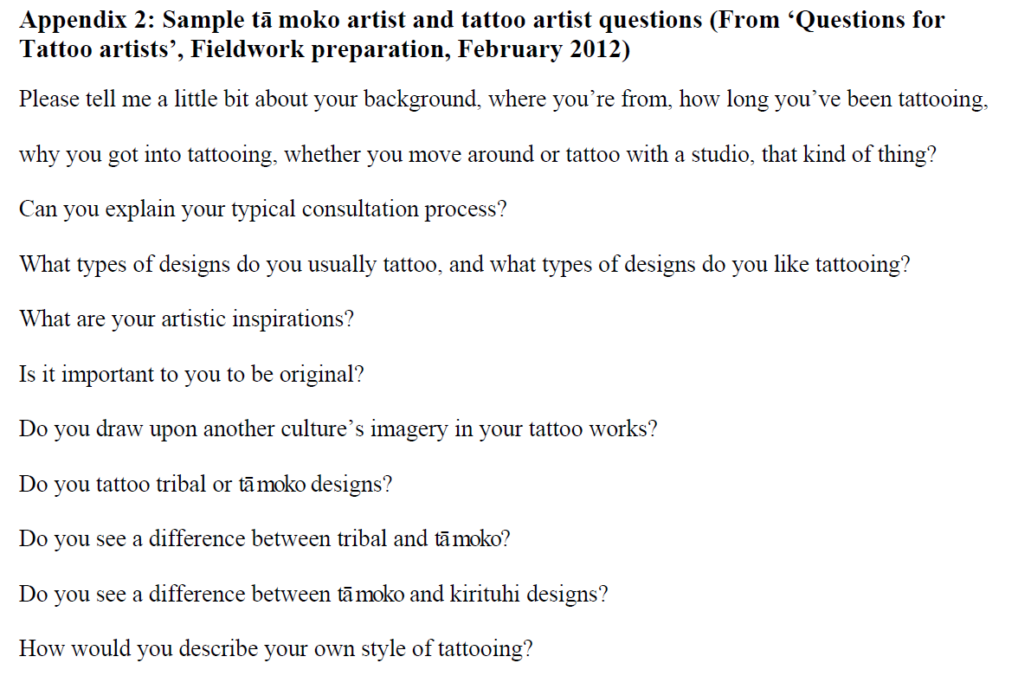
What did I do?
A small-scale study
Semi-structured interviews with 5 tā moko artists and 5 pākeha tattooists
North Island of New Zealand
10 days fieldwork
8 interviews conducted in person, 2 via zoom
0.5–2 hours long
Interviews were conducted in the preferred setting of participants – typically their workspace

Slide 7
A mishap… but not a mistake?
A series of mishaps…. Participant recruitment
Email recruitment
Walk-ins
Opportunistic sampling
Fieldwork was done way too early in the research process. A lot of my questions were off.
My expectations and assumptions were also often wildly out of touch/inaccurate. For example:
I expected synergy between media representations of disputes and cultural/subcultural practices
I went into my first interview thinking: Māori-style work was “bad”; tā moko practitioners only work with Māori clientele; tā moko was a type of tattoo; that artists cared about law….

Slide 8
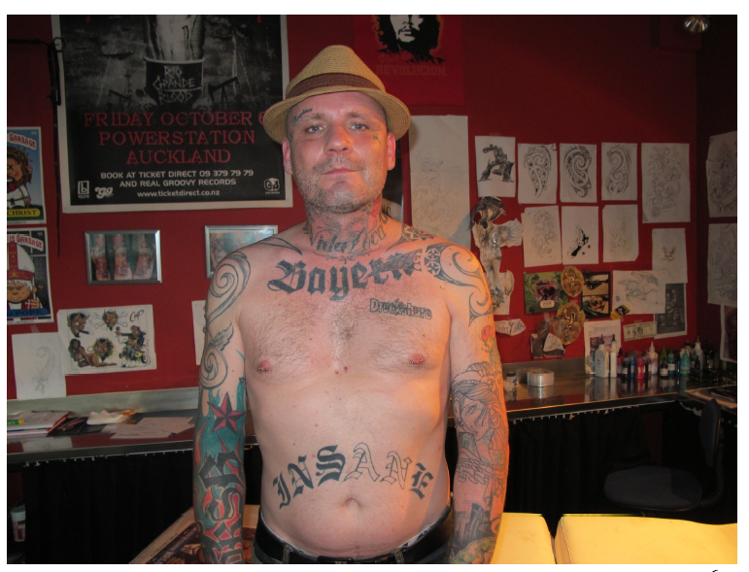
‘copyright can fuck off’
I was often surprised. My questions were laughed at.
As a result, I was constantly on the back foot, and I needed to adapt on the fly during what was already a short trip.
This led to some thin data, but also rich, unexpected, exciting data – that I did not, immediately, have the capacity to know how to integrate into the thesis…
7 years passed.
“… ‘tattooing has nothing to do with copyright’ because it’s a ‘fucking tatt’ and ‘[i]t’s complete nonsense to apply it to tattoos, you know, cus it’s on a body, man!’ In Pete’s opinion, ‘copyright can fuck off’.”

Slide 9
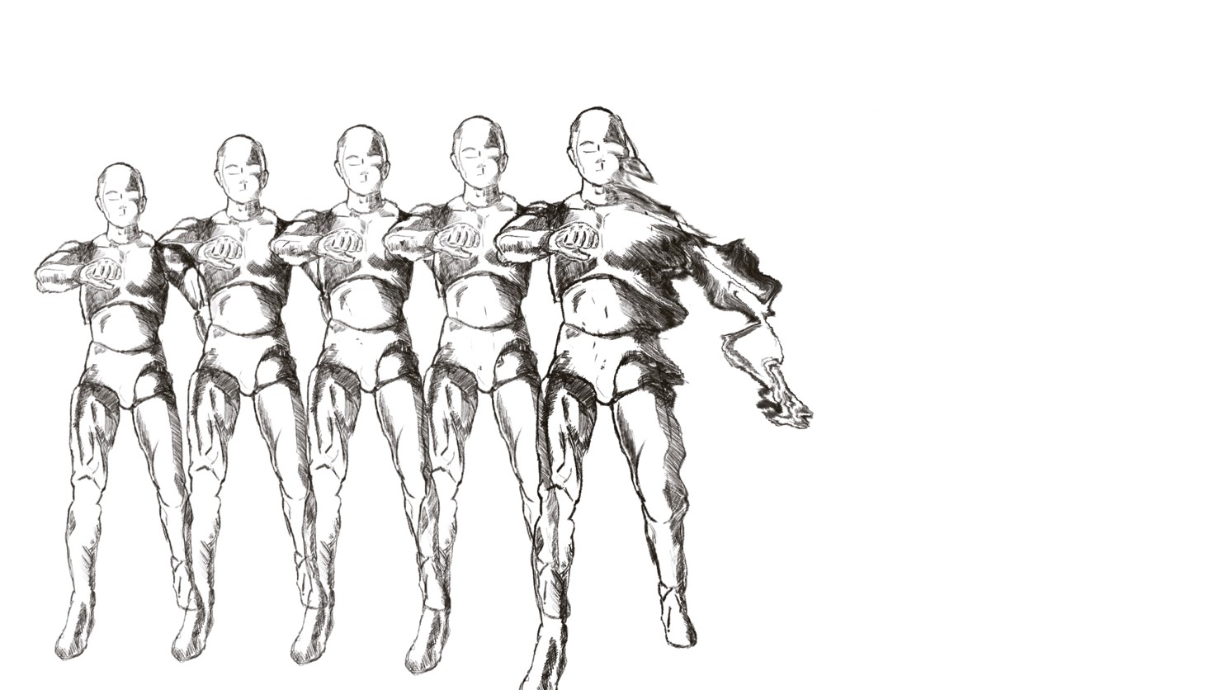
Project 2: The accidental artist collaborator
Research design:
Academic paper
Art that critically engaged with the paper + individual and collaborative reflections on the creative process
Practitioner Based-Enquiry
Data included work-in-progress images, conversations, semi-structured interviews, a YouTube series

Slide 10
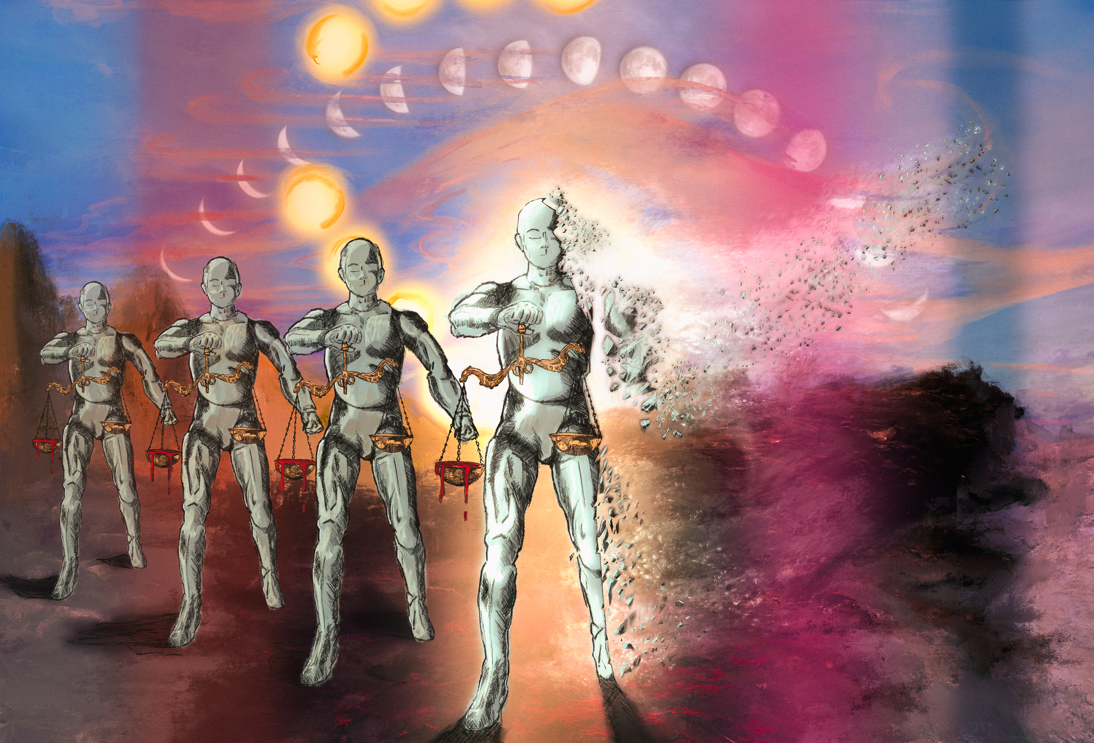
An exhibition, a sonic response, a teaching module
‘well you got, you know, Lady Justice, but it's a robot, so I was like, ‘Okay, so it's a mechanical justice, you know, there's bloody tipped scales. You, obviously something's not right there’. So I was like, ‘okay. It's mechanical justice. Isn't feeling anymore. It's just a robot. It's there to serve a purpose and because it doesn't have any feeling anymore, it is now actually doing more damage than good.’ … So, what's the context of that? Cause that's quite a bold statement on the justice system…. There's no ethics and morals in machines. So if Justice is a machine, what does that say?’
Audience reception data, student data, researcher reflections…

Slide 11
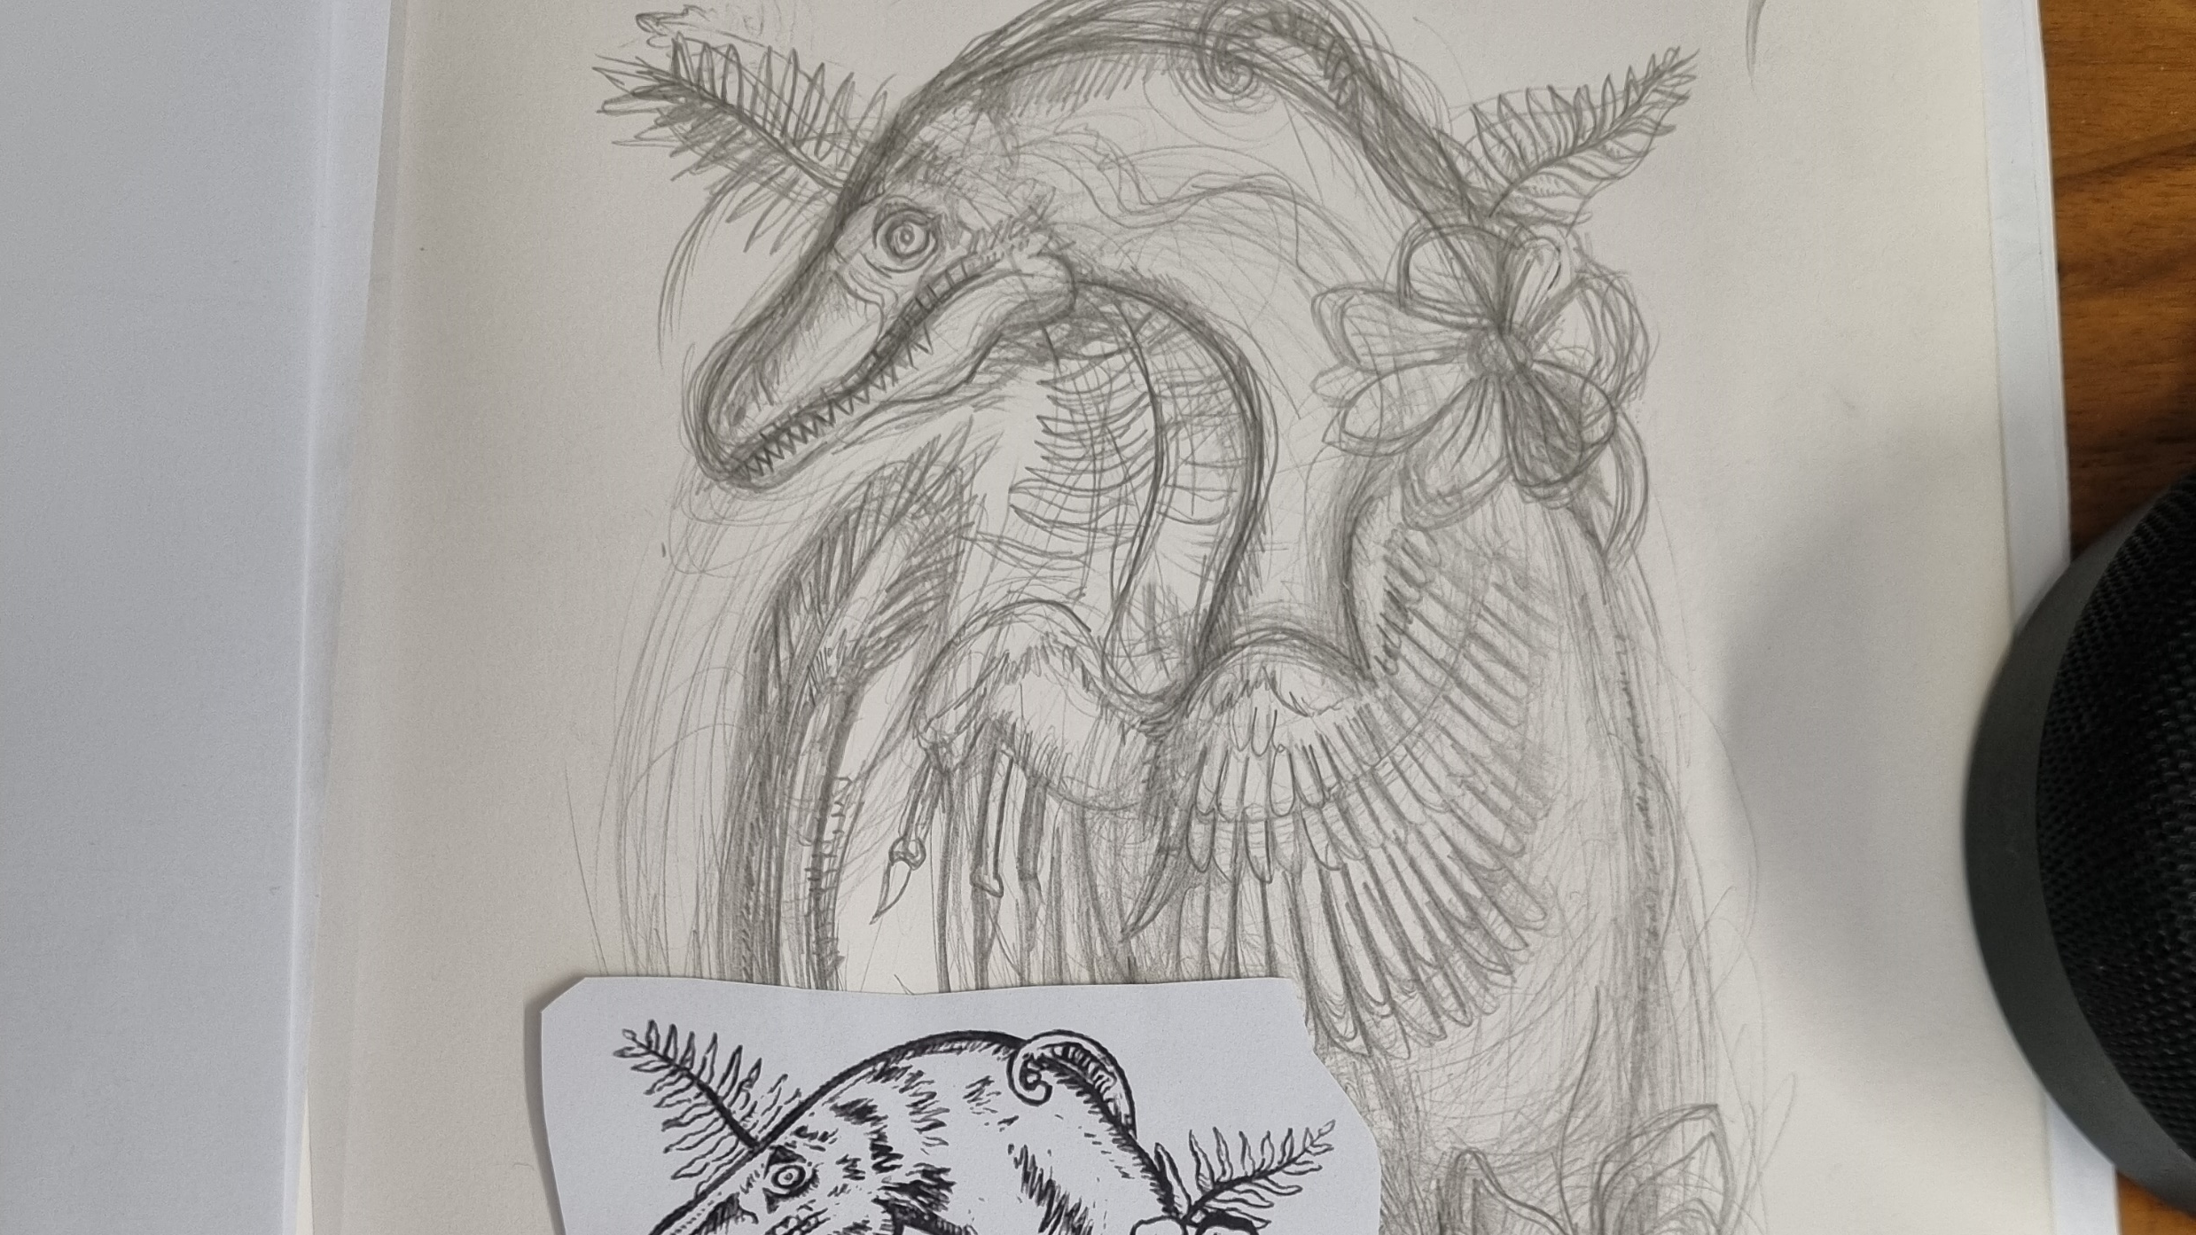
Project 3: The aspirational, experimental collaboration

Slide 12
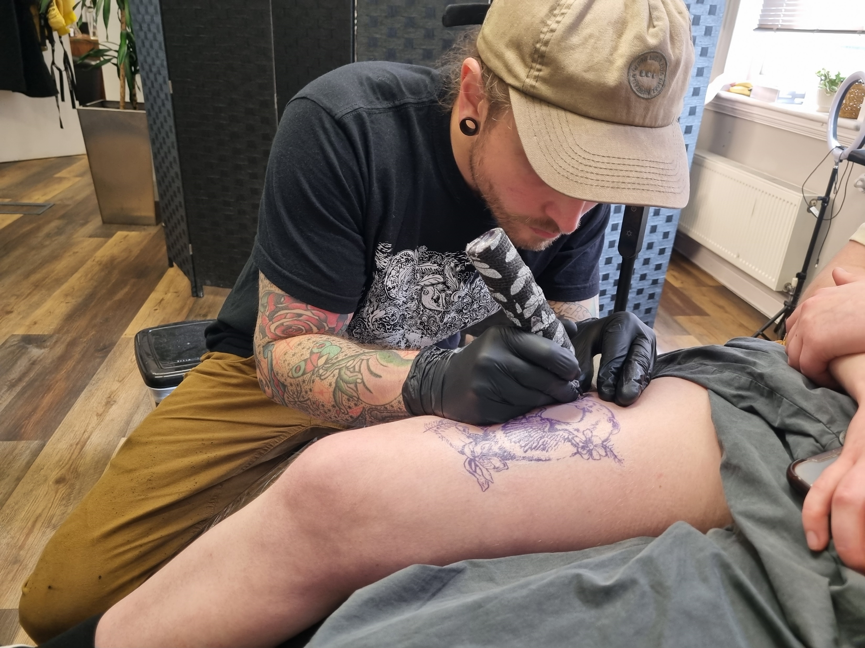
We planned:
a focus on authorship practices, creativity and copying in relation to the creation of 3 tattoos (ie practice-based research)
to be equal partners in research
But then…. we began to focus, organically, on the collaboration process as much as tattoo practice (if not more)
And then….. more experimental, less formal methods emerged

Slide 13
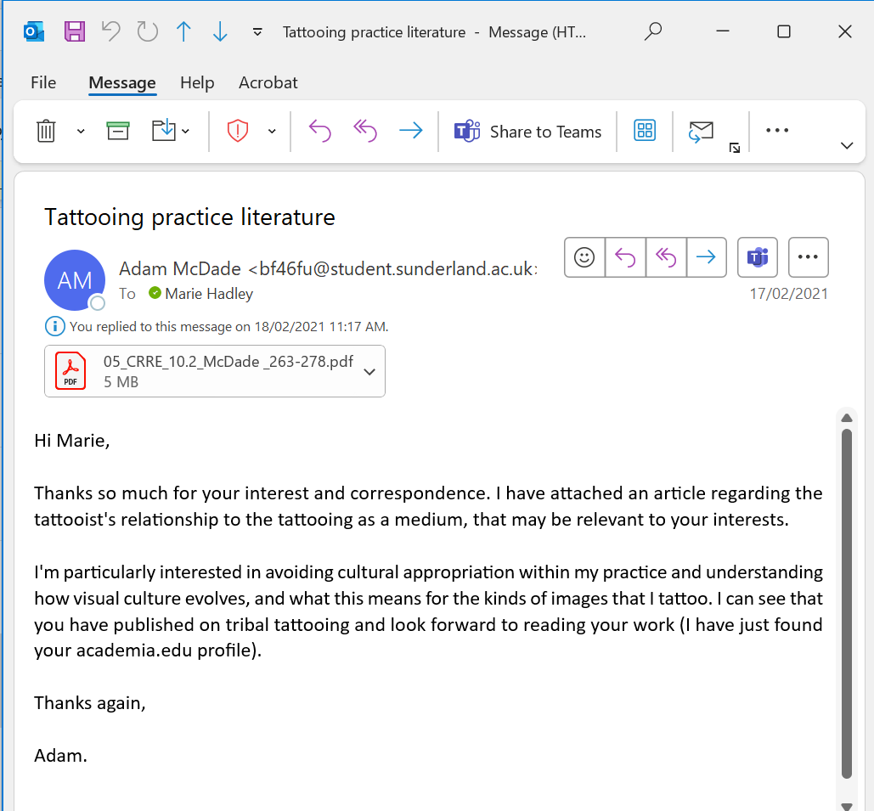
Whatsapp as a communication tool
1/30/25, 7:59 PM - Adam McDade: At the risk of taking this into a tenuous tangent—are you familiar with the gloves that Imogen heap made, that alter sounds in a mic based on the hand gesture and movements? I feel like this Synesthesia themed stuff is really interesting when considering the broader connection of all things. Visuals have sounds, sounds have smells, etc…
1/30/25, 8:00 PM - Adam McDade: I'll get back to the other stuff tomorrow on my way to work!
1/30/25, 10:32 PM - Marie Hadley: Oh that's so cool! … ps the tangents are where the magic happens! Pps hopefully have those ethics doc in your email later today

Slide 14
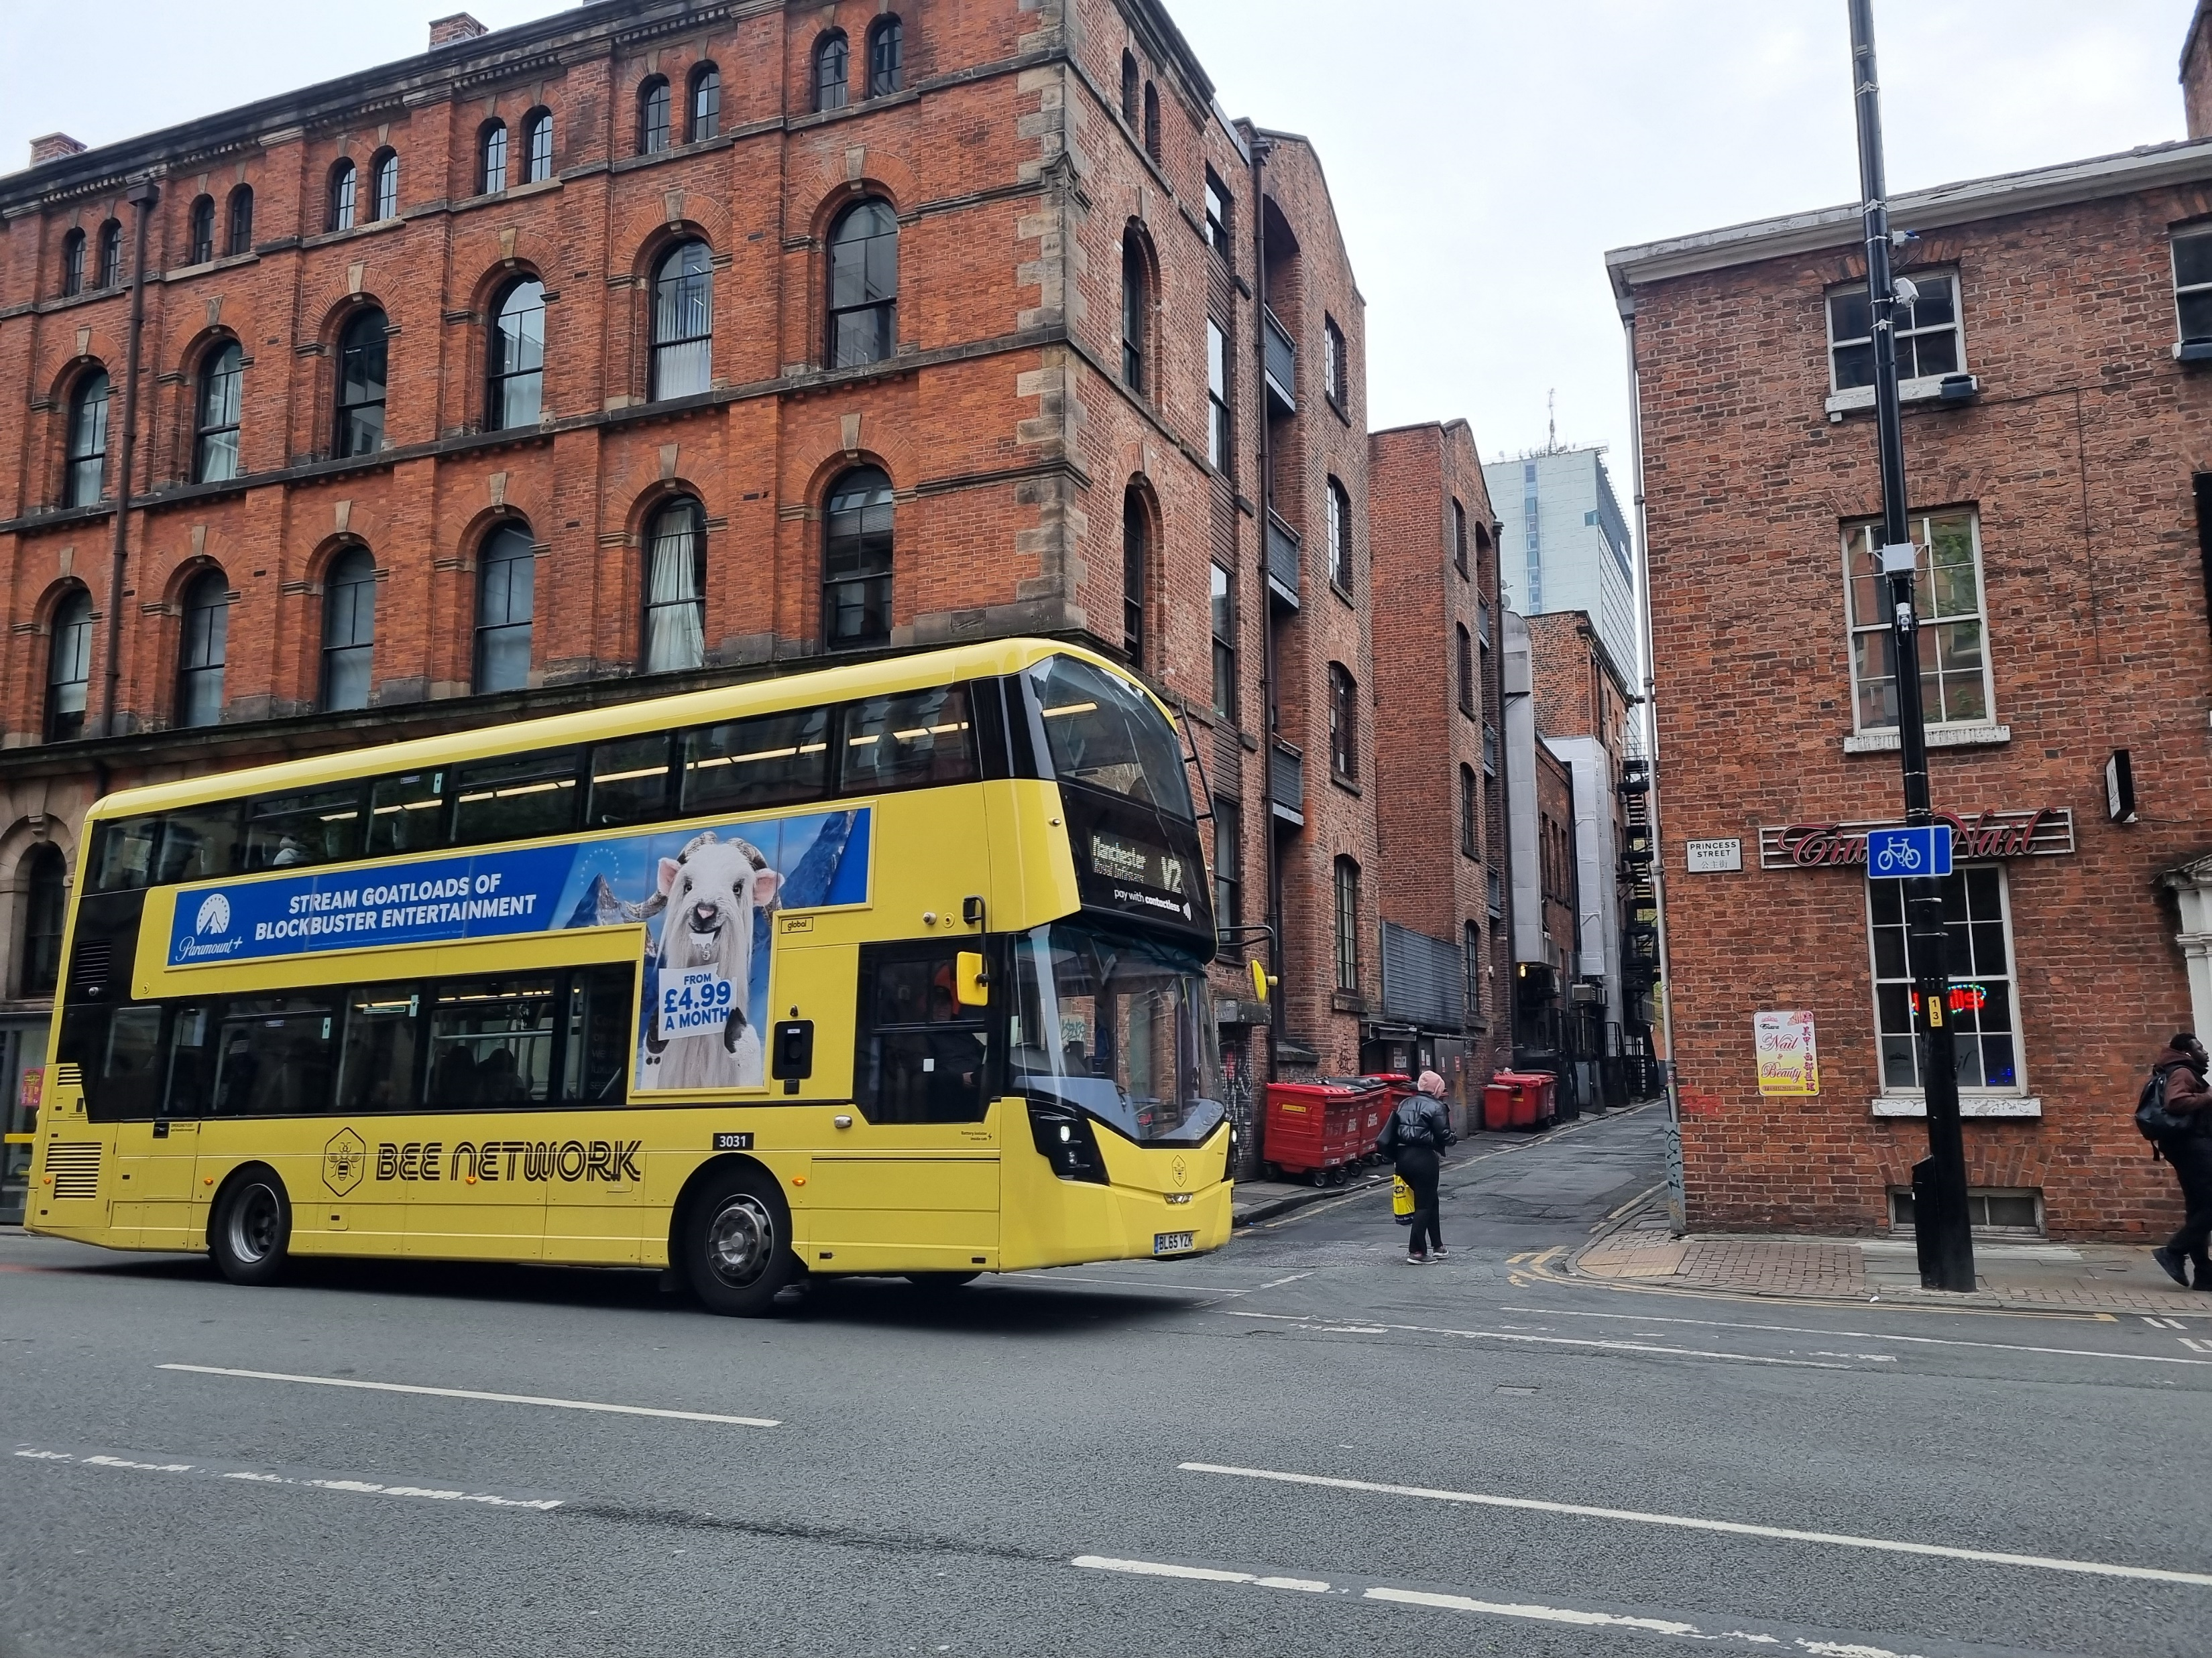
Catching the #192

Slide 15
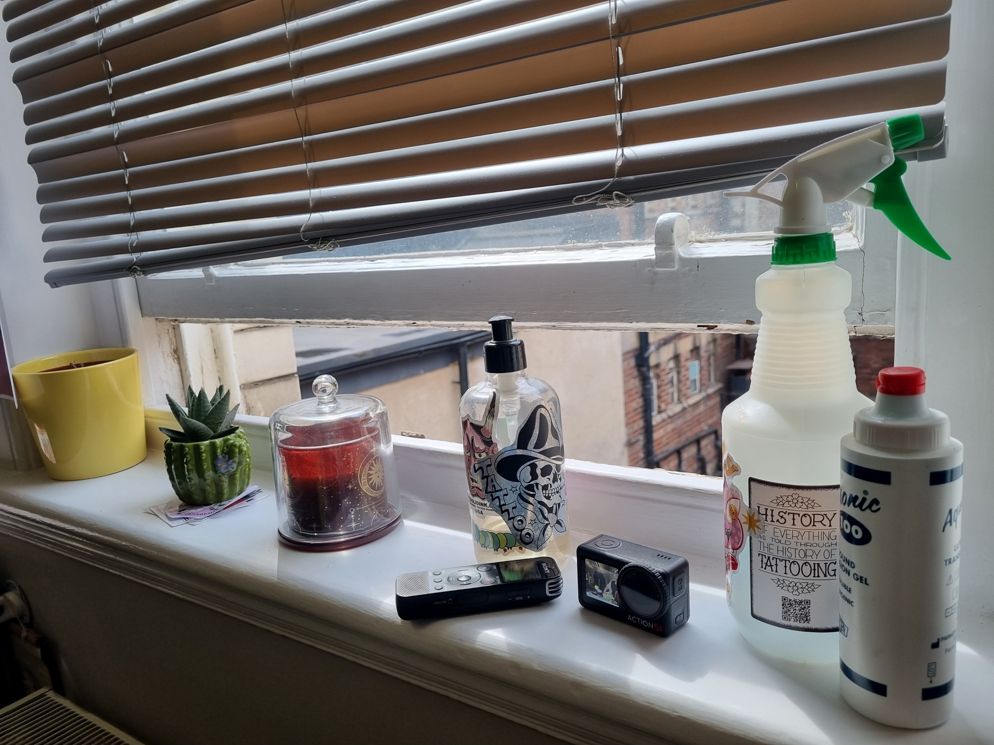
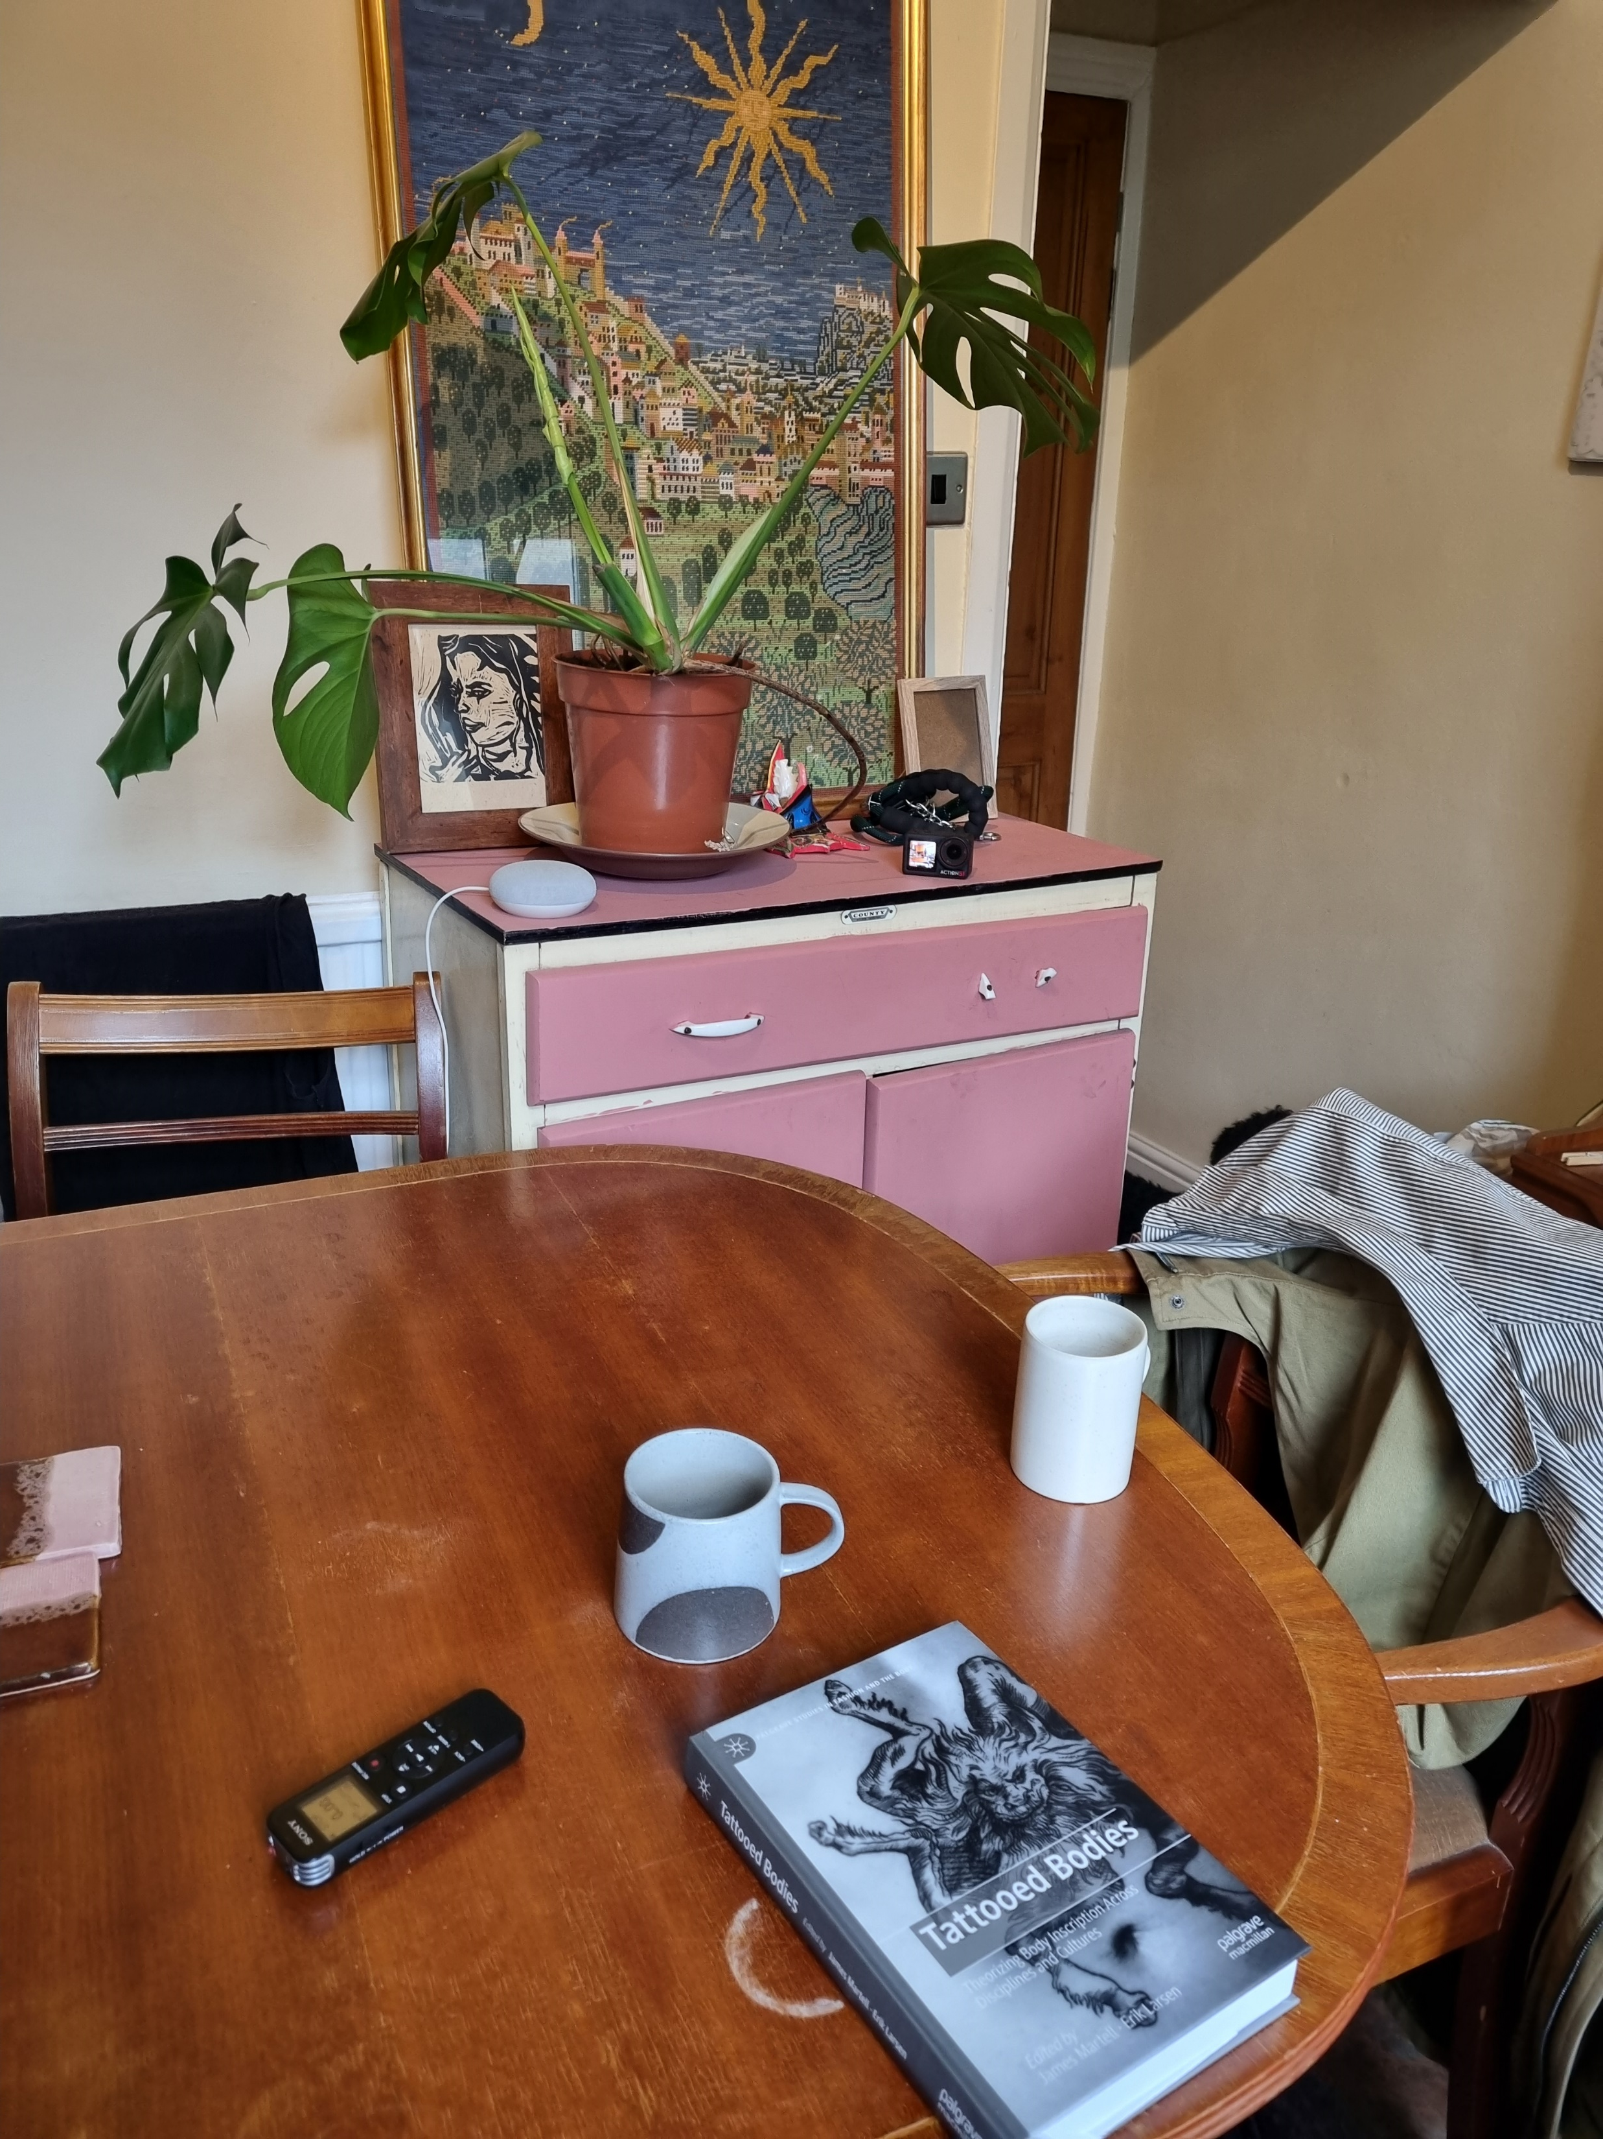
Informal settings, unstructured conversation
‘… I'm very bad at performing accepted versions of professionalism …’
Adam McDade, whatsapp message 5 February 2025

Slide 16
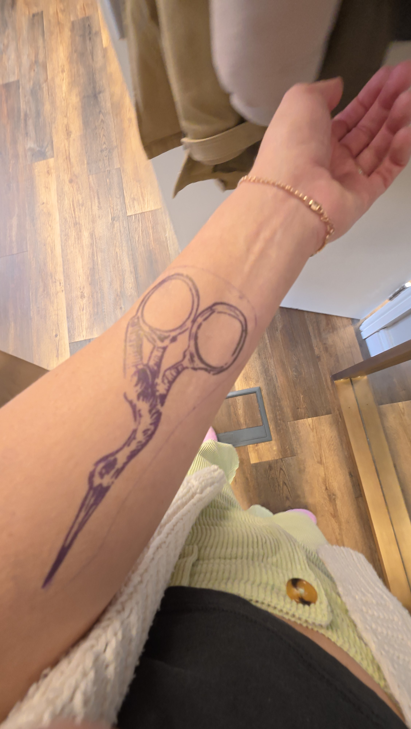
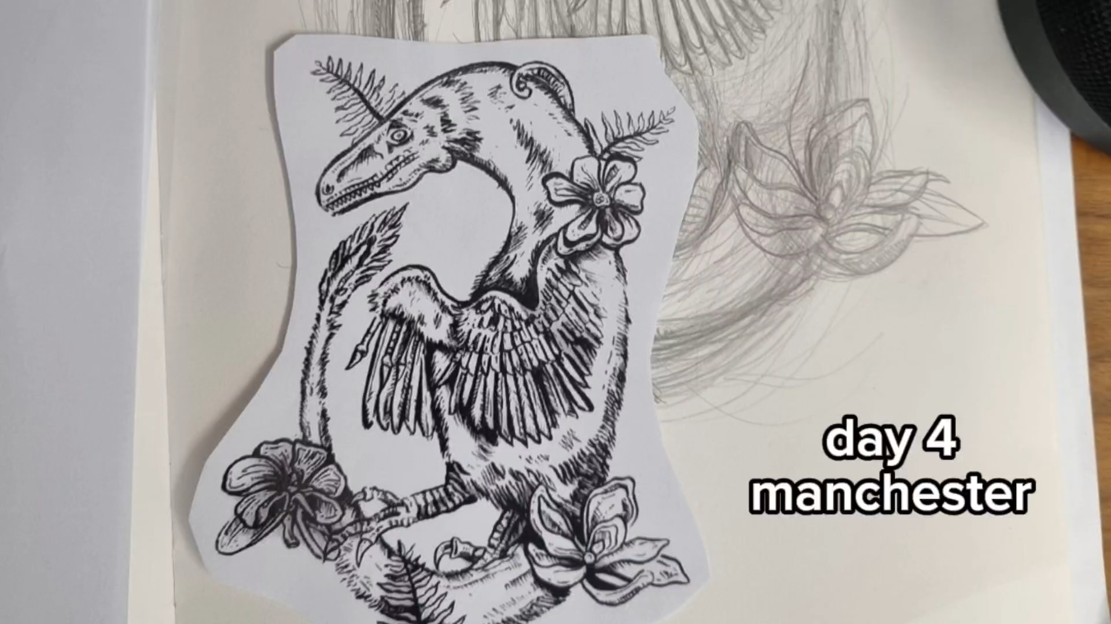
Research as practice and play: what we planned vs what emerged

Slide 17
Tips for successful collaboration
Involve the collaborator from the outset
Meet in person
Engage in deep listening
Give it time

Slide 18
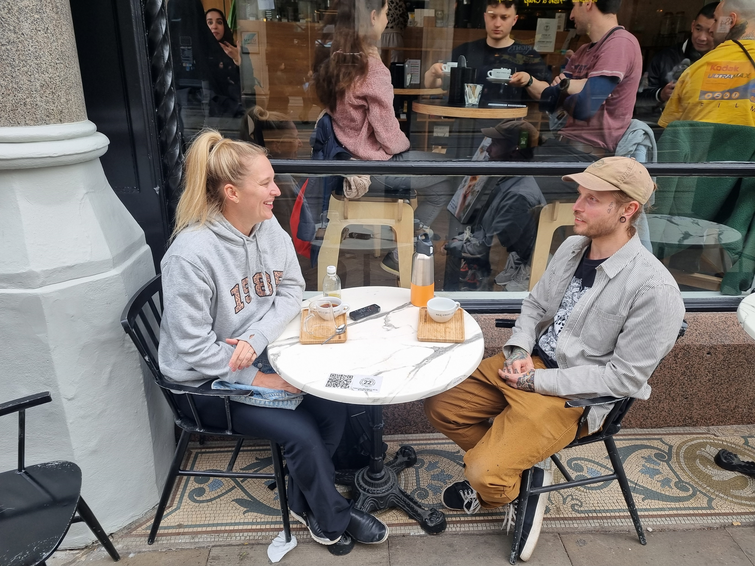
Meet in person
Zoom and Whatsapp can get you so far – but nothing can replace physical proximity
Walking in your collaborator’s shoes (and literally catching the #192 bus) can help you understand them better (and yourself)
Meeting in person opens up opportunities for different ways of “knowing”

Slide 19
Engage in deep listening
Pay attention
Actively listen to both the verbal and non-verbal communications
Hold space for your collaborator
Listen to yourself – use the body as well as the ears.
How are you feeling in the moment?
How is your body responding?
What is this hearing doing to you?
‘He says when he’s asked to respond to something it's almost like he reflects on it. He feels it. He brings it into him, then if he's in the right state of mind, he is connected and grounded and in that reflective zone where he can work. And then when other people hear it, he hopes that they hear some of him in the output. … He's essentially not only deep listening to the thing he's responding to and deep listening to his own groundings for the different sides of himself, but he's helping others deep listen too and if you’re deep listening, then the scene is right for connection.’
Marie Hadley to Exhibition Attendee, 24 October 2022

Slide 20
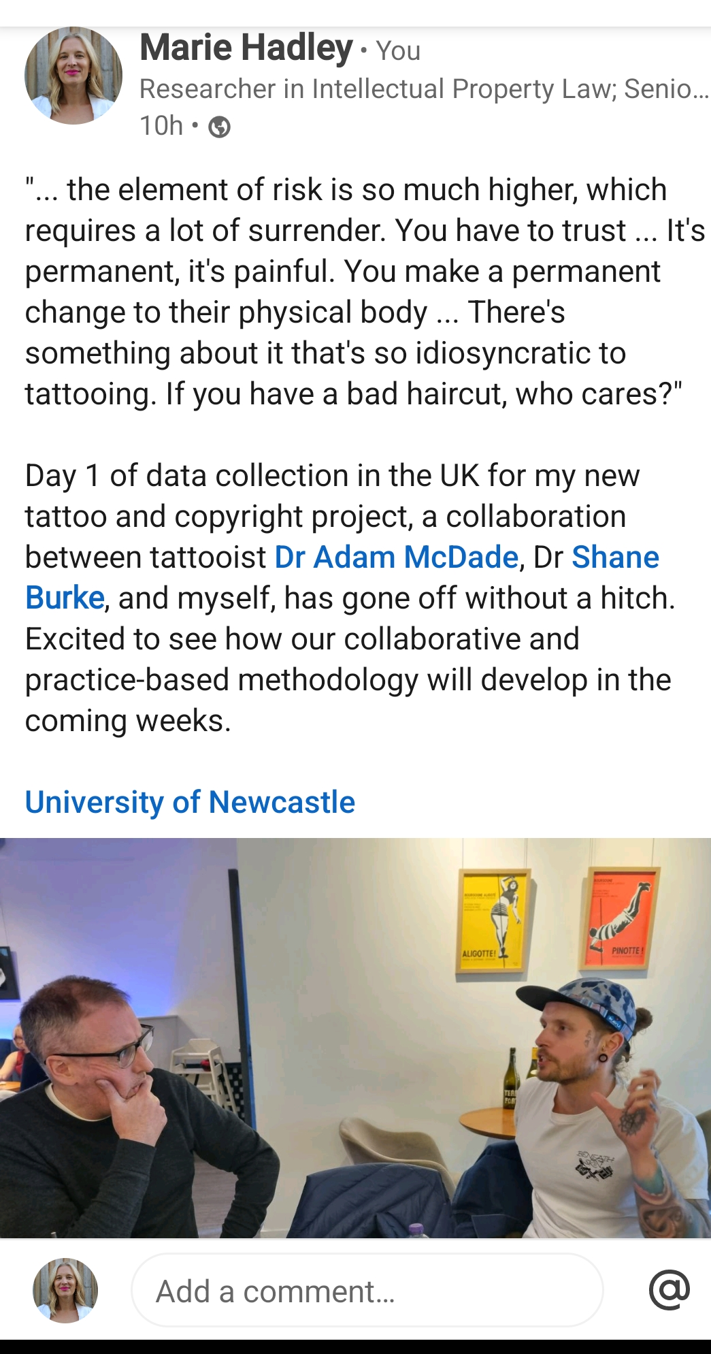
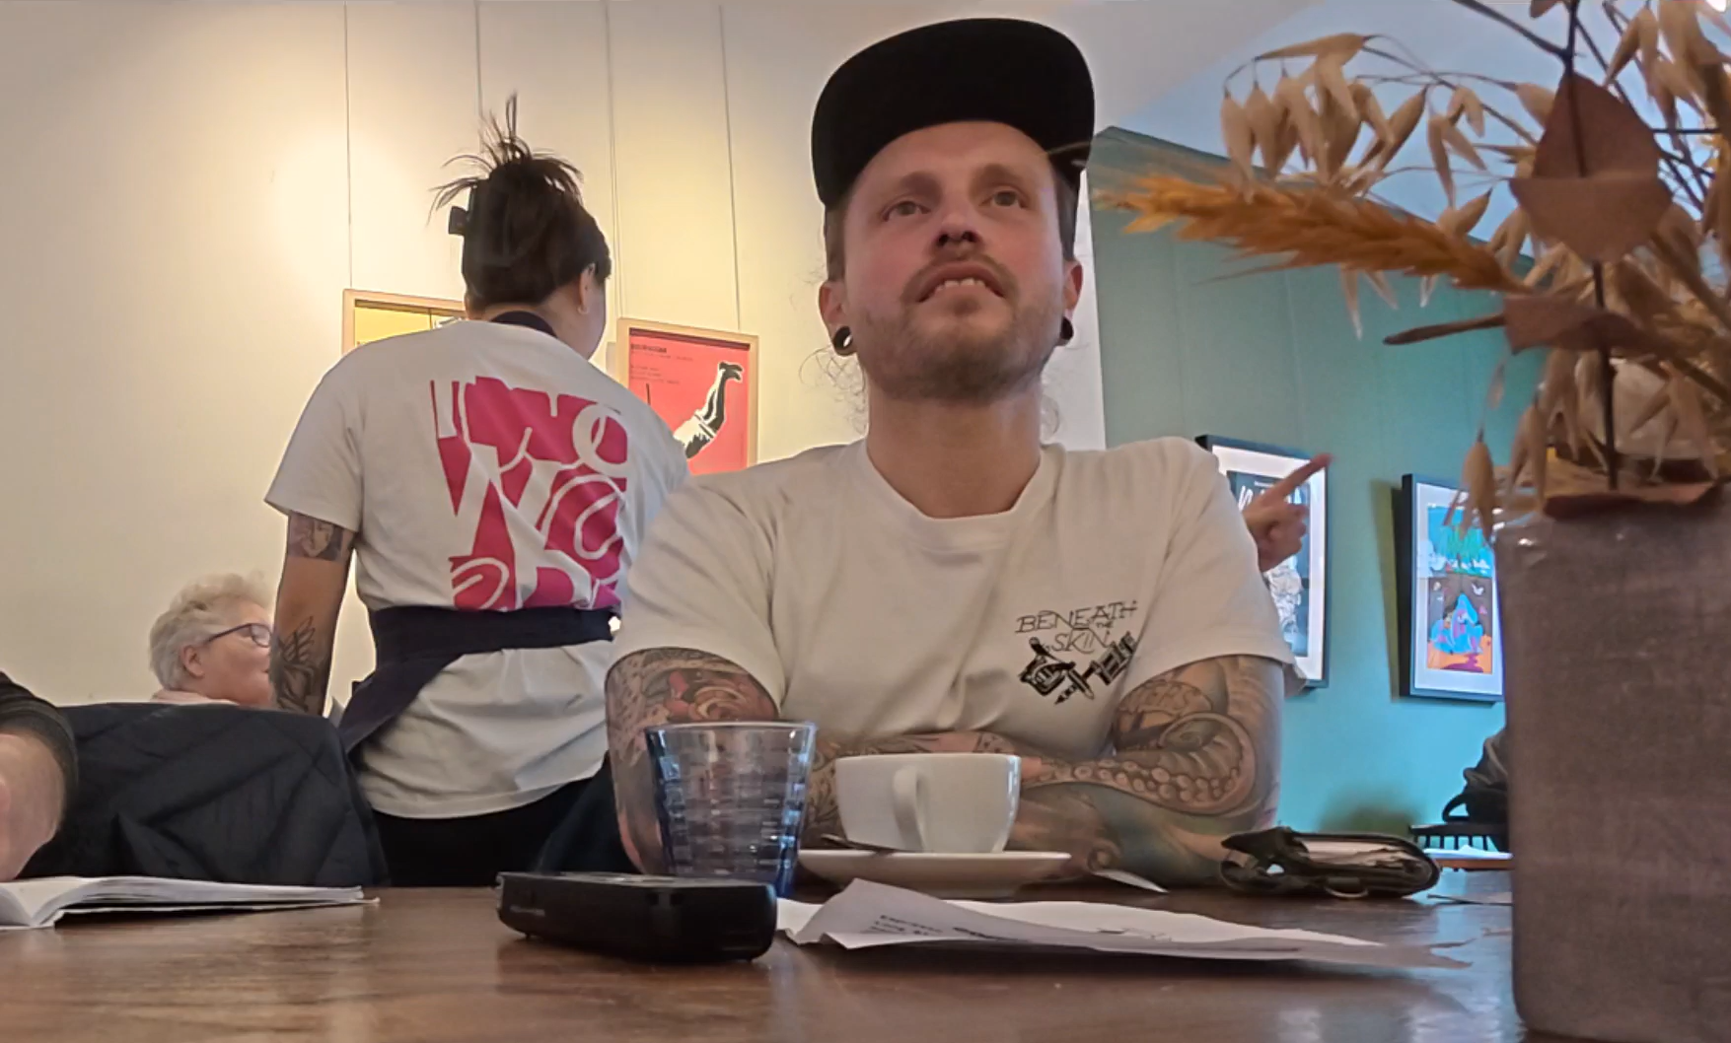

Slide 21
Give it time
AM: But how do we allow more time to build relationships and to let the process be as much of that, in combination with the things that we need to do as well? And that, that's a question for everyone. Cause there's things that would play out naturally if we're meeting face to face, right? All those sorts of things.
MH: Essentially what you're saying is that you need to have enough space for things to be organic and to develop? And then once the relationship is just as important as what you're actually doing, as the output and from the relationship, everything else gets better, infinitely.
AM: Exactly. A hundred percent. That's it. And then other things will emerge that, you know, we didn't predict as well, right?
Adam Manning and Marie Hadley, Post-Exhibition Reflection, 20 October 2022
Relationship-building takes time
Experimenting takes time
Qualitative work takes time
But - the process can be as rewarding as the output

Slide 22
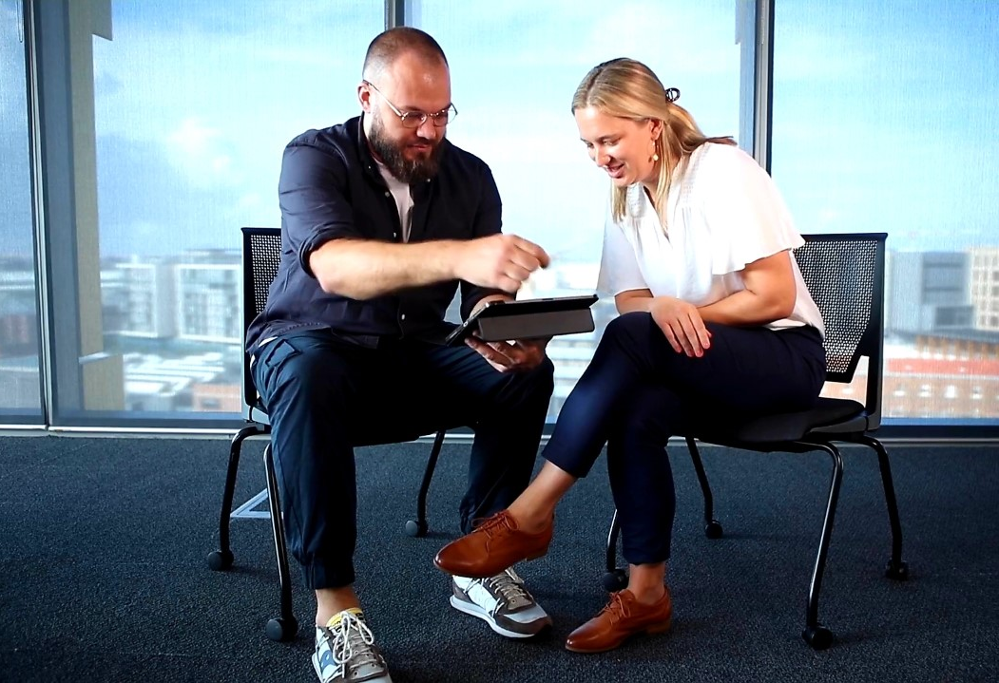
But …. there are challenges too
Project management across disciplines is difficult
Funding
Is your collaborator salaried?
Expectations – who is to do what?
What does the split of labour look like?
Outputs: how do you meet everyone’s needs?
Timelines
You need to line up your ducks with Ethics
Organic projects are great…. But when do they end? And what happens when the funding runs out?

Slide 23
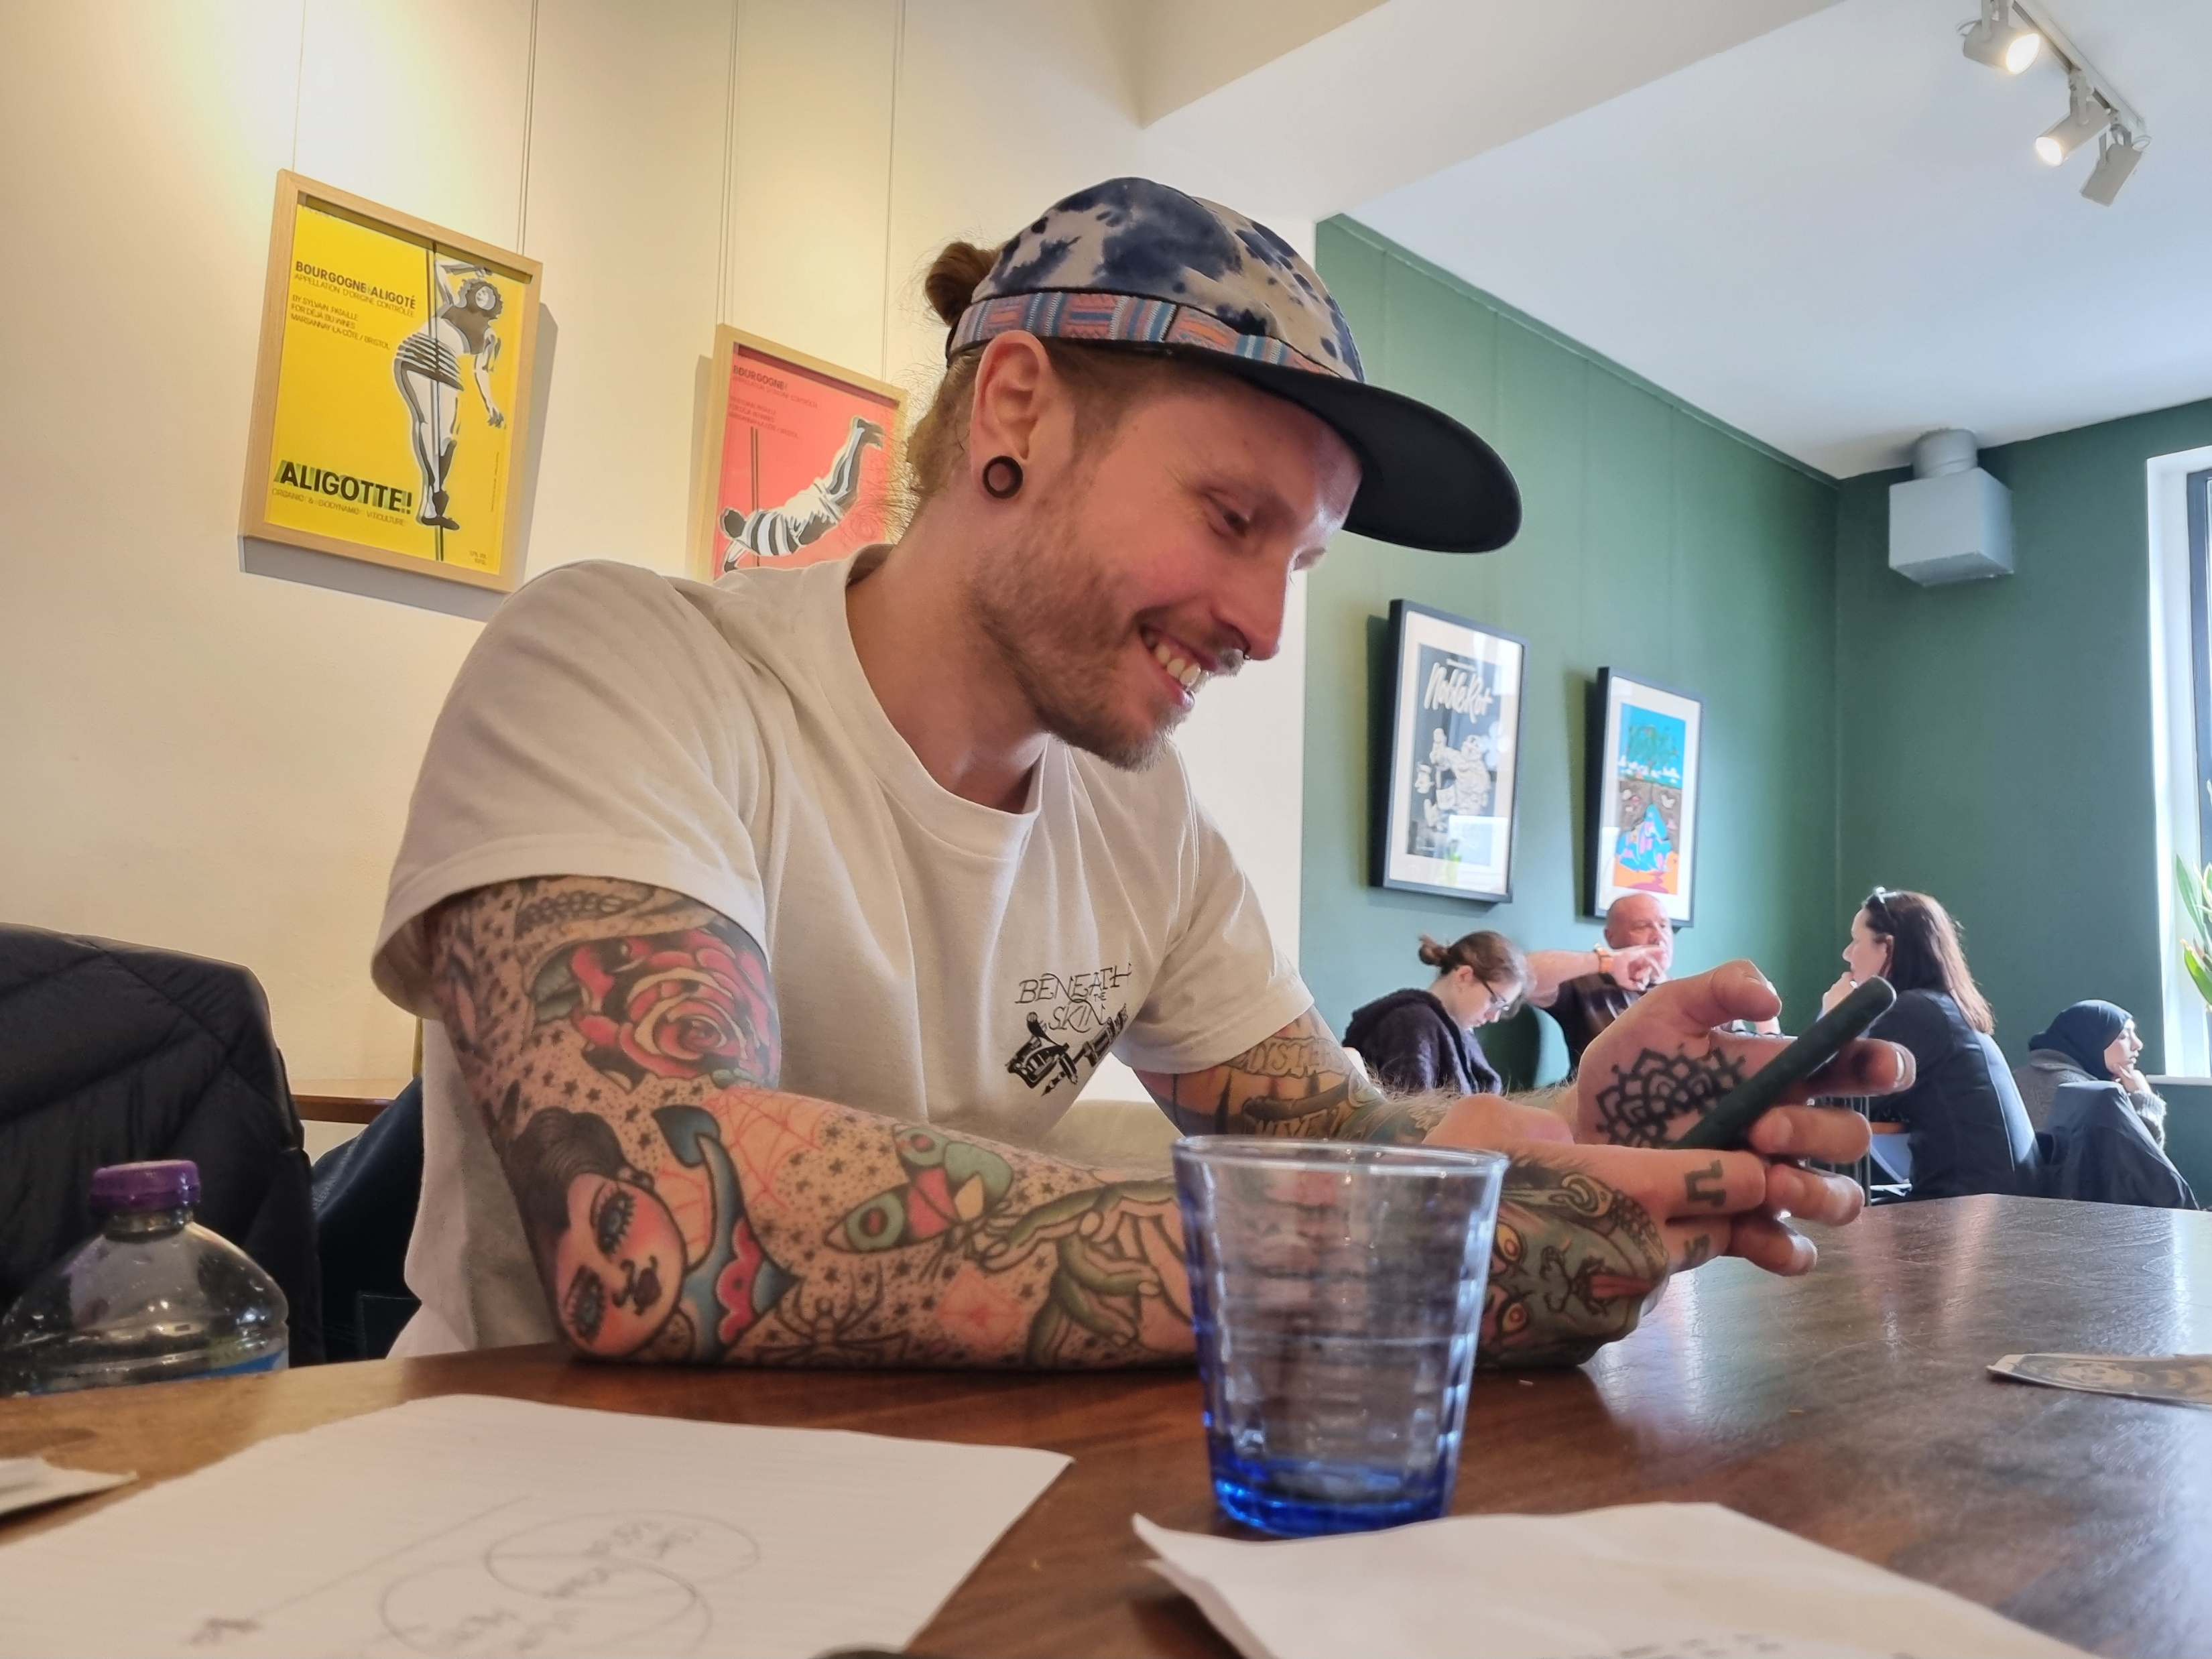

Final thoughts
When you are thinking about your future research projects, try for alignment: values, skills, methods
Do the things you think you should do, but don’t forget about the things you want to do
The low lows are tolerable when you have some high highs

Slide 24
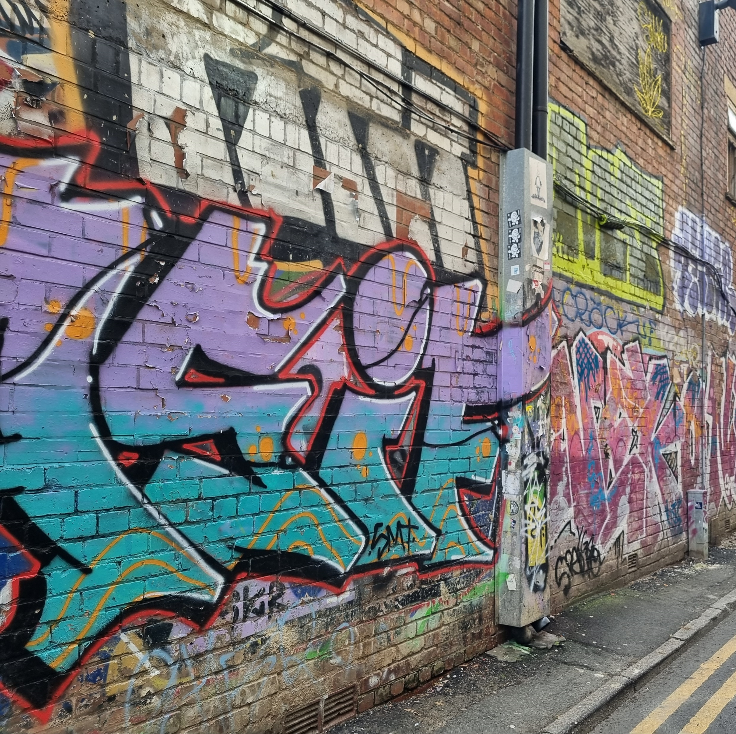
Contacts:
Any questions? I’d love to hear from you:
Email: Marie.Hadley@newcastle.edu.au
Bluesky: @drmarieip.bsky.social
Connect with me on Linkedin for updates about Adam McDade and I’s tattoo project: https://www.linkedin.com/in/marie-hadley-63b85346/
Connect with Adam on Instagram: @adammcdadeillustration
Check out Travis De Vries’ work at: https://travisdevries.com/

