Slide 1
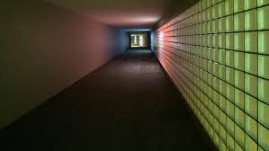
Liminal Space
Public art, public spaces, and digital interventions
Marie Hadley & Sarah Hook

Slide 2
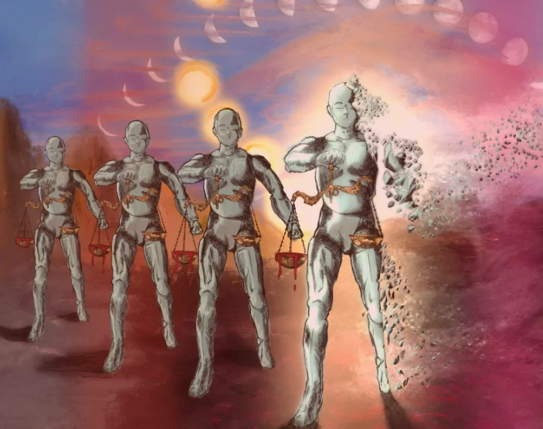
IDEOLOGICAL VANDALISM OF PUBLIC ART STATUES: COPYRIGHT, THE MORAL RIGHT OF INTEGRITY AND RACIAL JUSTICE

Slide 3
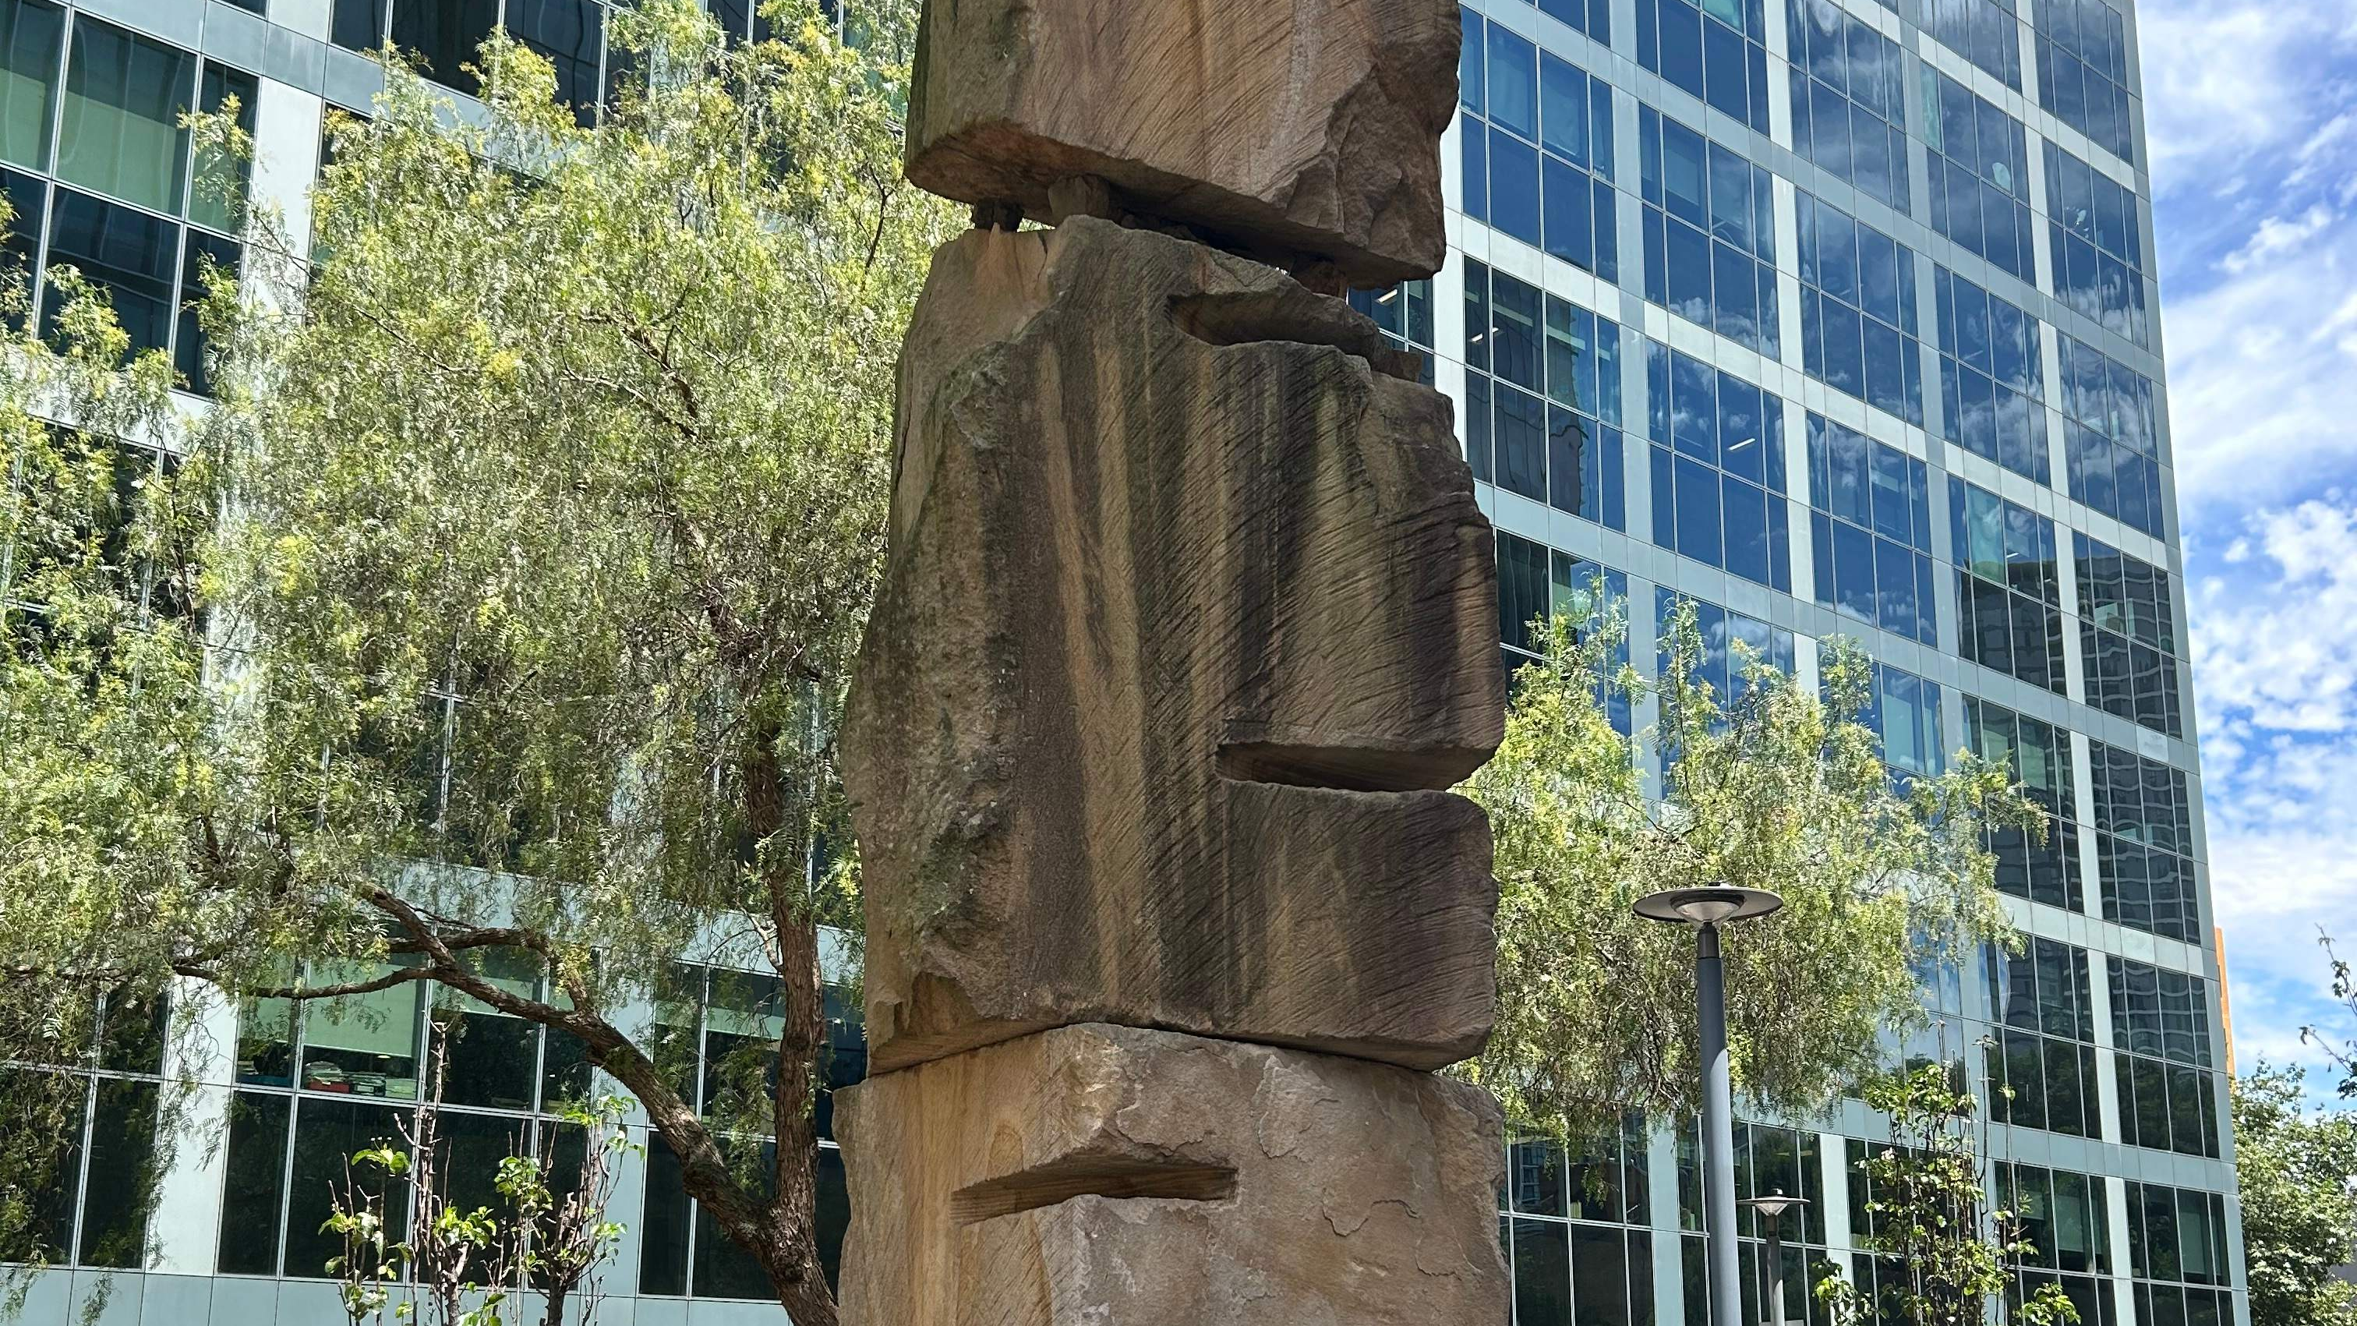
Gary Deirmendjian - a life, 2004-07
The Goods Line, Sydney

Slide 4
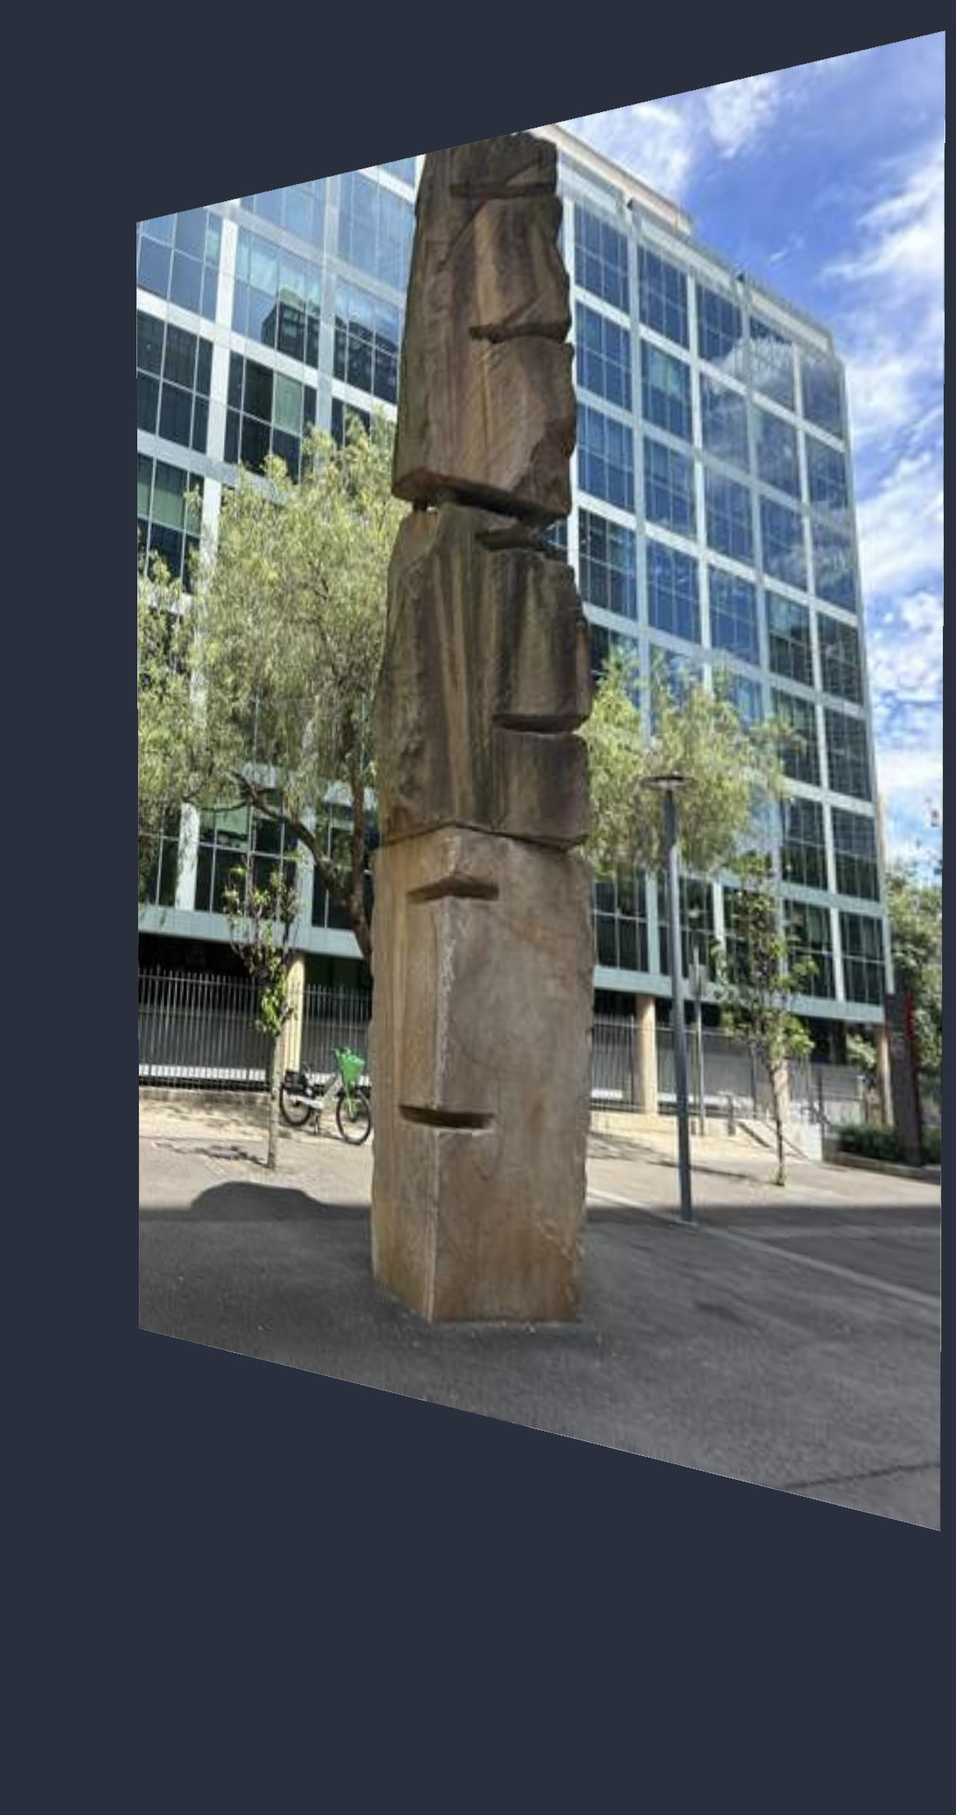
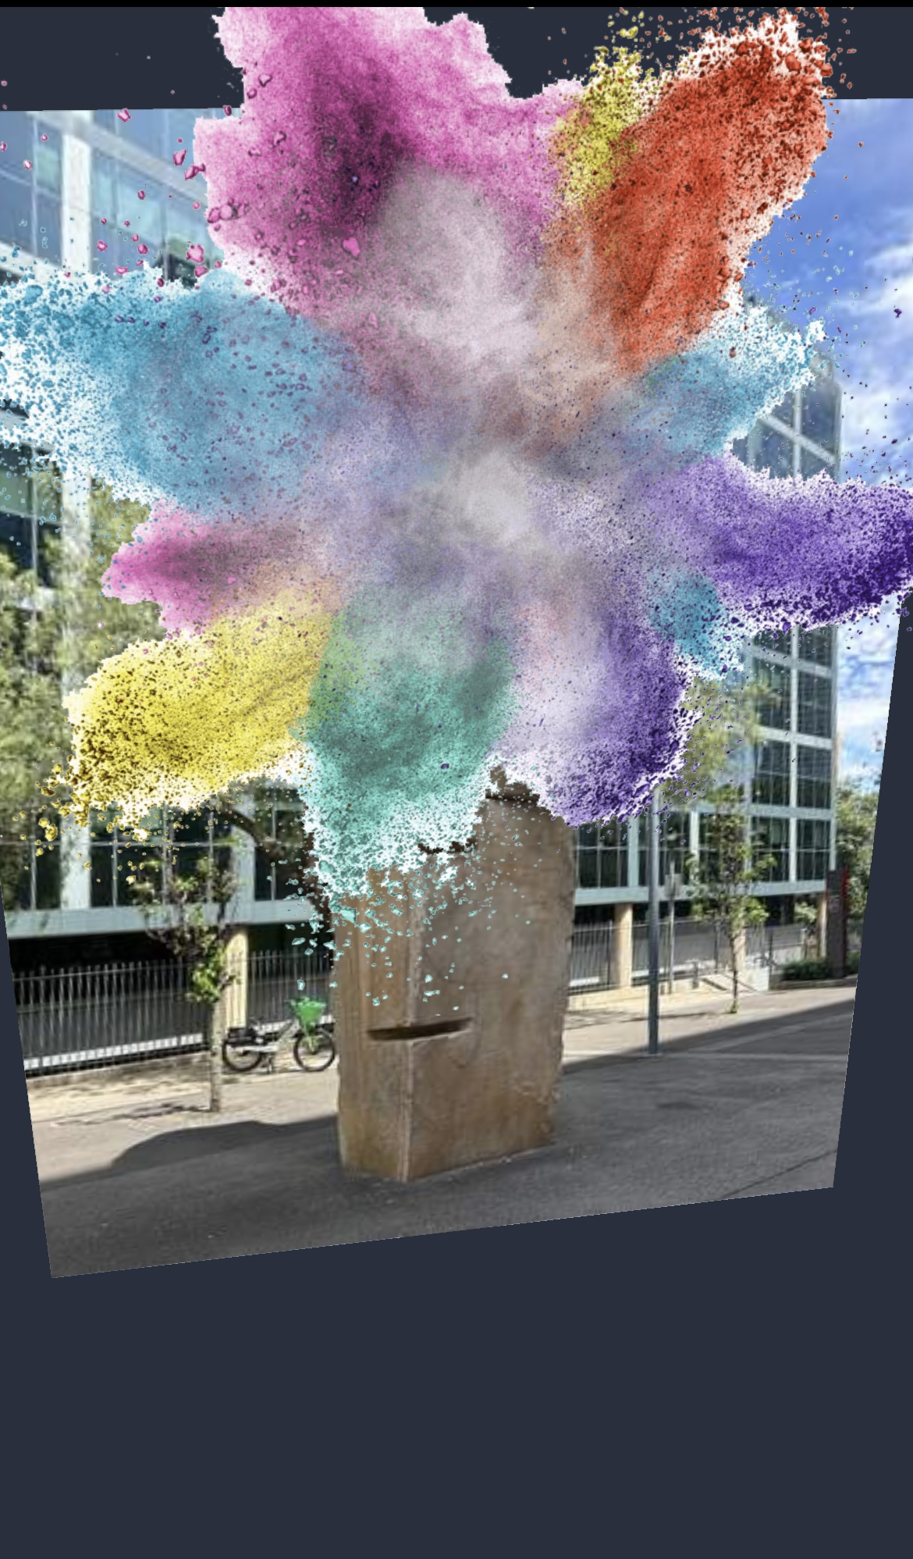
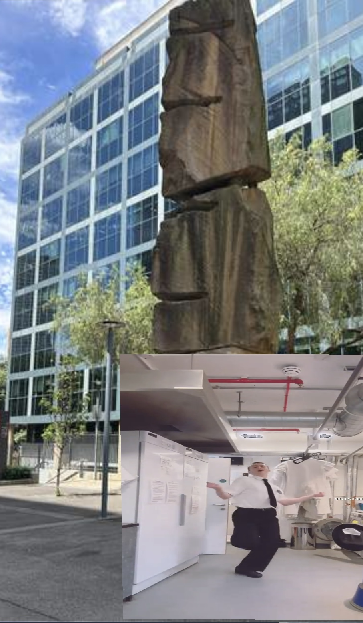

Slide 5
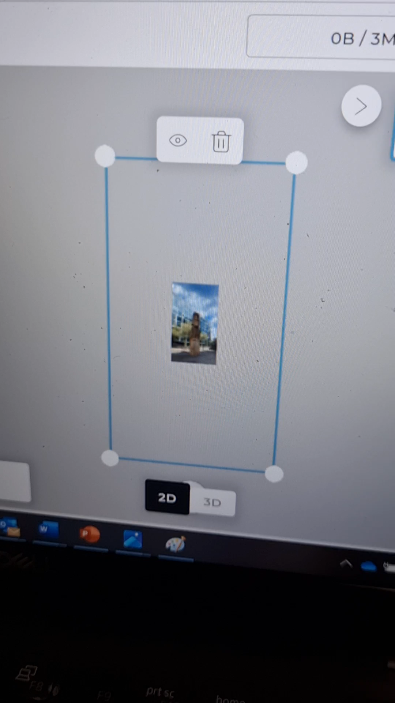
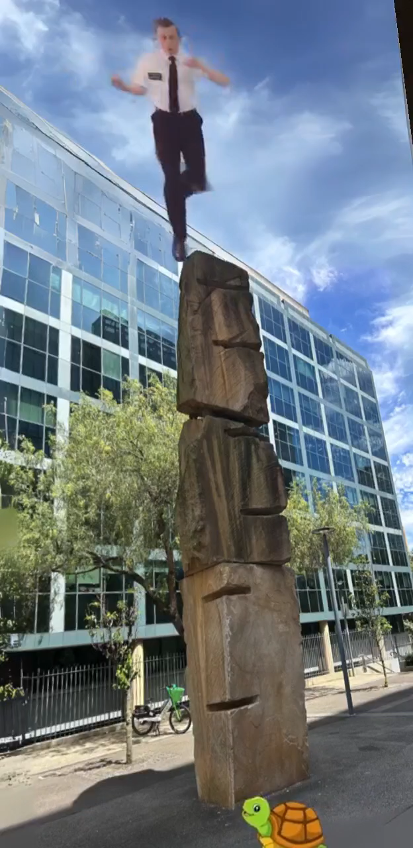
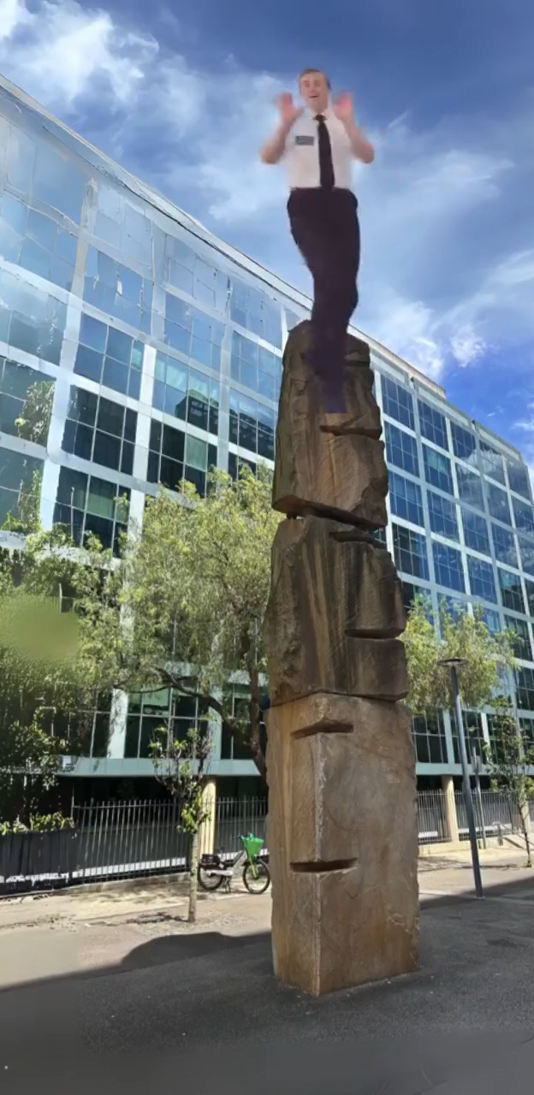

Slide 6
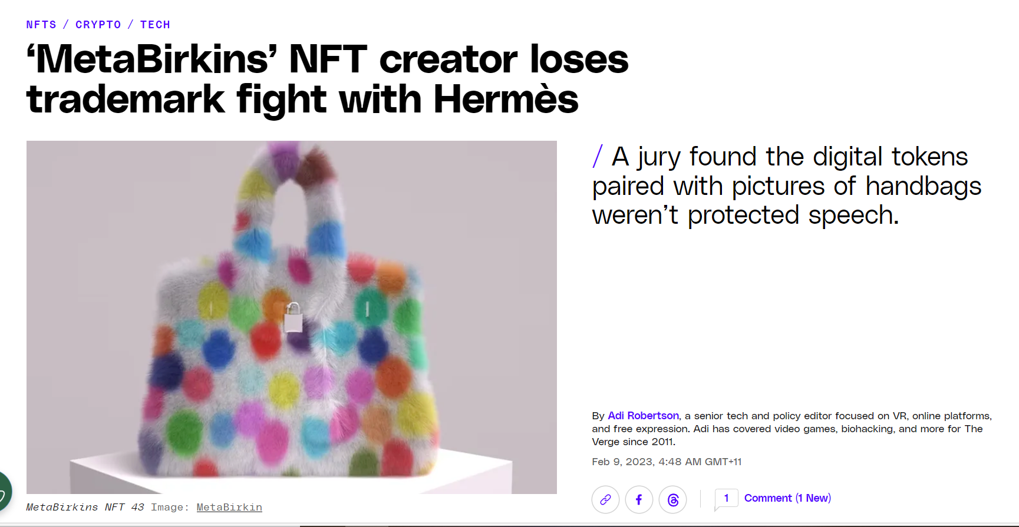
IP and augmented/virtual worlds

Slide 7
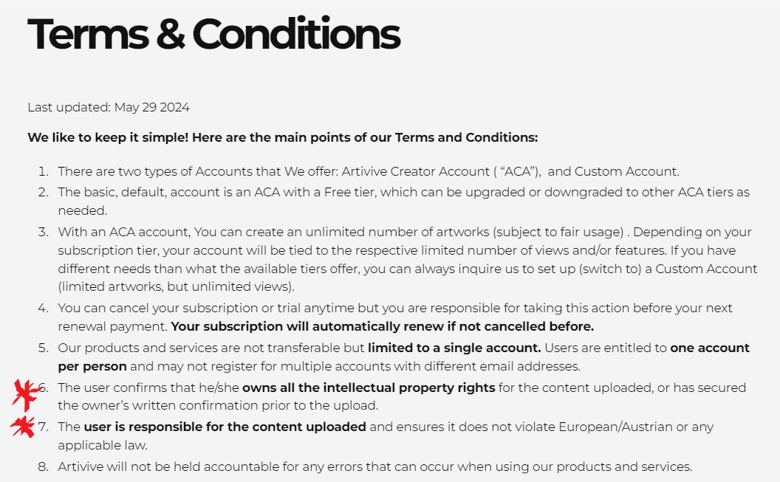
What is the Law?

Slide 8
Moral Rights Cases
Adams v Quasar Management Services Pty Ltd & Ors [2002] QSC 223 (13 August 2002)
Meskenas v ACP Publishing Pty Ltd [2006] FMCA 1136 (14 August 2006)
Boyapati v Rockefeller Management Corporation [2008] FCA 995 (2 July 2008)
Rutter v Brookland Valley Estate Pty Limited [2009] FCA 702 (30 June 2009)
Perez & Ors v Fernandez [2012] FMCA 2 (10 February 2012)
Corby v Allen & Unwin Pty Limited [2013] FCA 370 (24 April 2013)
Tylor v Sevin [2014] FCCA 445 (26 February 2014)
Monte v Fairfax Media Publications Pty Ltd [2015] FCCA 1633 (7 August 2015)
Pocketful of Tunes Pty Ltd v The Commonwealth of Australia (No 2) [2015] ACopyT 2 (22 May 2015)
Briner v The Happy Herb Company & Ors [2017] FCCA 1854 (11 September 2017)
Boomerang Investments Pty Ltd v Padgett (Costs of the Liability Phase) [2021] FCA 385 (21 April 2021)
Sankey v Bollig [2023] FedCFamC2G 227
Hoser v Georges (No 2) [2024] FedCFamC2G 243
Skildum-Reid v University of Queensland [2024] FCA 733
Hoser v Harrison [2024] FedCFamC2G 436

Slide 9
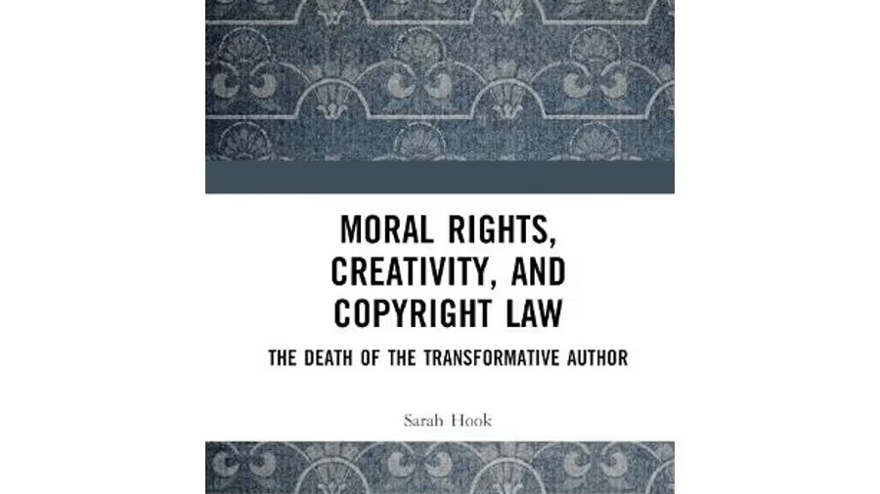

Slide 10

Summary
Artists
Do the public art exceptions apply?
If not – do you hold the copyright ? (what does the commission agreement say about IP?)
Check for moral rights infringements:
Attribution?
False attribution?
Has your honour or reputation been damaged?
Consider: is the likely remedy worth it?
Users
Check if the public art exceptions apply to the object you are working with
proper attribution (if possible)
May be subject to a moral rights claim if objectionable treatment
Consider: is a high profile moral rights infringement worth it?

