Slide 1

Slaves to the Machine:
How artists are talking back to AI
Marie Hadley & Kathy Bowrey

Slide 2

algorithms, the social media hustle & income precarity
Artist’s speak…

Slide 3
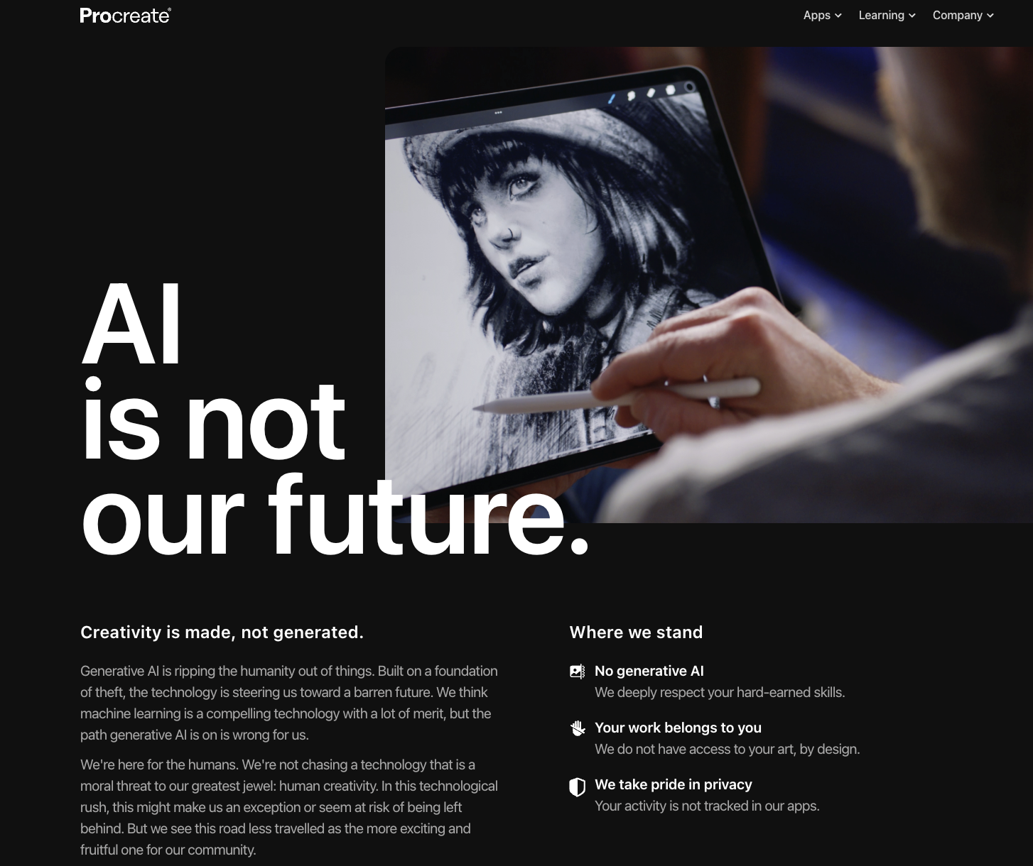
procreate

Slide 4
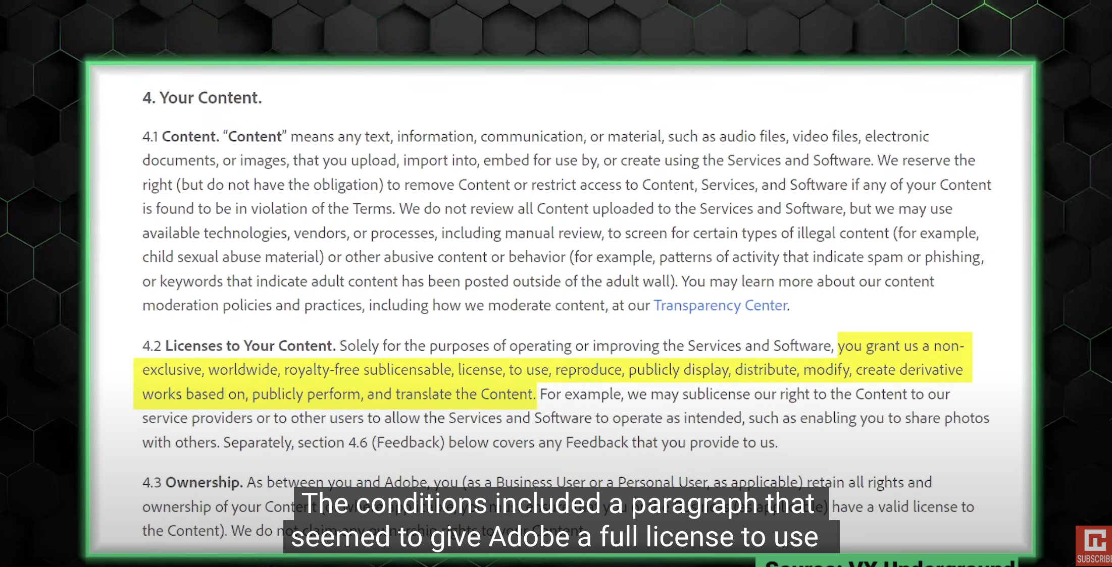
Adobe

Slide 5
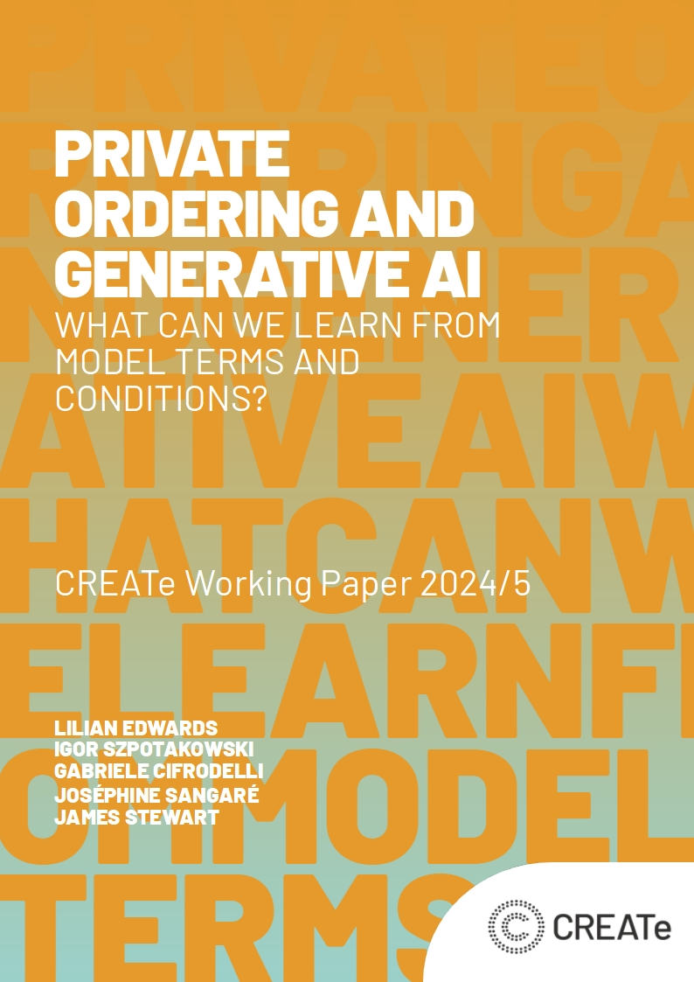
The law
…private ordering remains probably the most significant current form of governance of foundation models.
… In almost every model or service studied, ownership of outputs was assigned to the user, but, in many cases, an extensive license was also granted back to the model for coexisting use of the outputs.
Similarly, in almost every case, risk of copyright infringement in the output work was left, with some decisiveness, with the user.

Slide 6
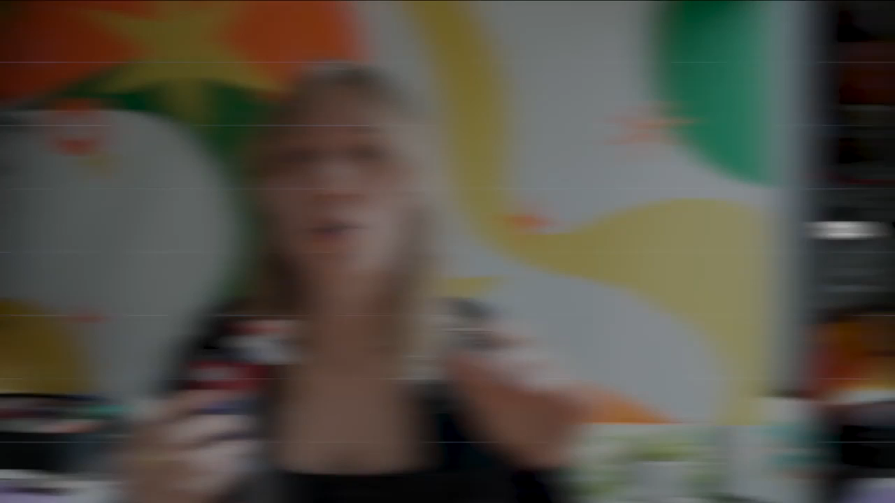
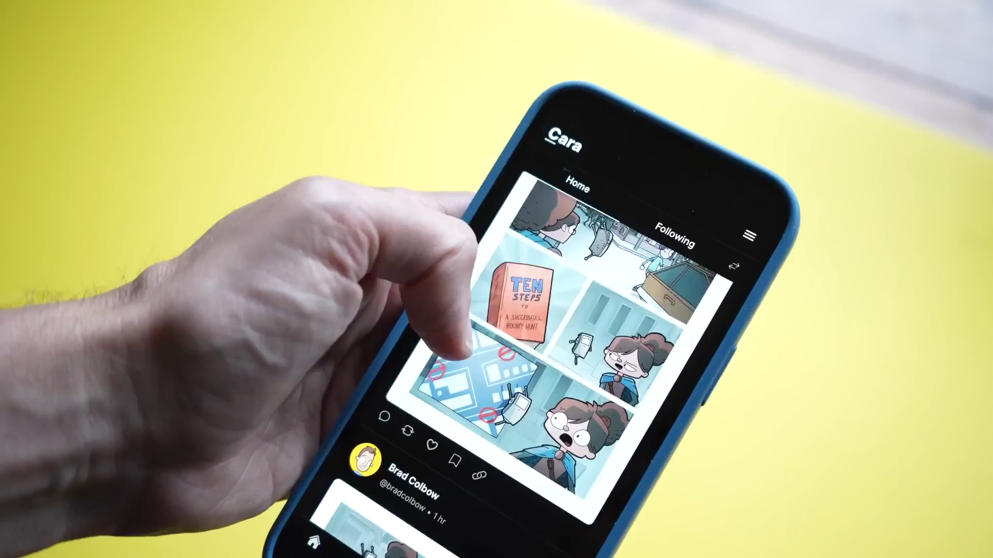
How are artists protecting their art?
Strategic uploads & disruptive technologies
Artist operated apps & community verification
Jackie Droujko:
754K YouTube subscribers; 186 million YouTube views
Brad Colbow:
875K YouTube subscribers; 127 million YouTube views

Slide 7
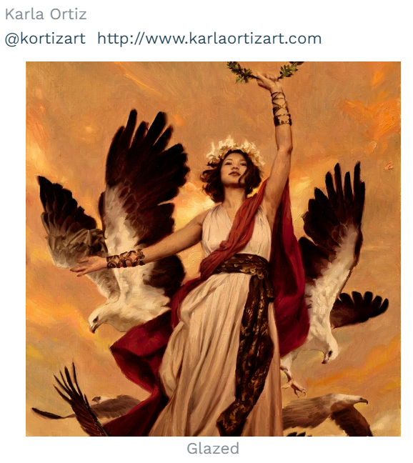
Is Glaze a TPM?
"Unfortunately, Glaze is not a permanent solution against AI mimicry. Systems like Glaze face an inherent challenge of being future-proof (Radiya et al). It is always possible for techniques we use today to be overcome by a future algorithm, possibly rendering previously protected art vulnerable. Thus Glaze is not a panacea, but a necessary first step towards artist-centric protection tools to resist AI mimicry. Our hope is that Glaze and followup projects will provide protection to artists while longer term (legal, regulatory) efforts take hold."

Slide 8
DIGITal constitutionalism enhanced through moral rights?
What is digital constitutionalism?
"looking at rights and powers beyond the boundaries of nation states and expanding the debate on how rights and freedoms are mediated due to the power relocation from states to corporations typical of the digital age".
Giovanni De Gregorio, How does digital constitutionalism reframe the discourse on rights and powers?, Ada Lovelace Institute 7 Dec 2022
COPYRIGHT ACT 1968 - SECT 190
Moral rights conferred on individuals
Only individuals have moral rights.

Slide 9
RIGHT OF INTEGRITY
S195AK right of derogatory treatment of an artistic work
In this Part:
"derogatory treatment”, in relation to an artistic work, means:
(a) the doing, in relation to the work, of anything that results in a material distortion of, the destruction or mutilation of, or a material alteration to, the work that is prejudicial to the author's honour or reputation; or
(b) an exhibition in public of the work that is prejudicial to the author's honour or reputation because of the manner or place in which the exhibition occurs; or
(c) the doing of anything else in relation to the work that is prejudicial to the author's honour or reputation.

Slide 10
INDIGENOUS Communal moral rights Bill 2003
There must be a work in which copyright subsists.
Drawing on the “particular body of traditions, observances, customs or beliefs held in common by the Indigenous community.”
An agreement must be entered into between an Indigenous community and the creator of the work (the copyright holder).
There must be an acknowledgement of the Indigenous community’s association on or with the work

Slide 11
Implementing collective moral rights for groups like Cara
Artistic works that subsist in copyright
Adhering to CARA voluntary codes of practice (eg. Community guidelines)
An agreement must be entered into between an artistic community and the creator of the work (the copyright holder).
There must be an acknowledgement of the artistic community’s association on or with the work

Slide 12
The why questions
Why does it matter who is speaking, and who is heard?
"The coming into being of the notion of the author constitutes a privileged moment of the individualisation in the history of ideas, knowledge, literature, philosophy and the sciences".
  MICHEL FOUCAULT

Slide 13
The case for A MORAL RIGHT OF VERIFICATION
A moral right of verification of human authorship could
  help our conception of humanist authorship evolve in line with the move towards digital constitutionalism;
  support creator advocacy and agency in the context of growing income precarity;
Facilitate carve outs from Big Tech AI surveillance for those that want them;
Interact with TPM protection to support community self defence;
Allow for change over time:
  What is an author could evolve in line with (likely shifting) voluntary community rules around the appropriate use of technology and the openness of artistic works to consumption as data by Big Tech.
Notes:
Thought experiment about where copyright needs to go to retain impact and relevance to the creators it purports to serve.
Artists are not working in negative space but looking to use the limited rights they have. Their practices and inventions do have legal implications, Law could and should do more to help support these aspirations.

Slide 14
Questions? Comments?
k.bowrey@unsw.edu.au
marie.hadley@newcastle.edu.au

