Slide 1
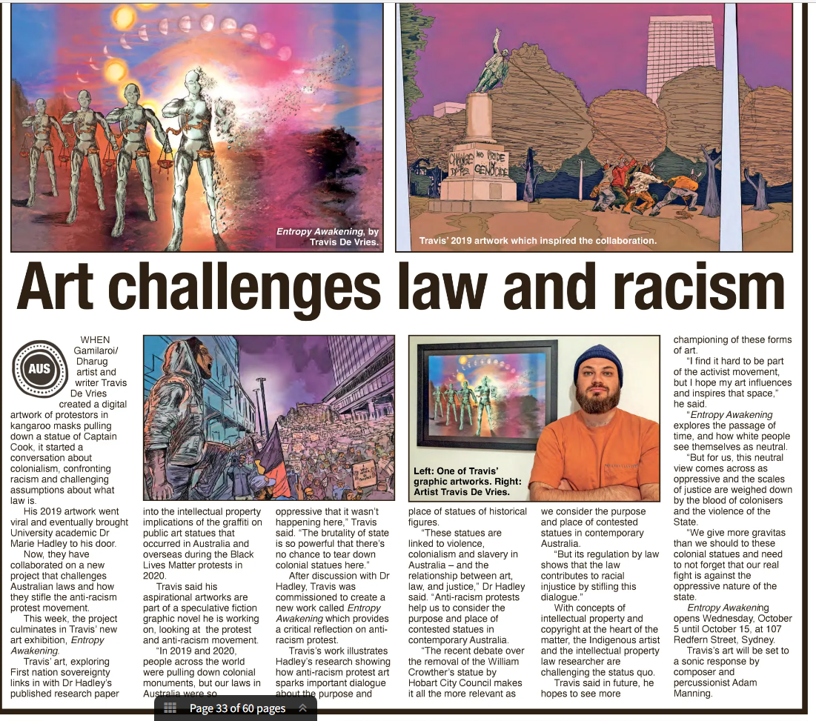
The power and impact of artist-academic collaborations
Marie Hadley
School of Law and Justice, University of Newcastle, Australia
@drmarieip.bsky.social

Slide 2
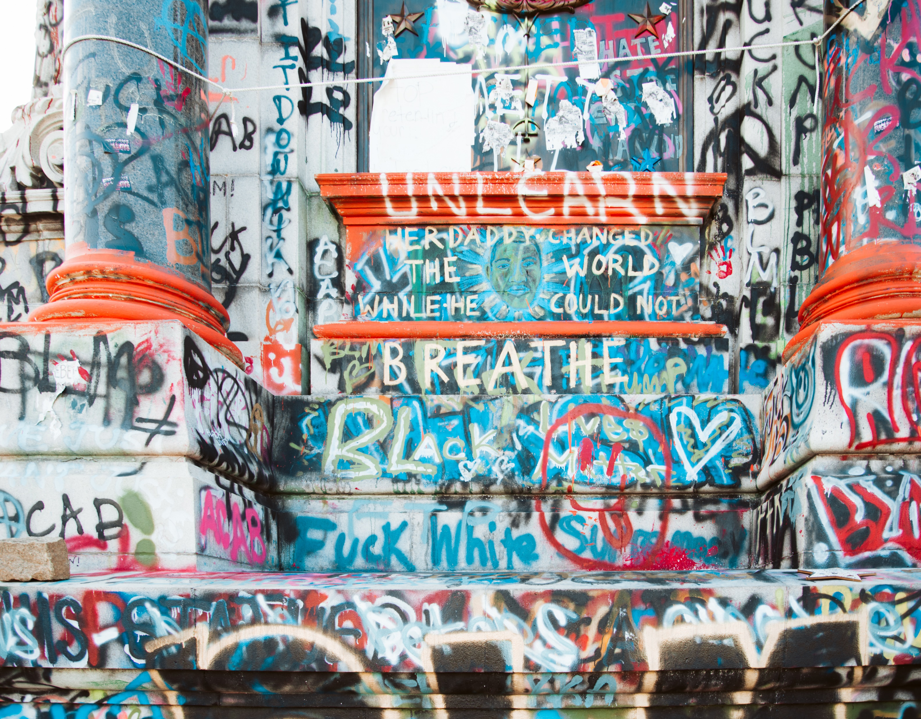
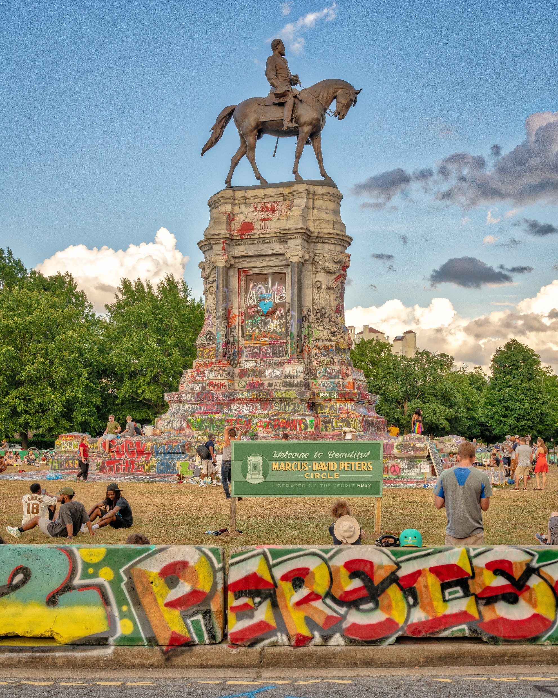
BLM-019 2020 © i threw a guitar at him. CC BY 2.0 License via Wikimedia Commons
RVA 2020 2020 © Mobilus In Mobili. CC BY-SA 2.0 License via Wikimedia Commons

Slide 3
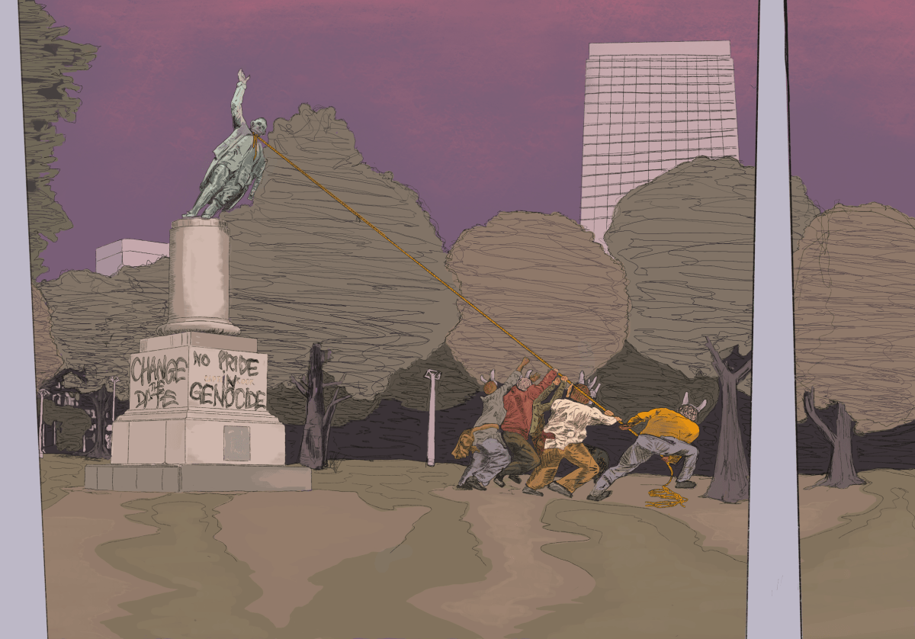
Tear it Down (Cook Falling), Travis De Vries (2019)

Slide 4
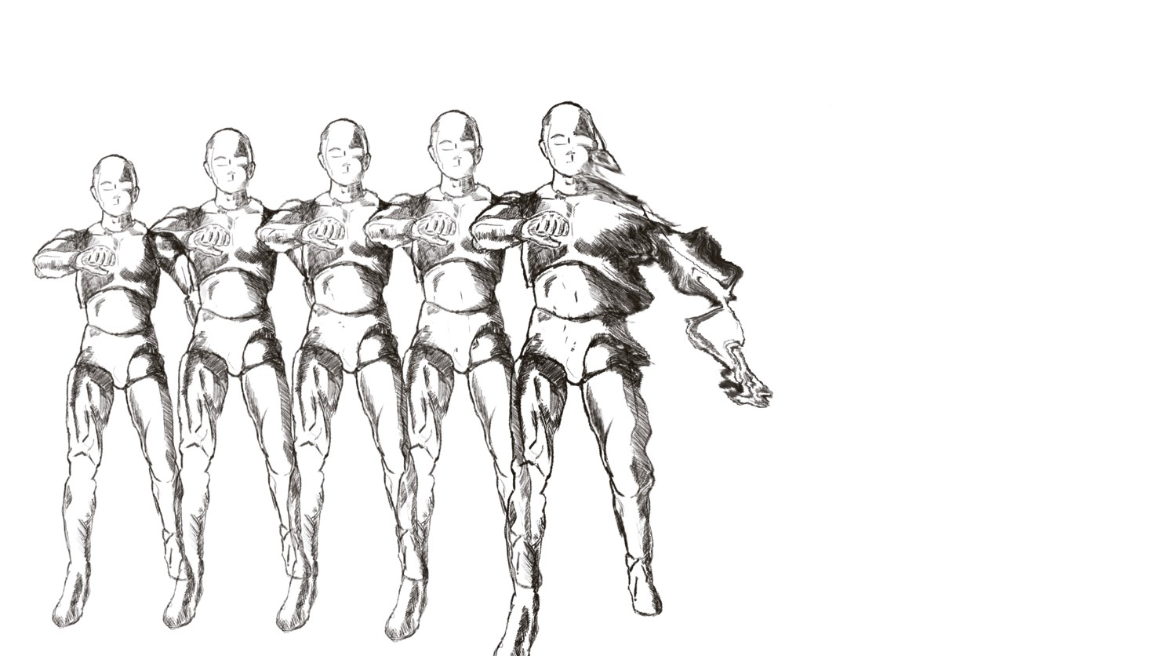

Slide 5
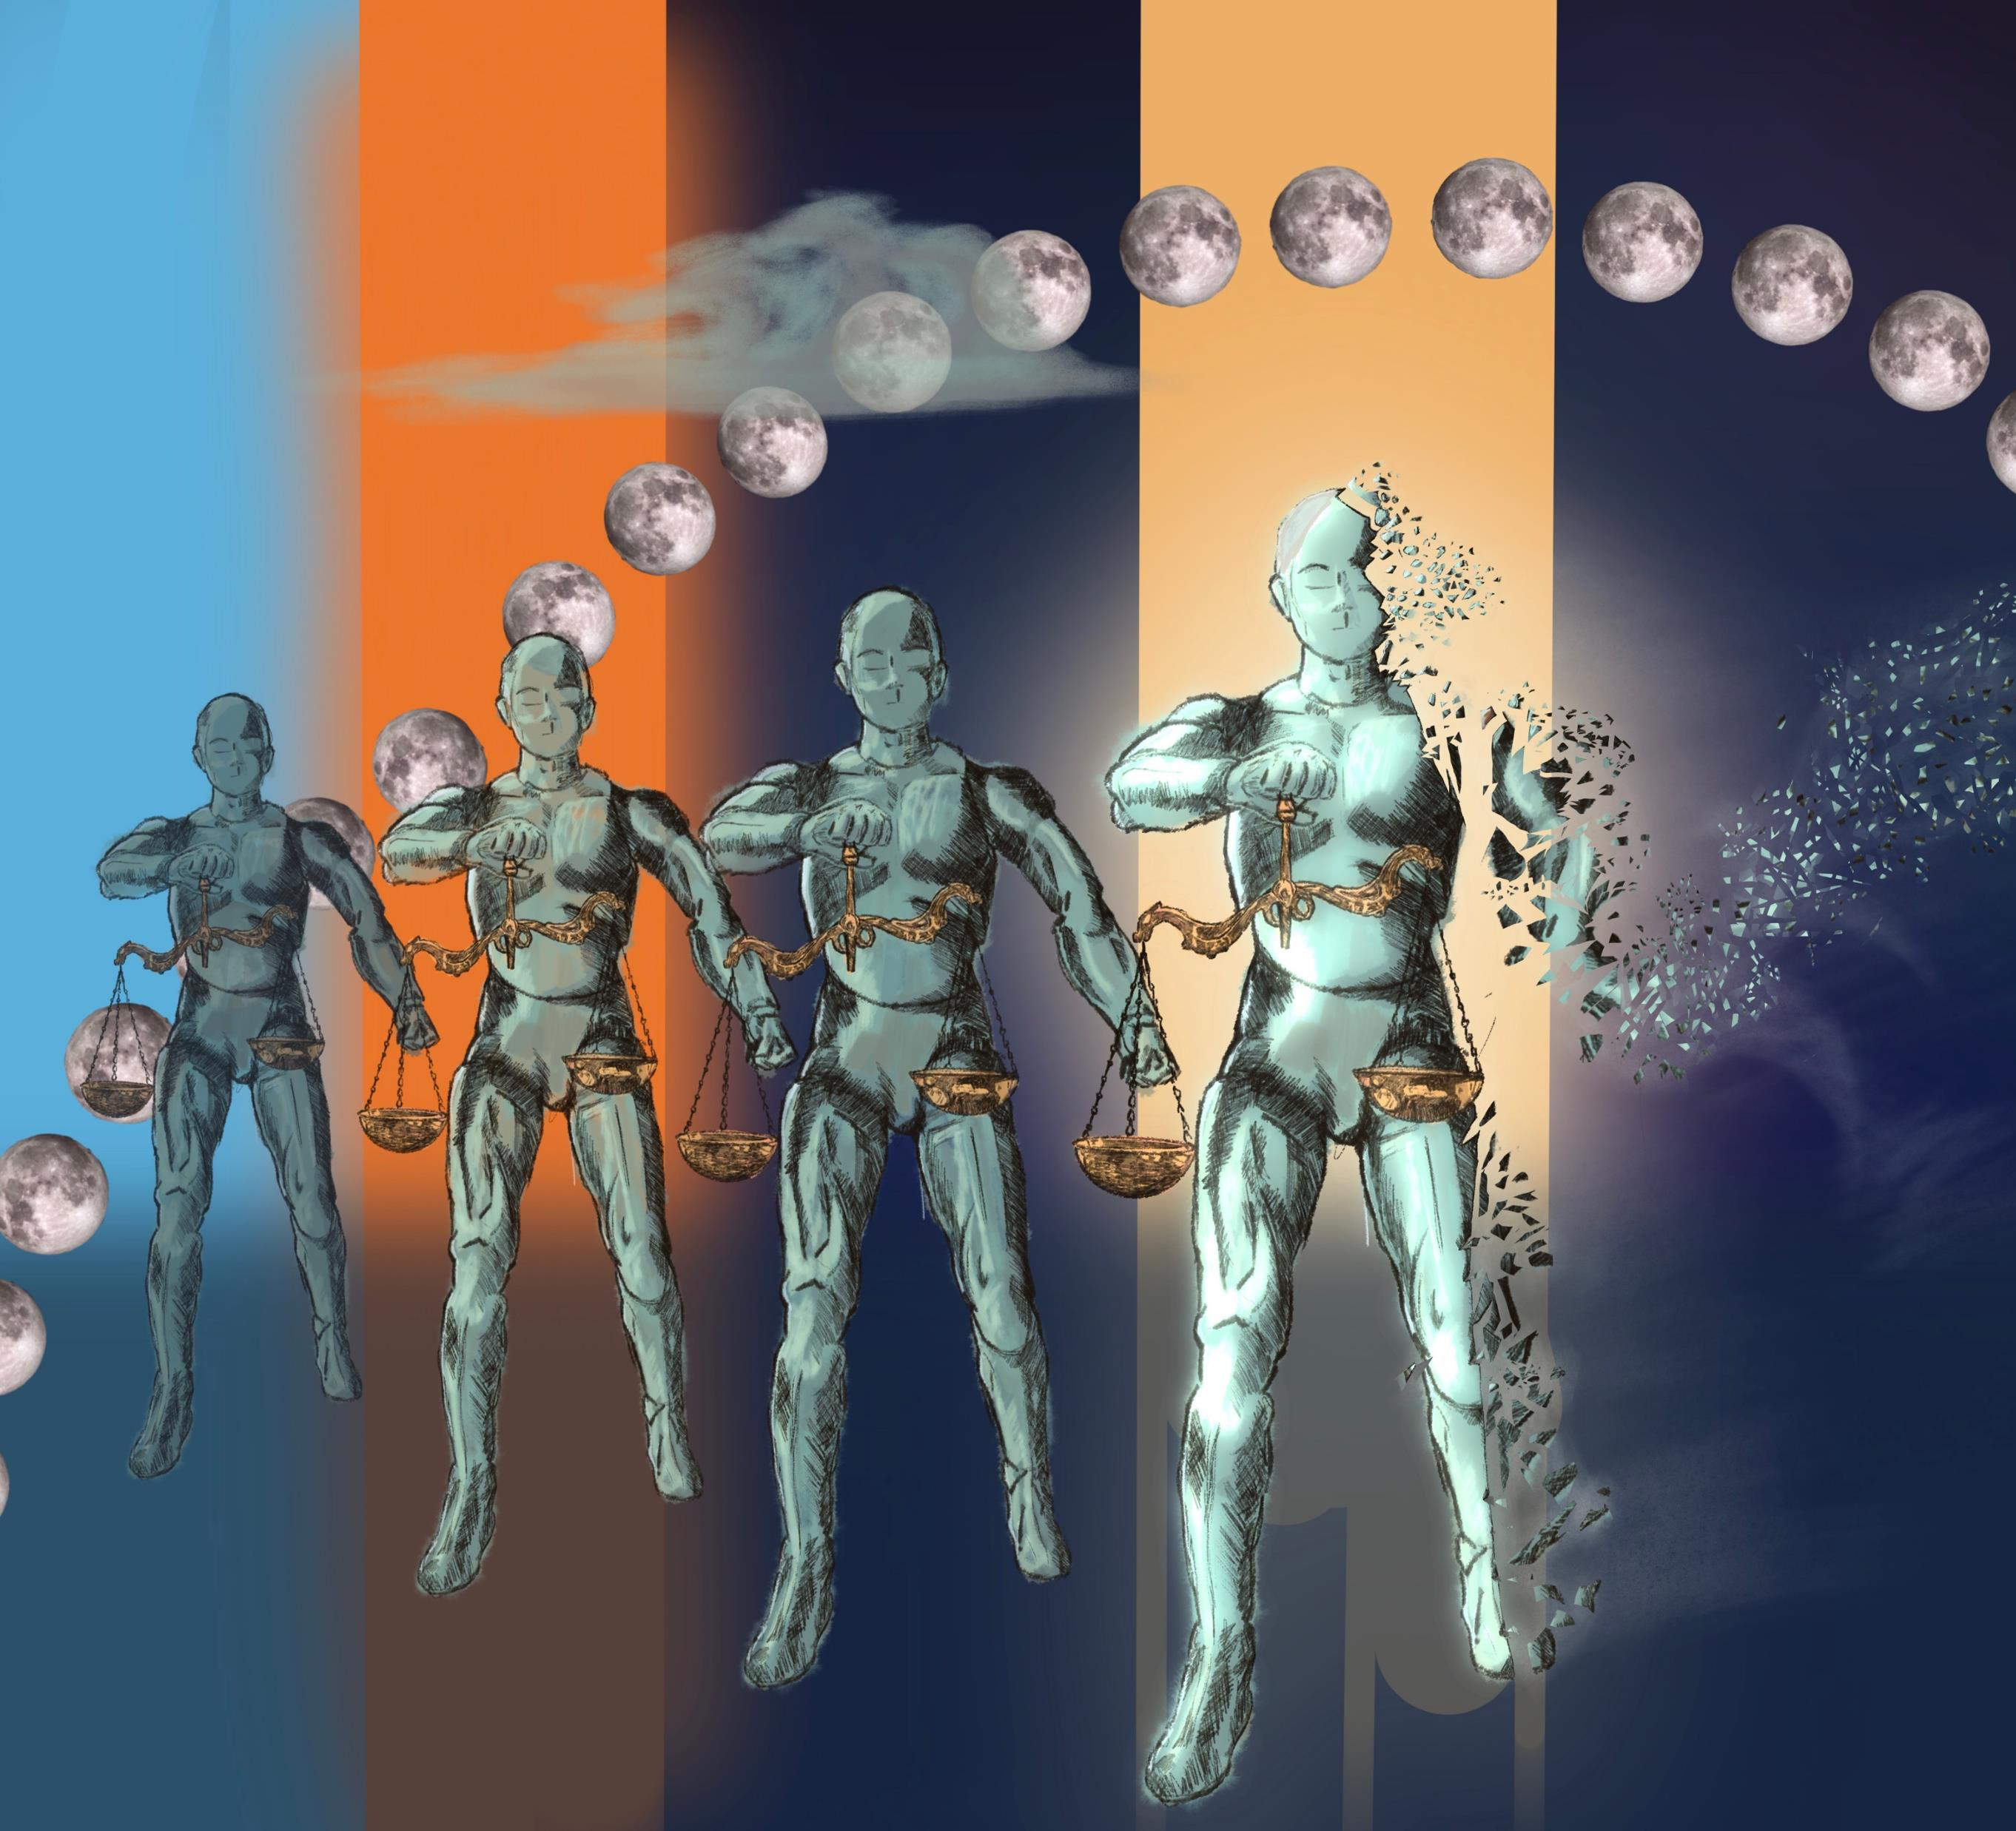
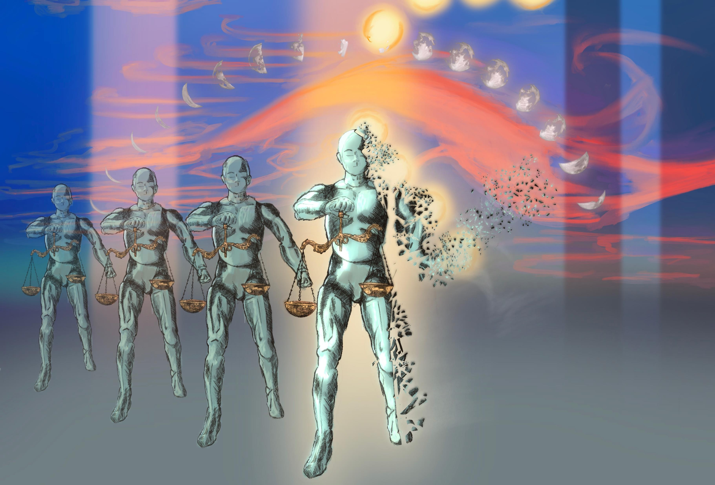

Slide 6
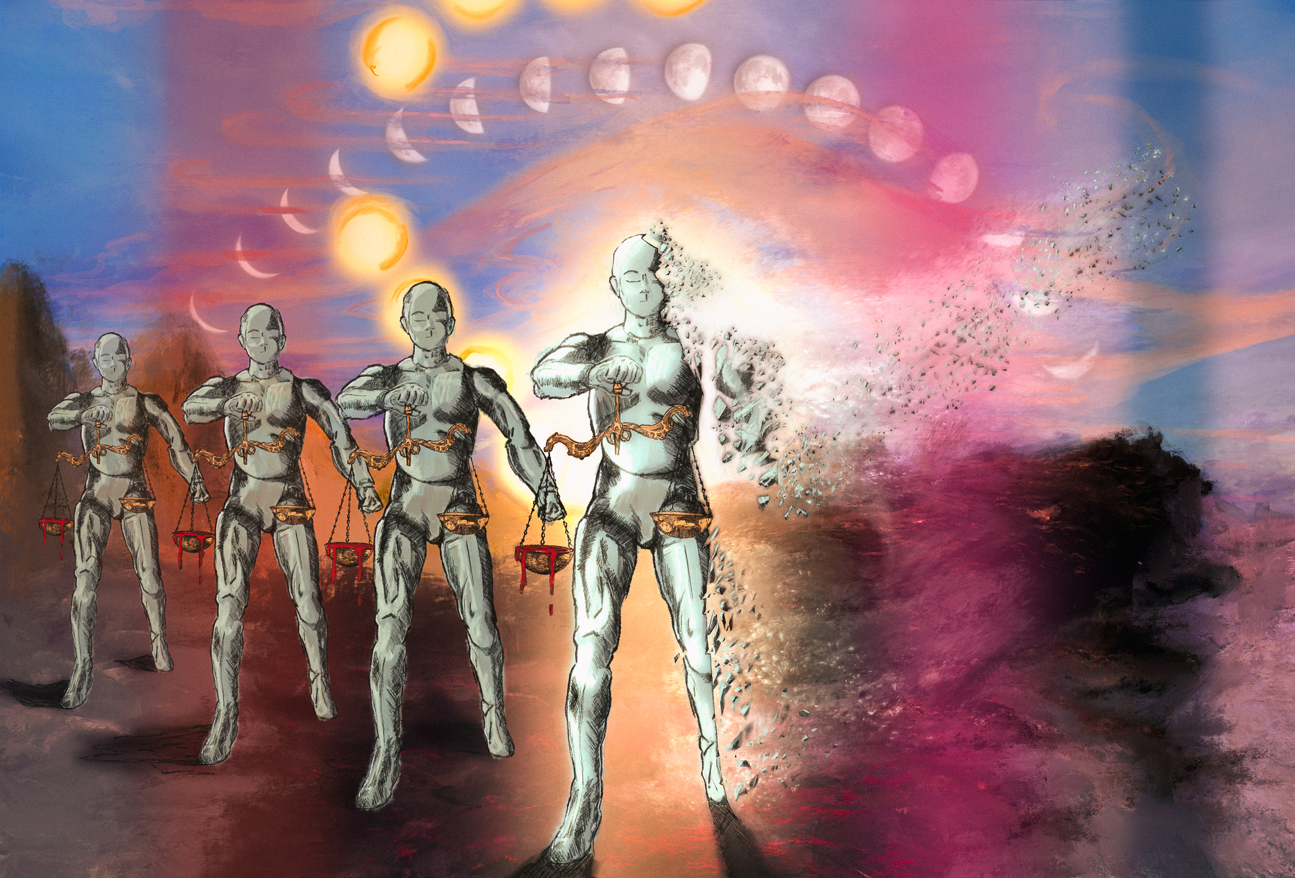
Entropy Awakening, Travis De Vries (2022)

Slide 7
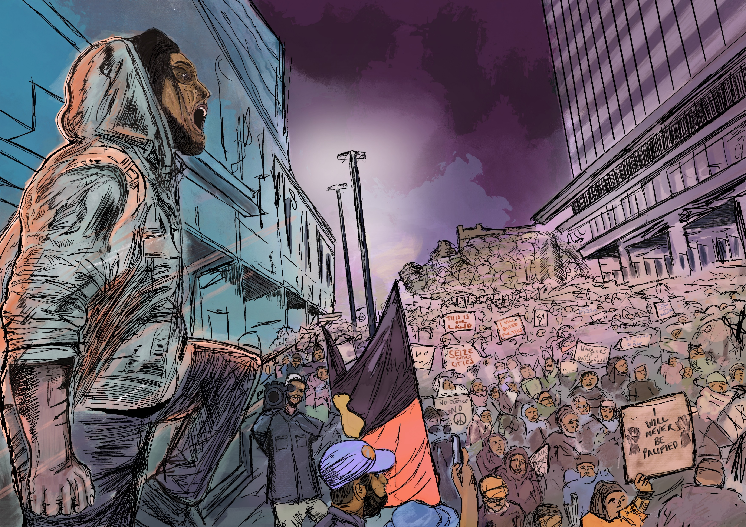
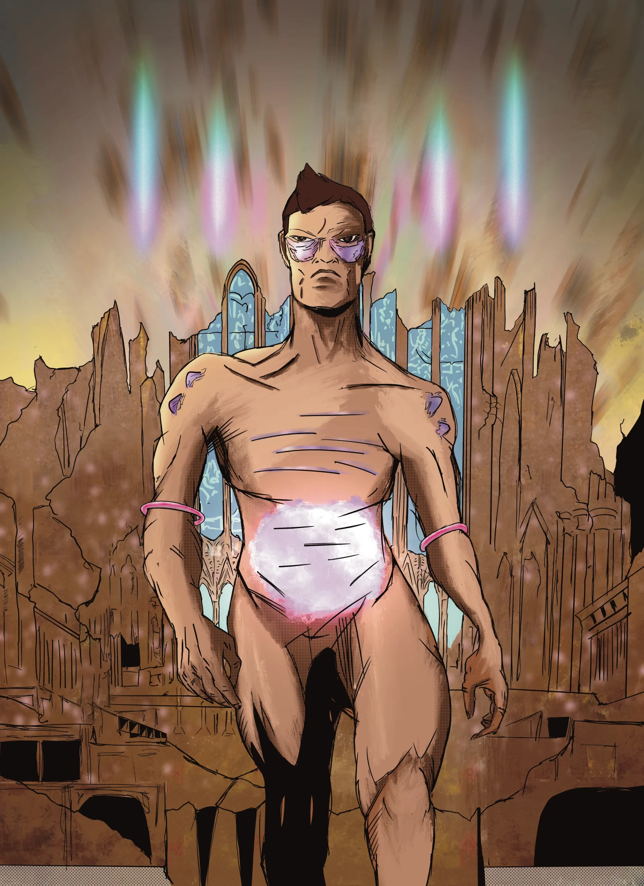
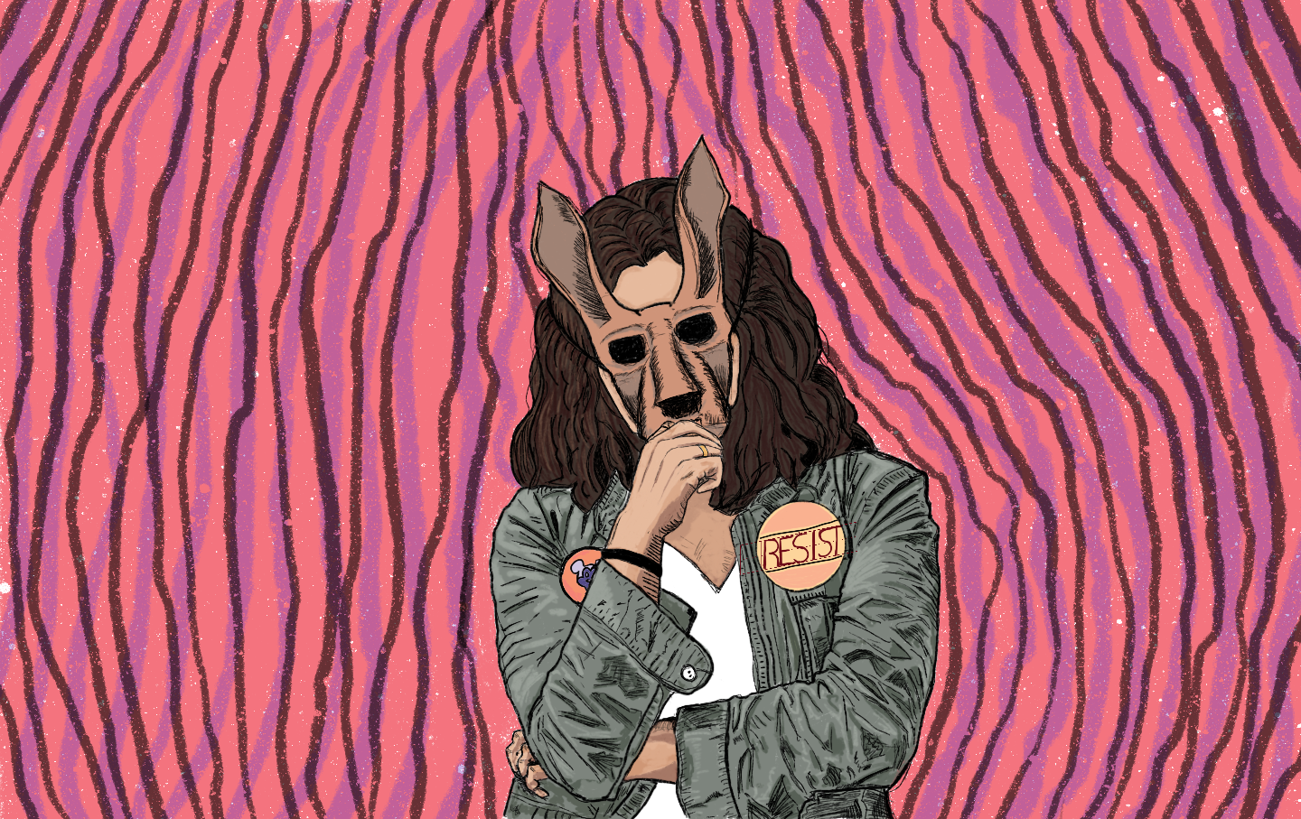
Uprising
Resist
Agent of Revenge

Slide 8
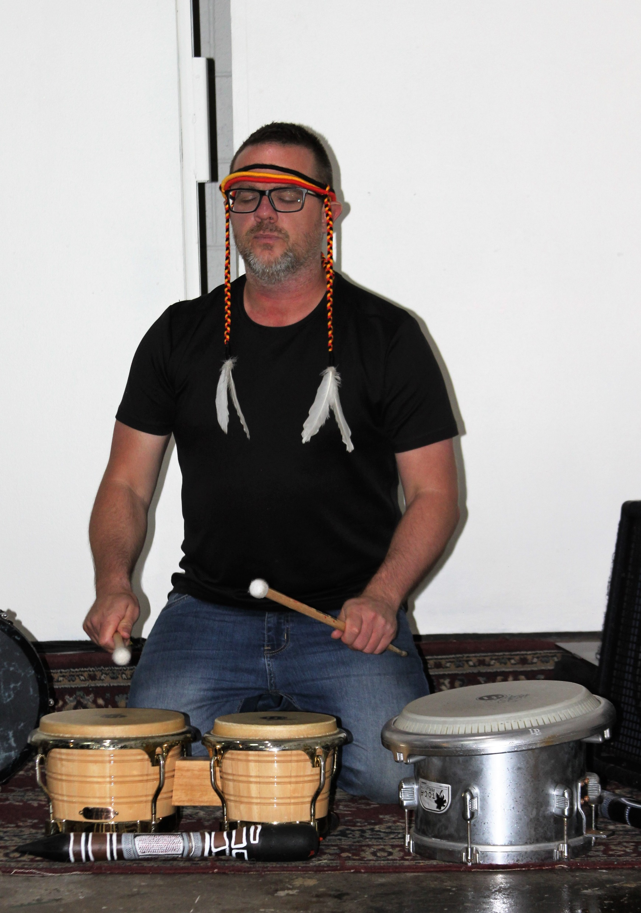


Slide 9
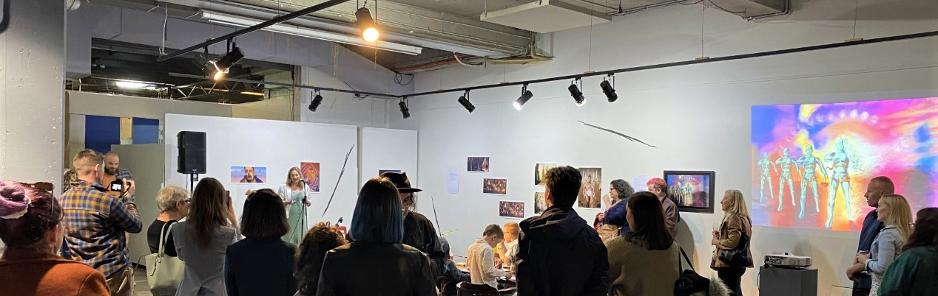
‘How did it make me feel? I was feeling kind of intrigued and somewhat curious. I didn't walk away feeling uncomfortable, sad. No. It was a powerful presentation. It certainly like stuck with me ... Music was good. I liked having music. I liked hearing what Travis had to say ... I liked the students being there. That was lovely… That's always nice to see young, interested people and knowing that they're gonna be lawyers too, made me think, ‘oh, these people will remember’. I'm sure it has had, will have had an impact on them. … I don’t think you could go there and be part of this without recognising that it had multiple layers in it. Hmm… it opened up my mind as to like, what do you do? What, what do you do with this?

Slide 10
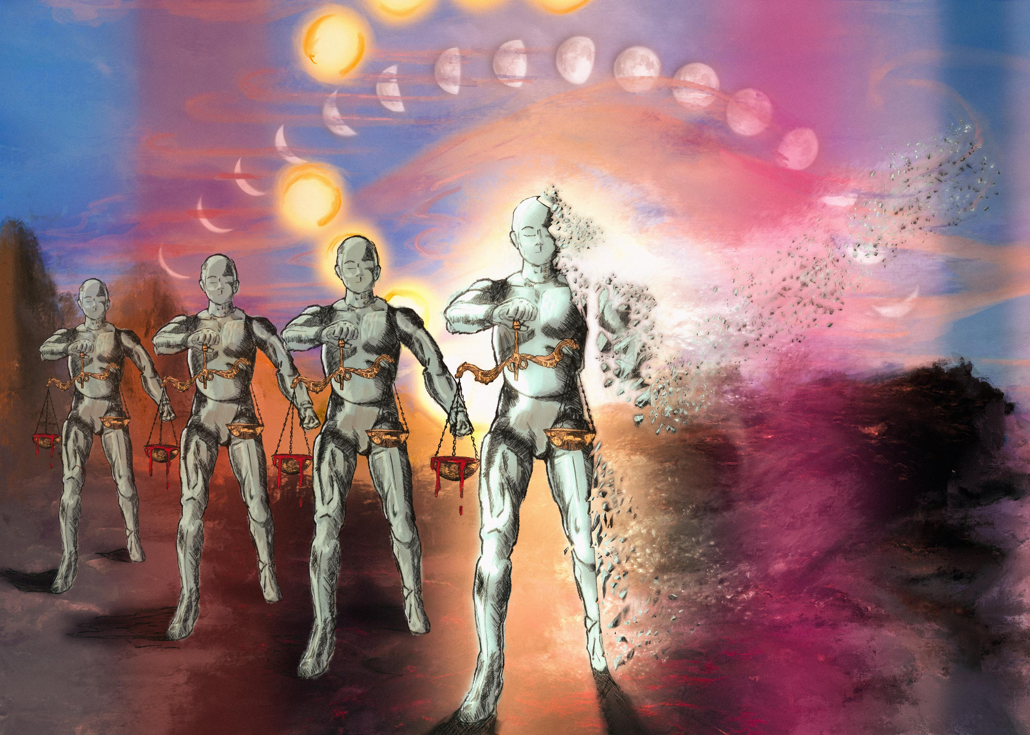
‘well you got, you know, Lady Justice, but it's a robot, so I was like, ‘Okay, so it's a mechanical justice, you know, there's bloody tipped scales. You, obviously something's not right there’. So I was like, ‘okay. It's mechanical justice. Isn't feeling anymore. It's just a robot. It's there to serve a purpose and because it doesn't have any feeling anymore, it is now actually doing more damage than good.’ … So, what's the context of that? Cause that's quite a bold statement on the justice system…. There's no ethics and morals in machines. So if Justice is a machine, what does that say?’

Slide 11
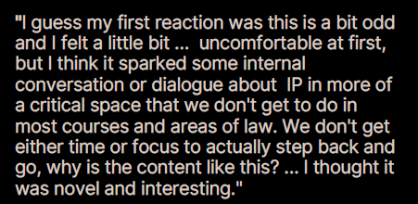
‘I didn’t expect this to be a successful learning activity. The presentation of it in our coursework, I kind of, my first reaction was, “Oh, here we go again. Uh, is this worth considering? Am I gonna be examined on this?” And then after looking at the questions a bit and having a quick read of the … text alongside it, after that context I guess. And then, and then, “ah, okay, we should stop and have a think about this.” And then, yeah, I think the learning activity did what it was supposed to do: prompt thought.’
‘I liked it … but initially I was like, ‘Okay, I've, this is my fifth year of law now’. Usually it's very like, ‘Here's the legislation, here's the case law. Piece 'em together, work it out’. … So I was like, ‘I have to speak about what I think, like this is crazy’.

Slide 12
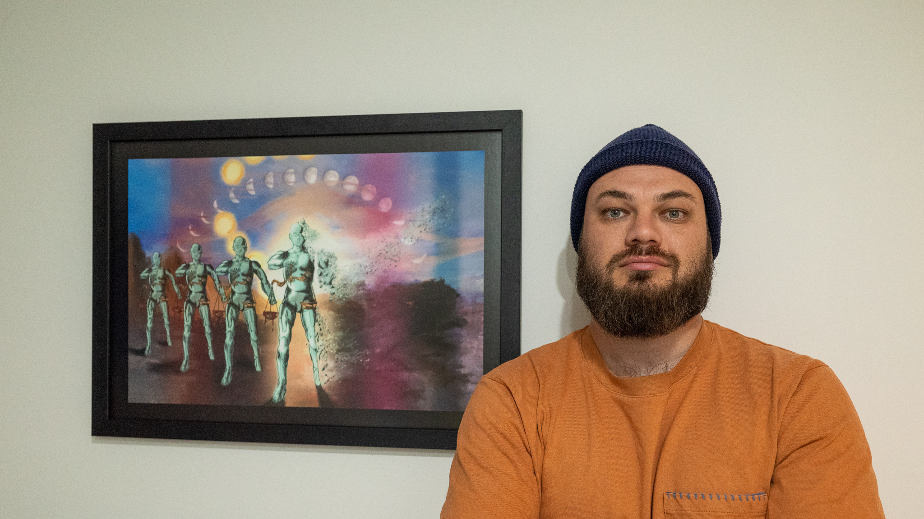
Where to from here?
Photograph by Jade Goodwin

Slide 13
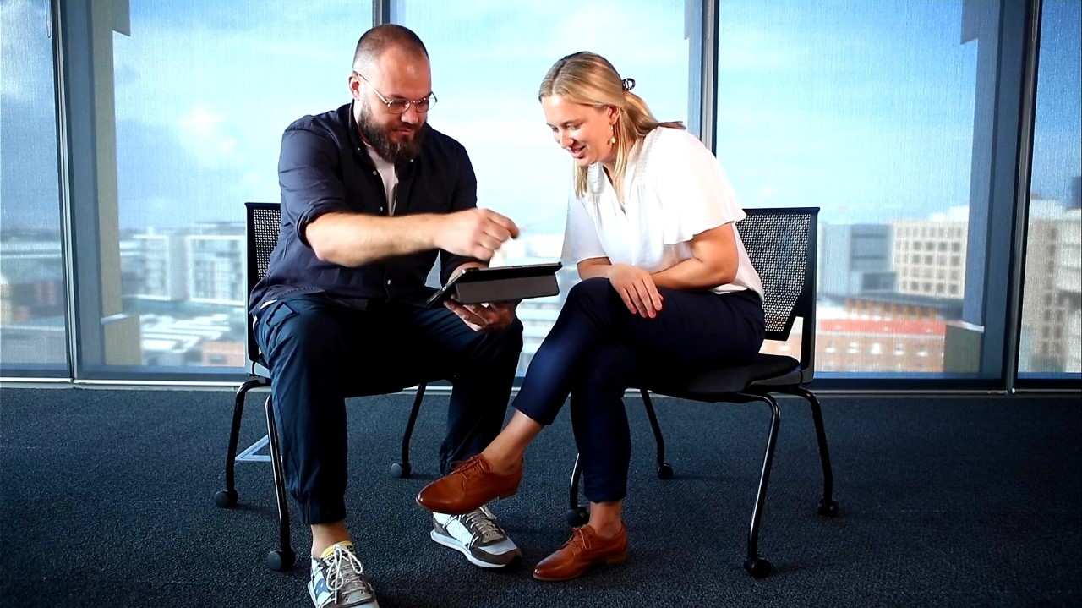
Marie Hadley & Travis De Vries, ‘Entropy Awakening or Tear it Down? A conversation about contested statues’ forthcoming in Law and Humanities (2025)
Marie Hadley & Travis De Vries, 'Teaching Critical Thinking about Intellectual Property Law and Justice through Art’, forthcoming in Indigenising Teaching, Learning, and the Student Experience (Open Education Resources Collective) (2025)
Marie Hadley, Sarah Hook, Nikolas Orr, 'Ideological Vandalism of Public Statues: Copyright, the Moral Right of Integrity and Racial Justice', Griffith Journal of Law and Human Dignity, 9 (2022)
Any questions? I’d love to hear from you.
Contact me:
E: marie.hadley@newcastle.edu.au
Bluesky: @drmarieip.bsky.social

