Slide 1
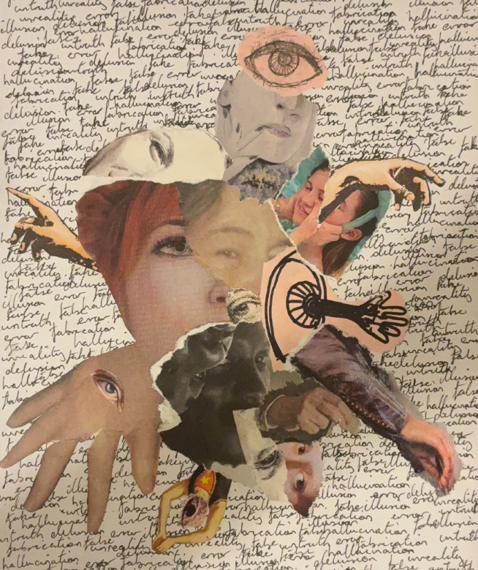
Creative Assessment as a Site of Reflective Practice in Legal Education
Marie Hadley (UoN); Sarah Hook (UTS); Sheridan Clark (UoN)
Creative assignment, Rhys Burke

Slide 2
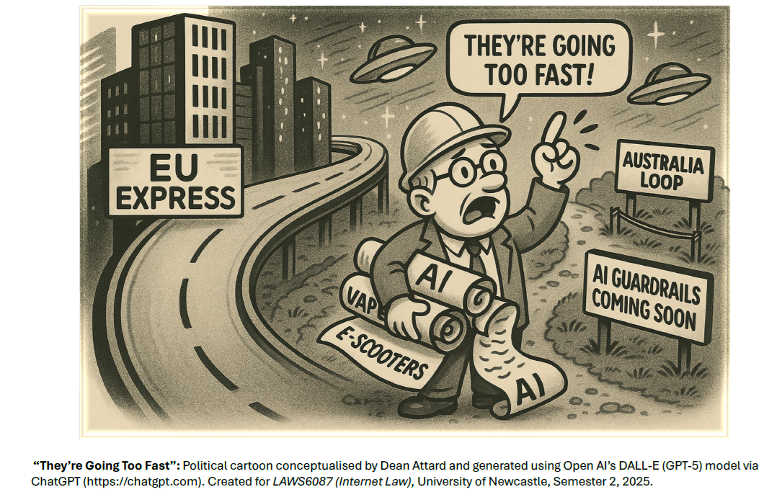
the challenge
How can we design an assessment suitable for an asynchronous learning environment, to support critical thinking about the relationship between law, technology and society, among a diverse cohort of law and non-law students?
Creative assignment, Dean Attard

Slide 3
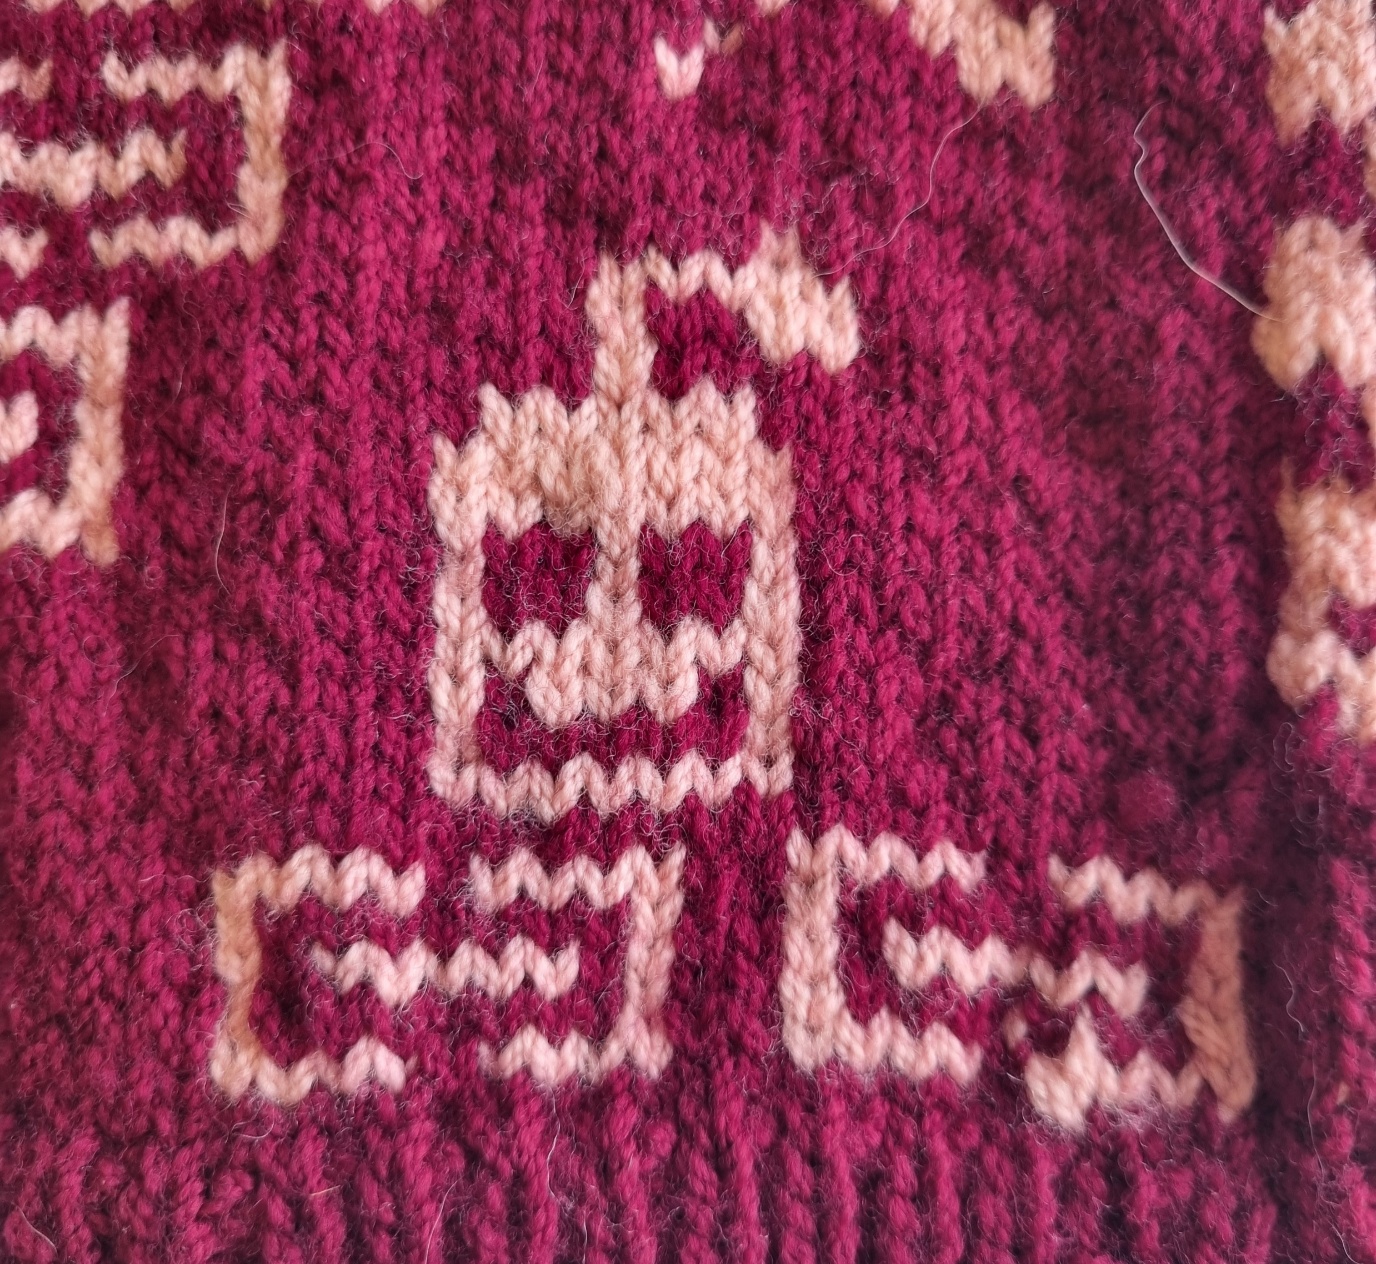

Assessment design
Intellectual Property Law (WSU; 2024) & Internet law (UoN; 2024; 2025).
Creative output + reflection
Any format
Suitable for inclusion in an online educational zine (or multisensory exhibition)
Assessment criteria:
    Creativity, Originality, and Critical Thought
    Knowledge, Accuracy, and Understanding of Legal information
    Target Audience
    Presentation Quality and Attention to Detail
Creative Assignment, Alanna Ryan

Slide 4
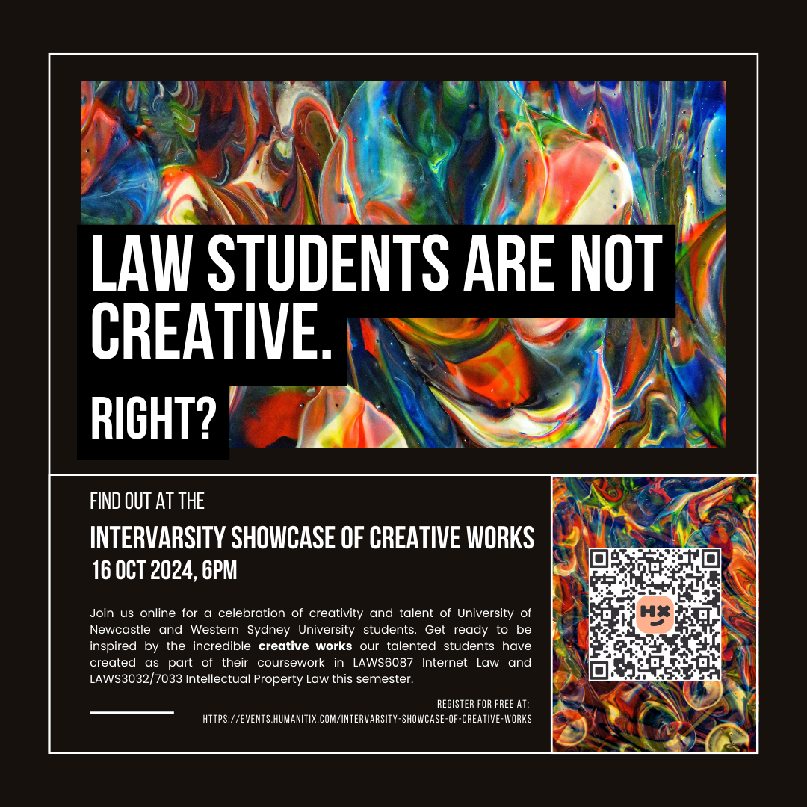
What did we do?
Year 1 (UoN & WSU)
Set a creative assignment: output & reflection
Held an Intervarsity showcase
Curated a flipbook of student works
Ran a competition (incl a public vote)
Year 2 (UoN)
Flipbook used as exemplar bank
Year 3 (UoN & UTS?)
Currently in discussions – another intervarsity event?

Slide 5
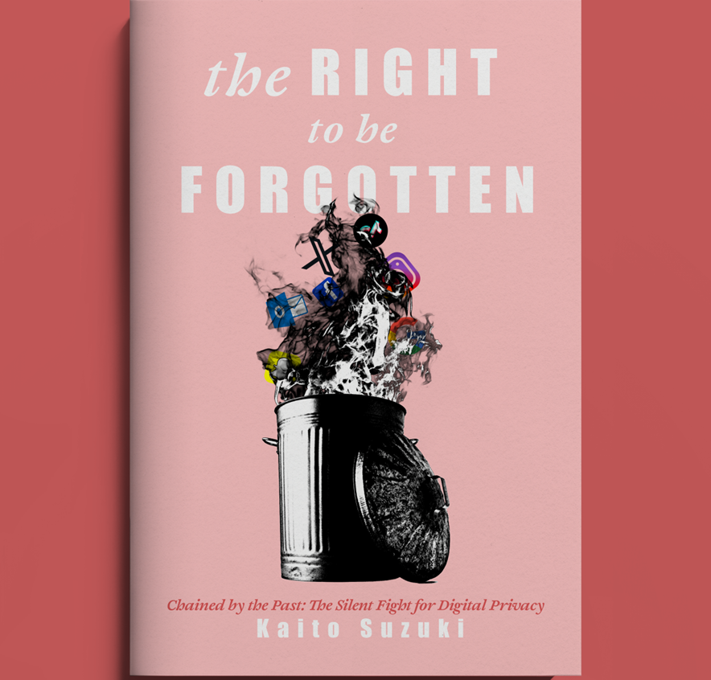
Research design
  Creative outputs
  Student experience data
    Survey (2024 UoN & WSU; 2025 UoN)
    Semi-structured interviews (2025 UoN)
  Audience experience data
    Interviews with members of the public who attended the Showcase (2024)
  Marker experience data (2024; 2025)
    Individual and collaborative reflections
    Written and audio (3+ hours)
    General marking feedback given to cohorts
Creative assignment, Kaito Suzuki

Slide 6
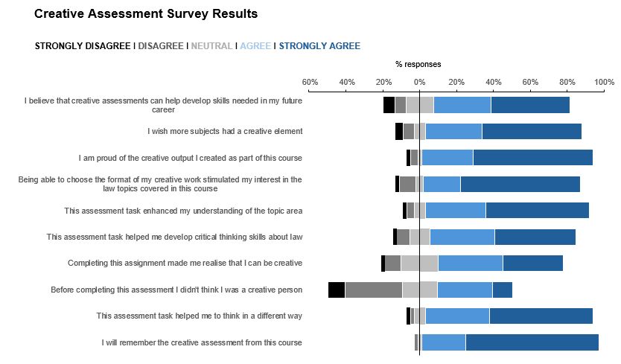
student experience: A Snapshot

Slide 7


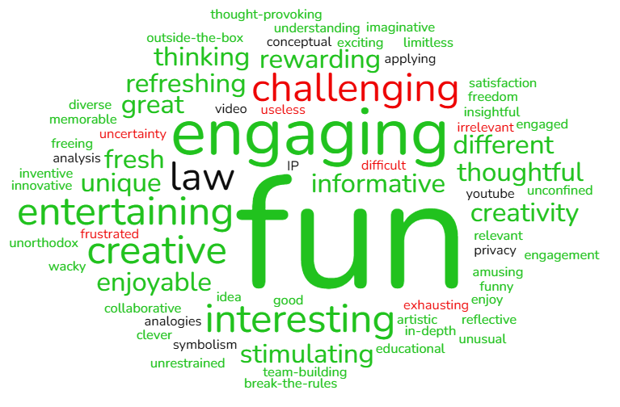
Creative assignment, Ellie Jones
Q: What did you like about the assessment?
freedom, flexibility, creativity, choice, brainstorming
fun, exciting, enjoyable
helped, encouraged, sparked
different, out of the box, difficult
Q: What words come to mind when you think about the creative assessment task you completed?

Slide 8
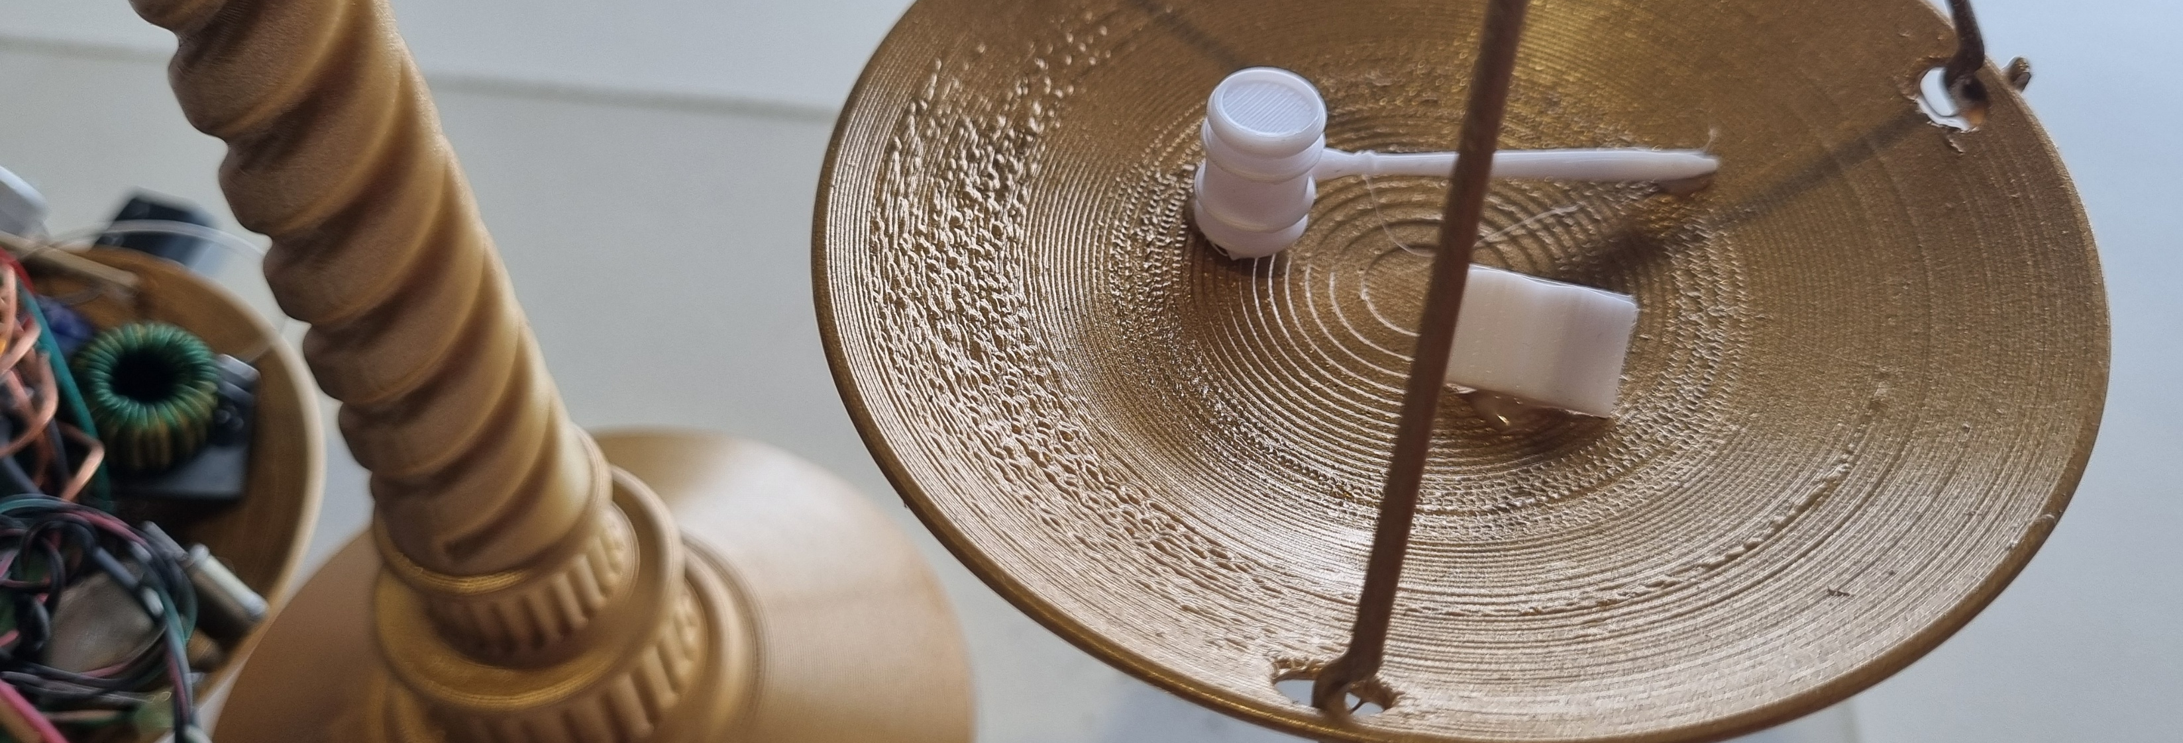

Interview insights
Creative assignment, Ella Bailey and Courtney Linton-Hall
‘I was like, how long does it have to be? Like, what, what could I even do? Like, I think because creativity is so discouraged within, like, all the law subjects, it took me a while to remember that I could be creative in a way, which I find interesting.’

Slide 9
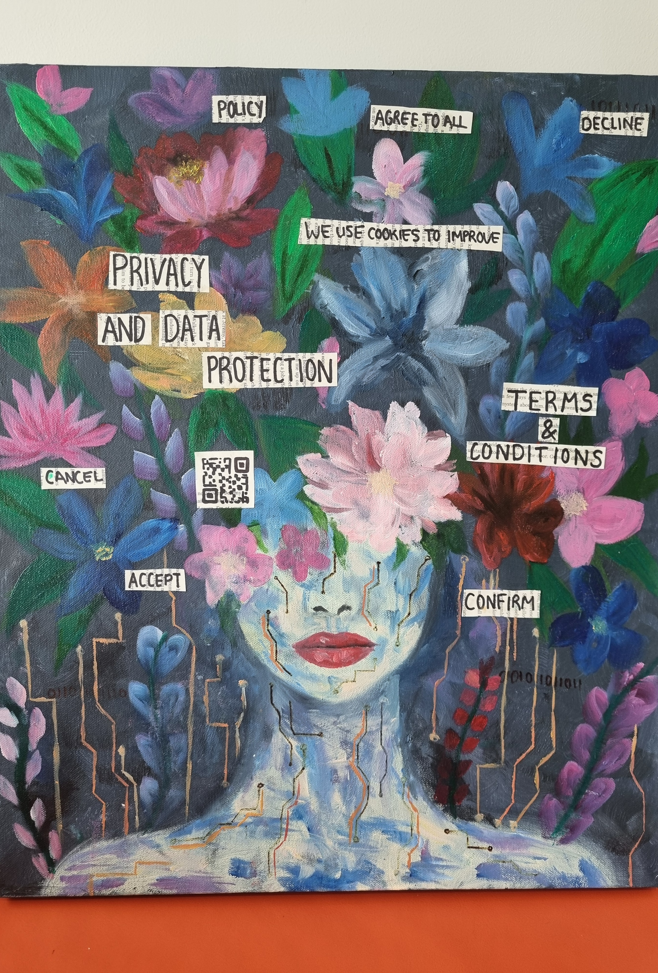

How was it to mark?
‘Those students that were enjoying what they were doing or liking learning new things fell down a bit of a rabbit hole.’
‘It was emotionally difficult to mark. I knew when I was marking what mark range the student should be falling into, but applying the criteria was exceptionally difficult.’
‘It was my favourite assessment I've ever marked.’
‘I’ve never had so much fun looking at student assignments.’
Creative assignment, Brodie Horn

Slide 10
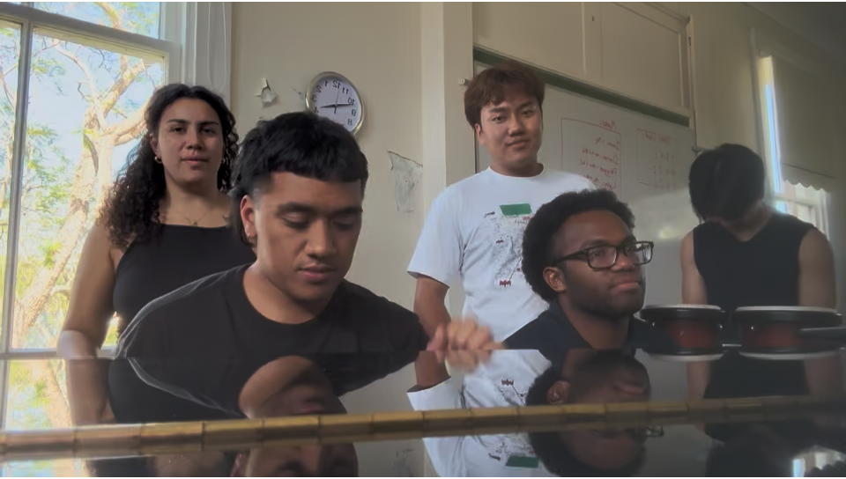
Closing remarks
Creative assignment, Eleora Tawake
‘When Will the Internet Forget?’ Performed by Eleora Tawake, Elihon Taulapapa, Charles Waqa, Muan Piang, Emmanuel Wiri
https://youtu.be/RRSB6IDonlg

Slide 11
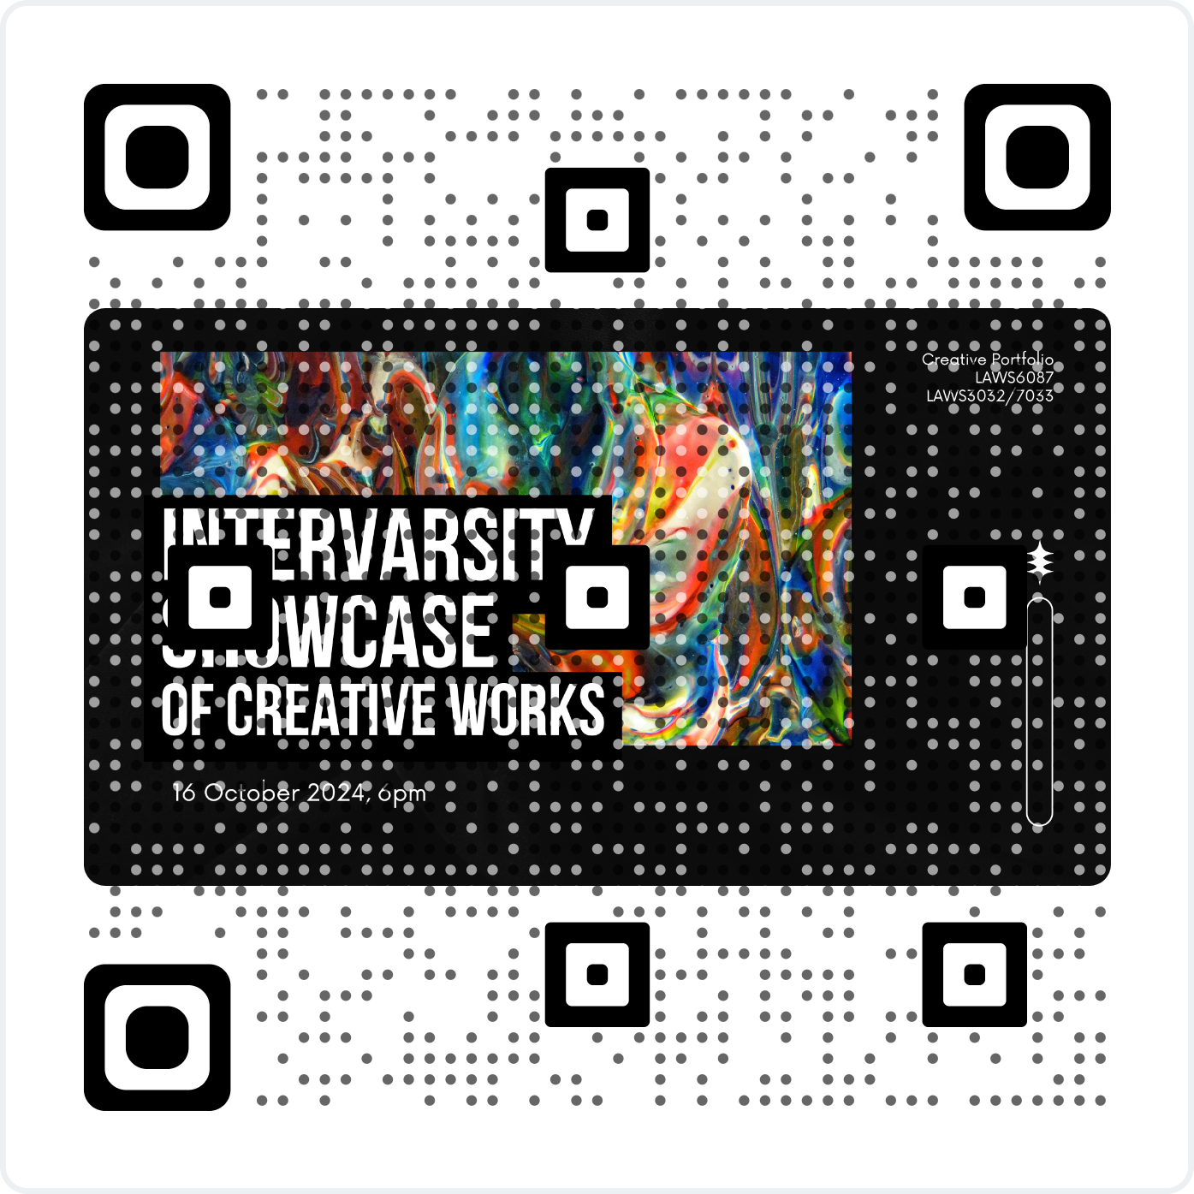
Any questions?
Flipbook: access via QR code
Project webpage & assessment materials available at: https://mariehadley.com/projects/
We would love to hear from you if you are planning to set a creative assessment task in semester 2 this year. Please do reach out: marie.hadley@newcastle.edu.au

