Slide 1
Navigating grey lines
Co-producing knowledge across disciplines and boundaries
Dr Marie Hadley, School of Law and Justice, University of Newcastle, Australia
Dr Adam McDade, @adammcdadeillustration

Slide 2
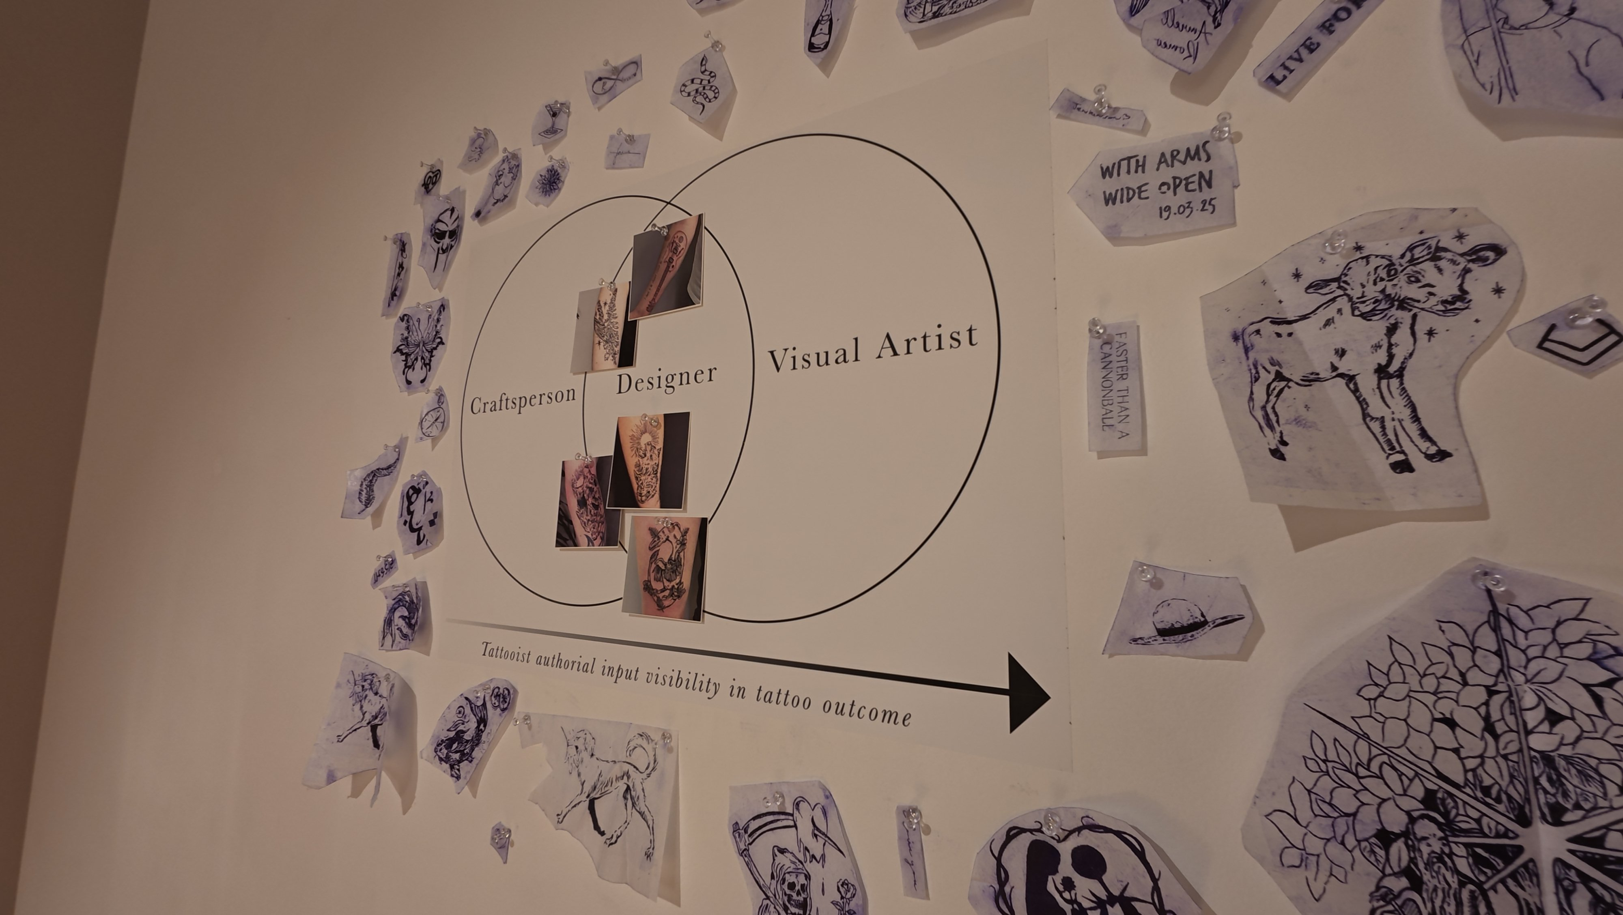
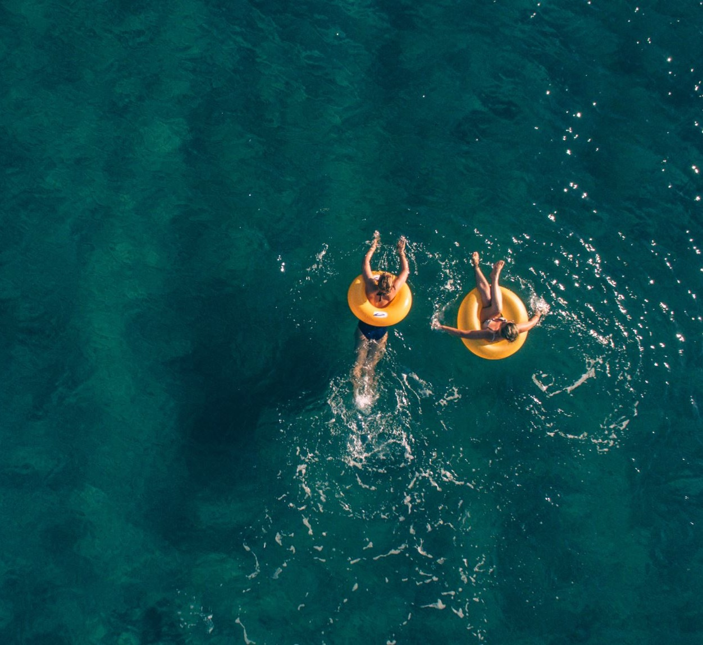
a tattoo + law project

Slide 3
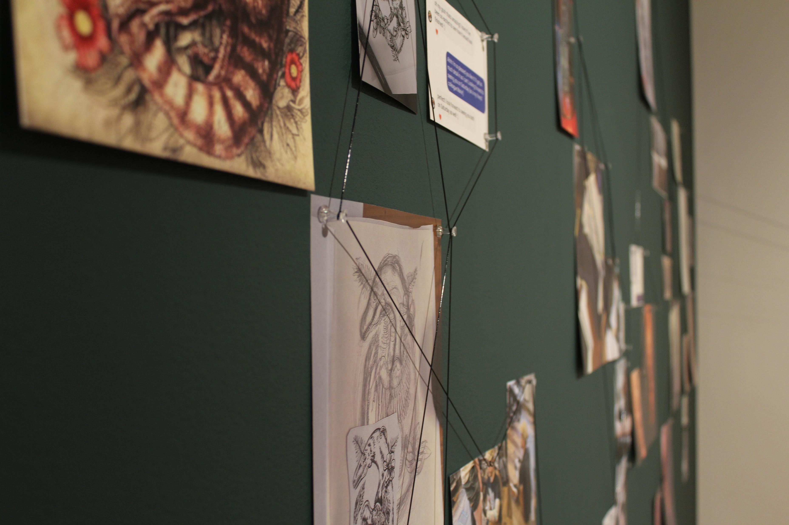

Slide 4
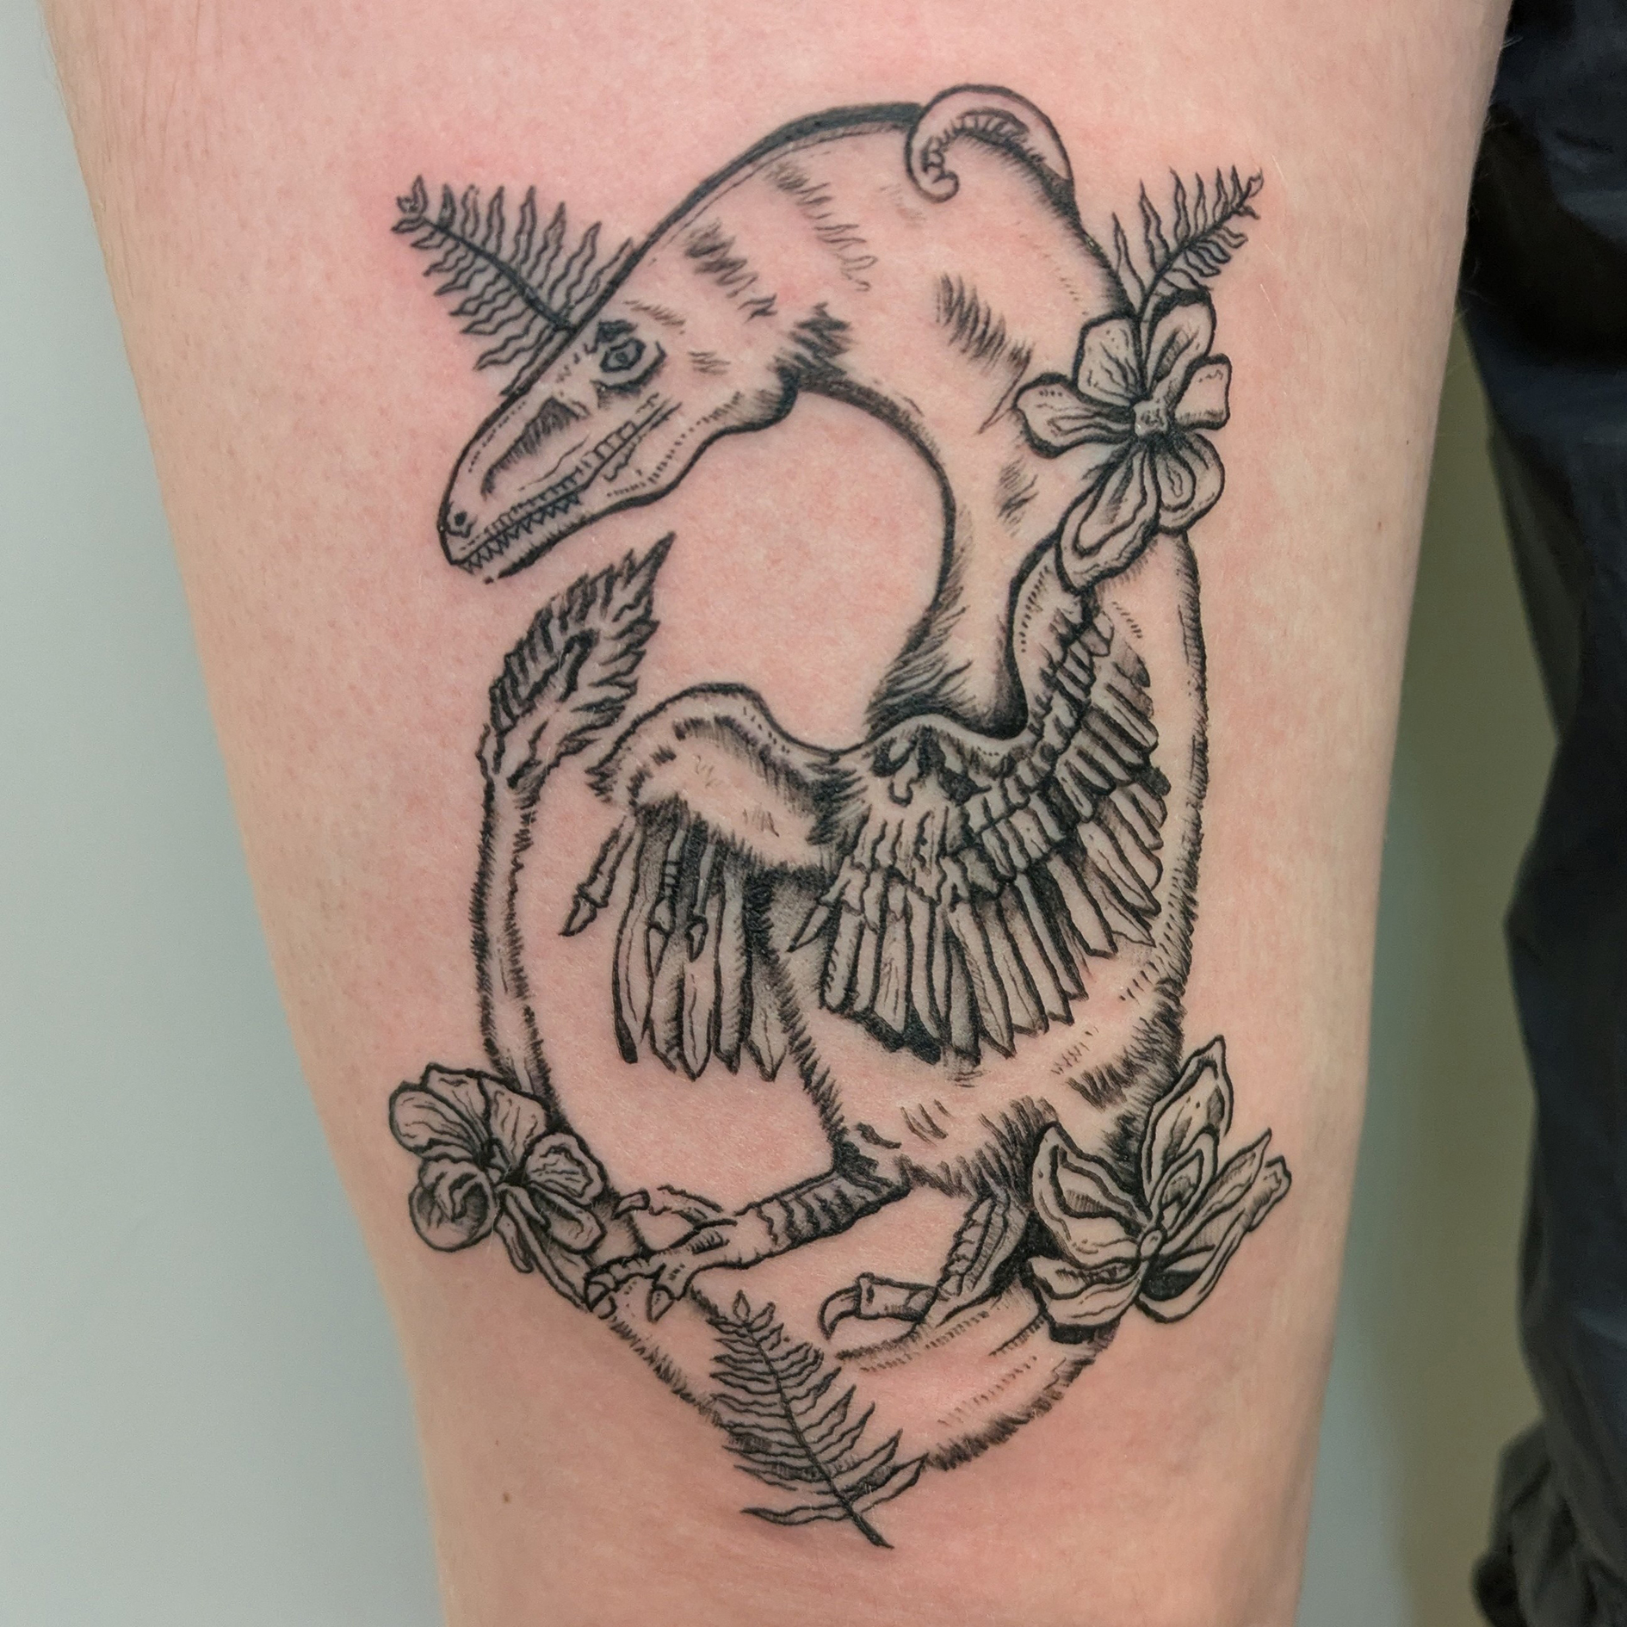
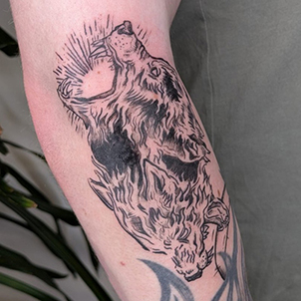
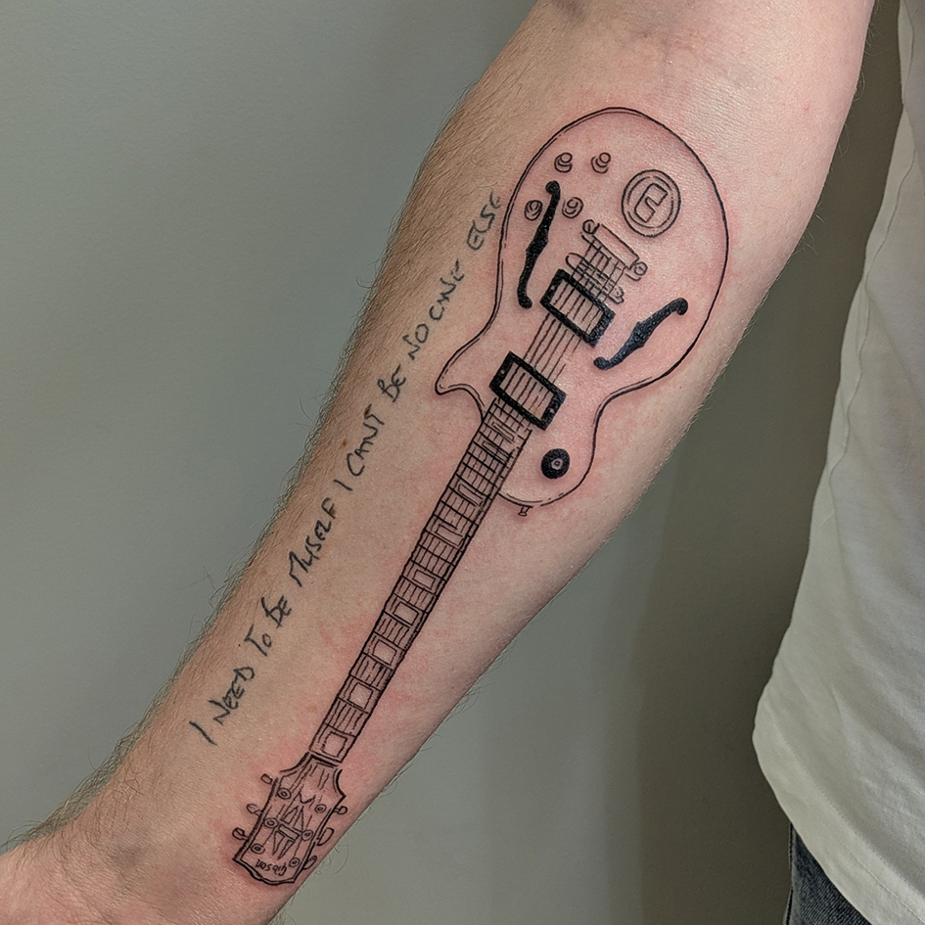
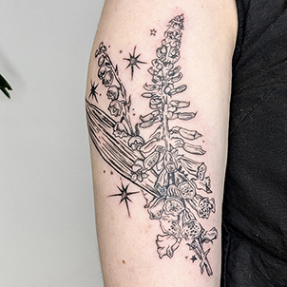
authorship dynamics collaboration dynamics
tattooist practices
creative process
client communications
tattoo paraphernalia and hardware
stencils
illustrations
studio sounds
research materials
fieldwork images
‘take something, leave something’ activity

Slide 5
artist as co-researcher. the value of collaborative and creative methodologies.

Slide 6


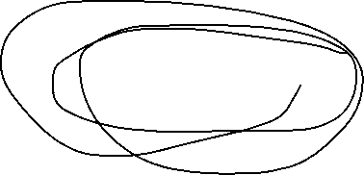

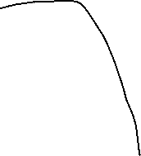




data
UK
UK / AUSTRALIA/ ONLINE
Collaborative fieldwork
Images
Videos
Experience
Observations
Reflection
Collaborative (point in time; post- and pre-fieldwork; exhibition)
Solo (fieldwork; tattooist practice; exhibition)
Write-up (exhibition materials; papers)
UK
Tattooist practice
client briefs
sketches
designs & redesigns
client communications (texts; emails; Instagram)
audio
AUSTRALIA
Audience experience
Public talk
  survey
Exhibition
  focus group; interviews
  participatory activity:
drawings; messages

Slide 7
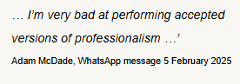
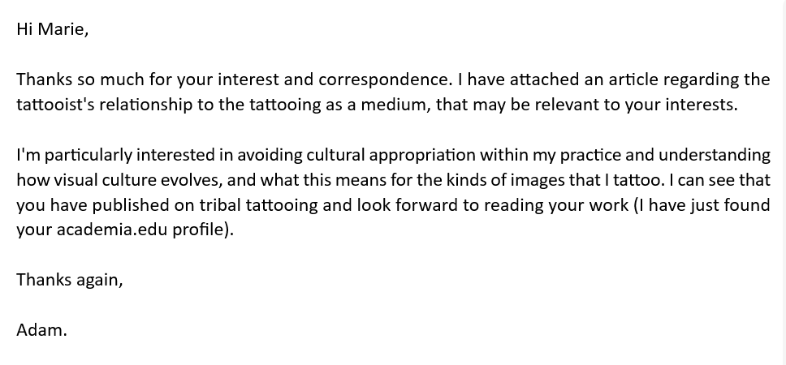
WhatsApp as a lightweight, relational collaboration space
1/30/25, 7:59 PM - Adam McDade: At the risk of taking this into a tenuous tangent—are you familiar with the gloves that Imogen heap made, that alter sounds in a mic based on the hand gesture and movements? I feel like this Synesthesia themed stuff is really interesting when considering the broader connection of all things. Visuals have sounds, sounds have smells, etc…
1/30/25, 8:00 PM - Adam McDade: I'll get back to the other stuff tomorrow on my way to work!
1/30/25, 10:32 PM - Marie Hadley: Oh that's so cool! … ps the tangents are where the magic happens! Pps hopefully have those ethics doc in your email later today

Slide 8
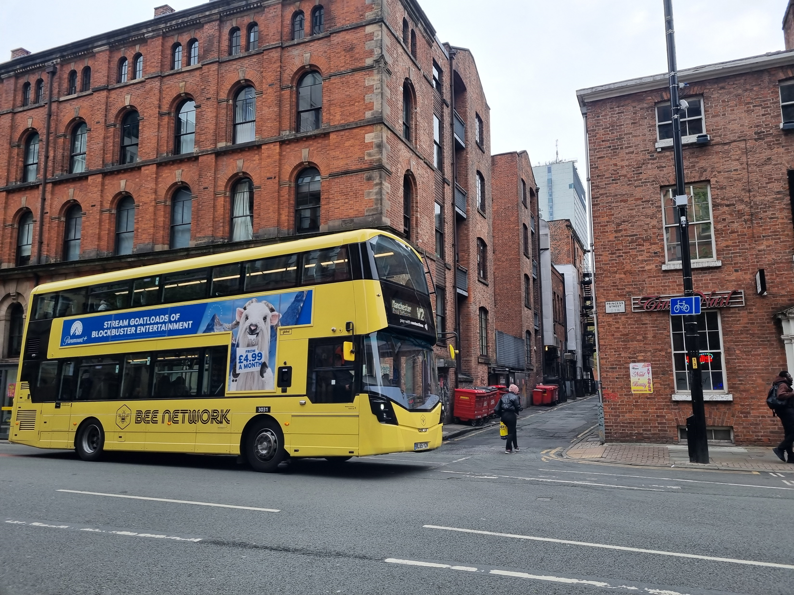
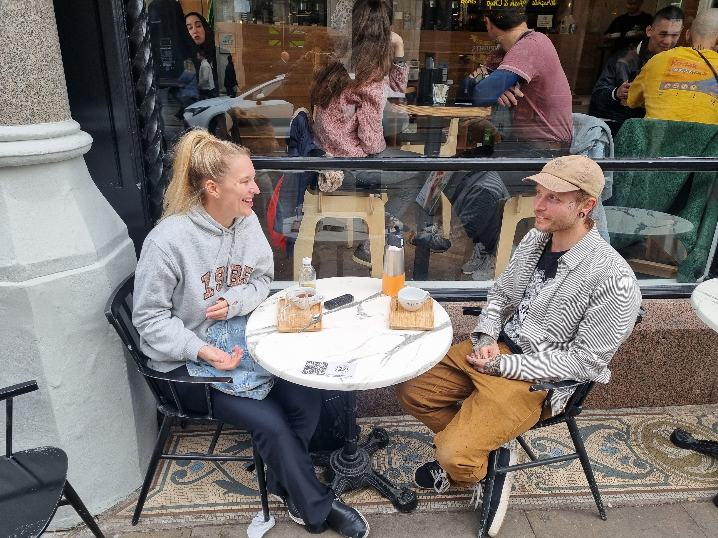

walk. talk. catch the bus.

Slide 9
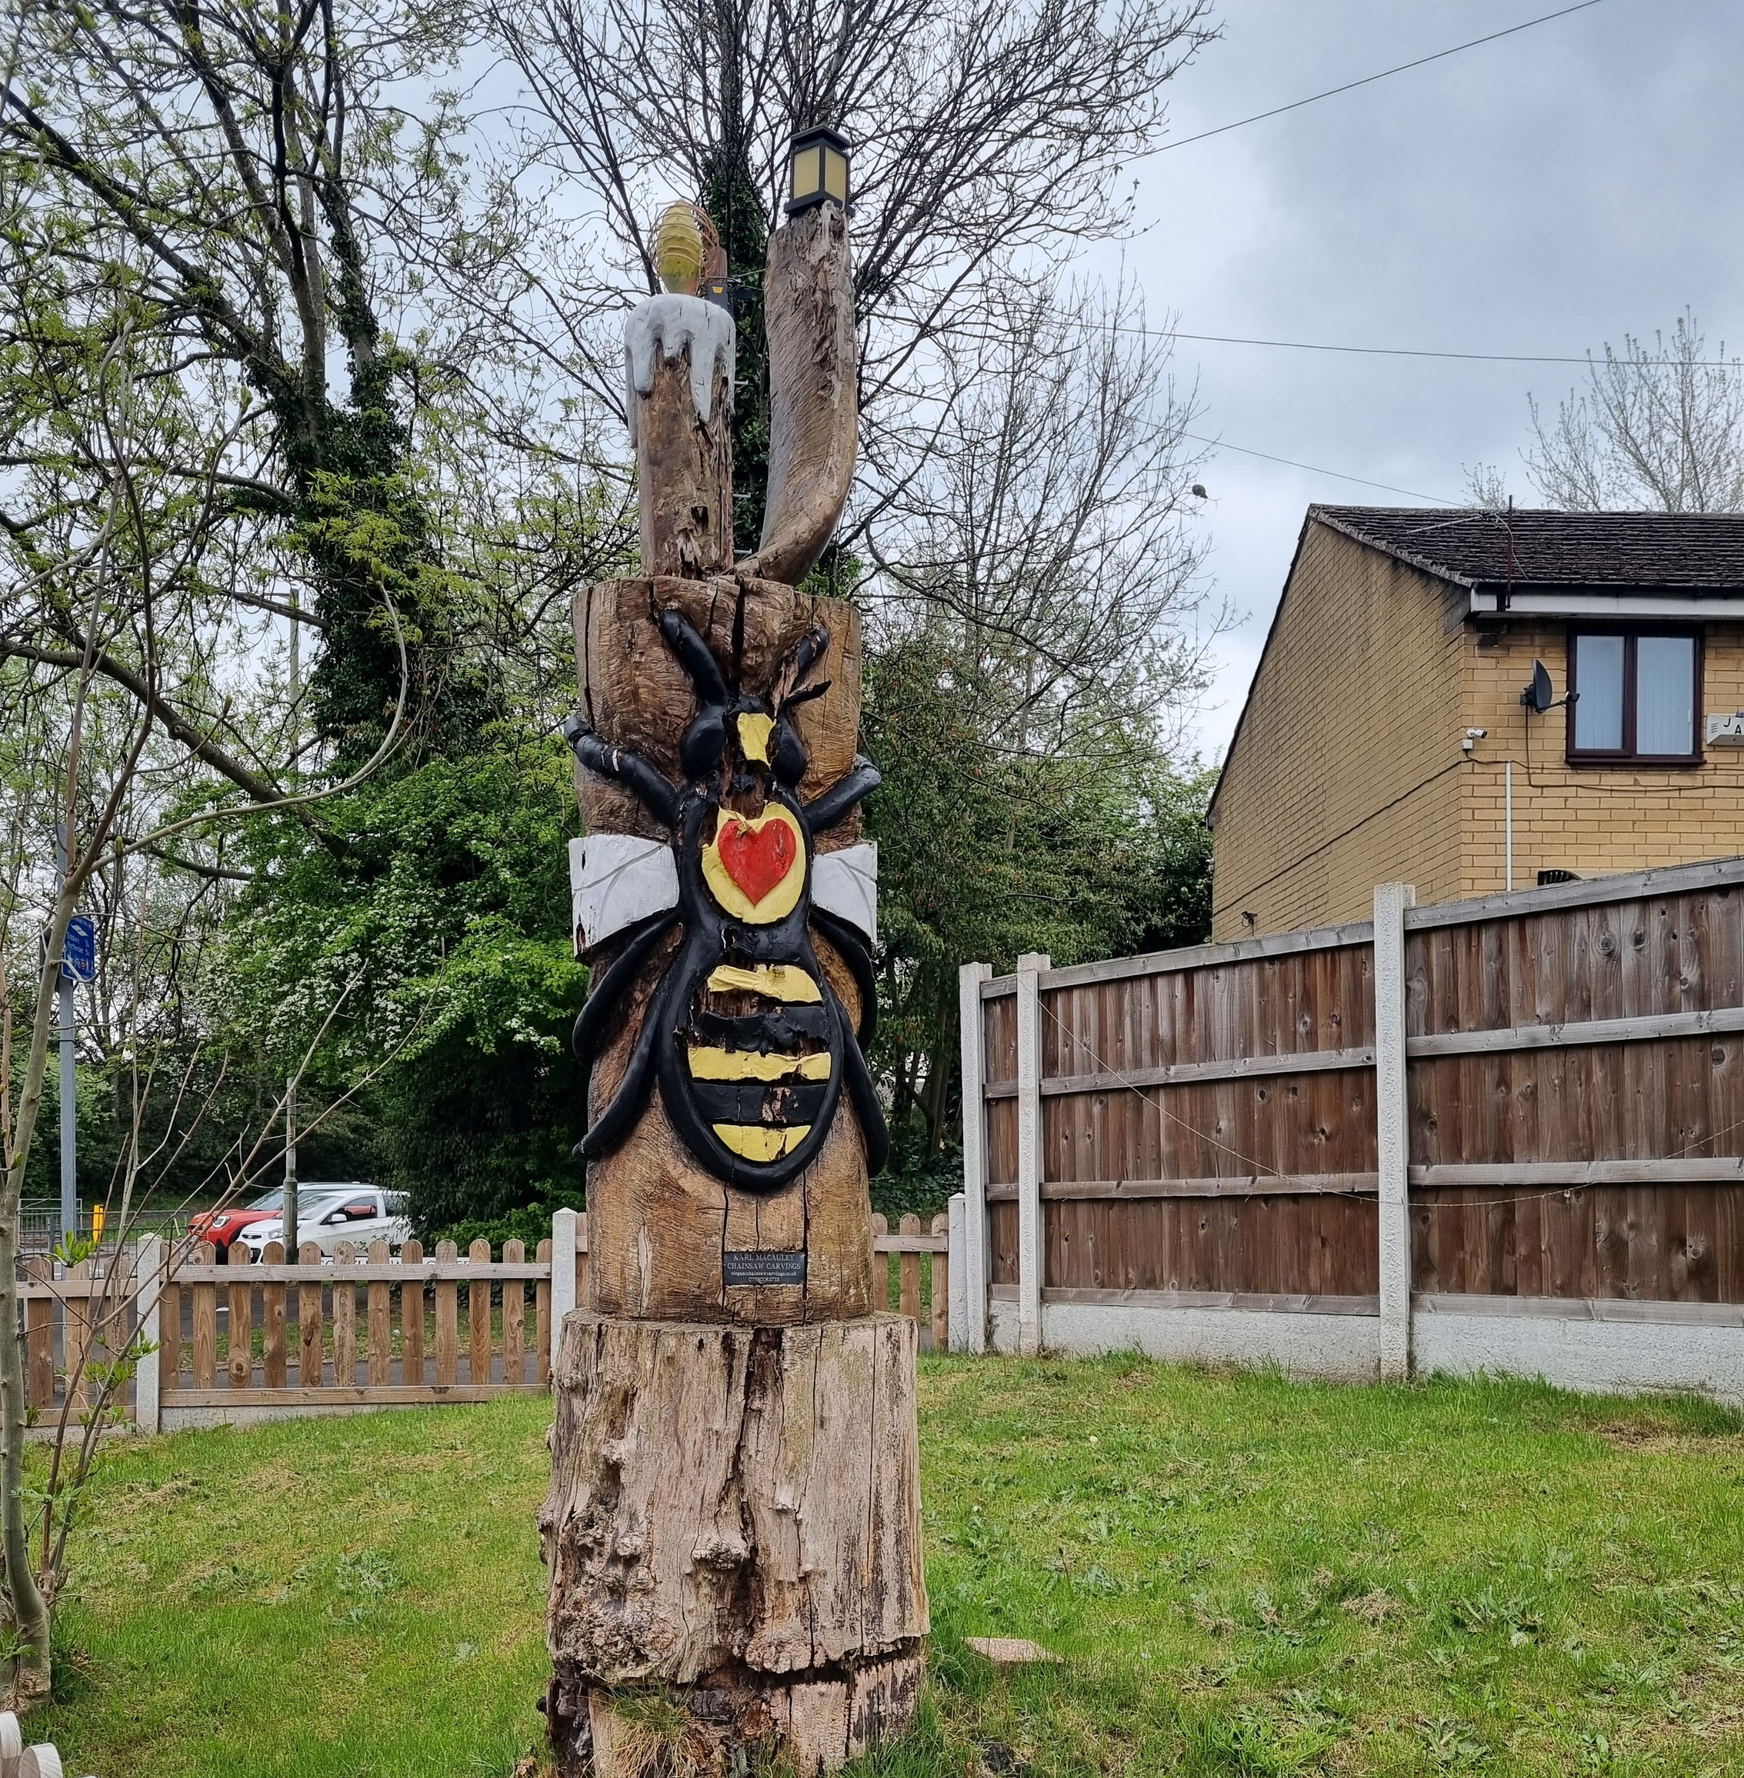
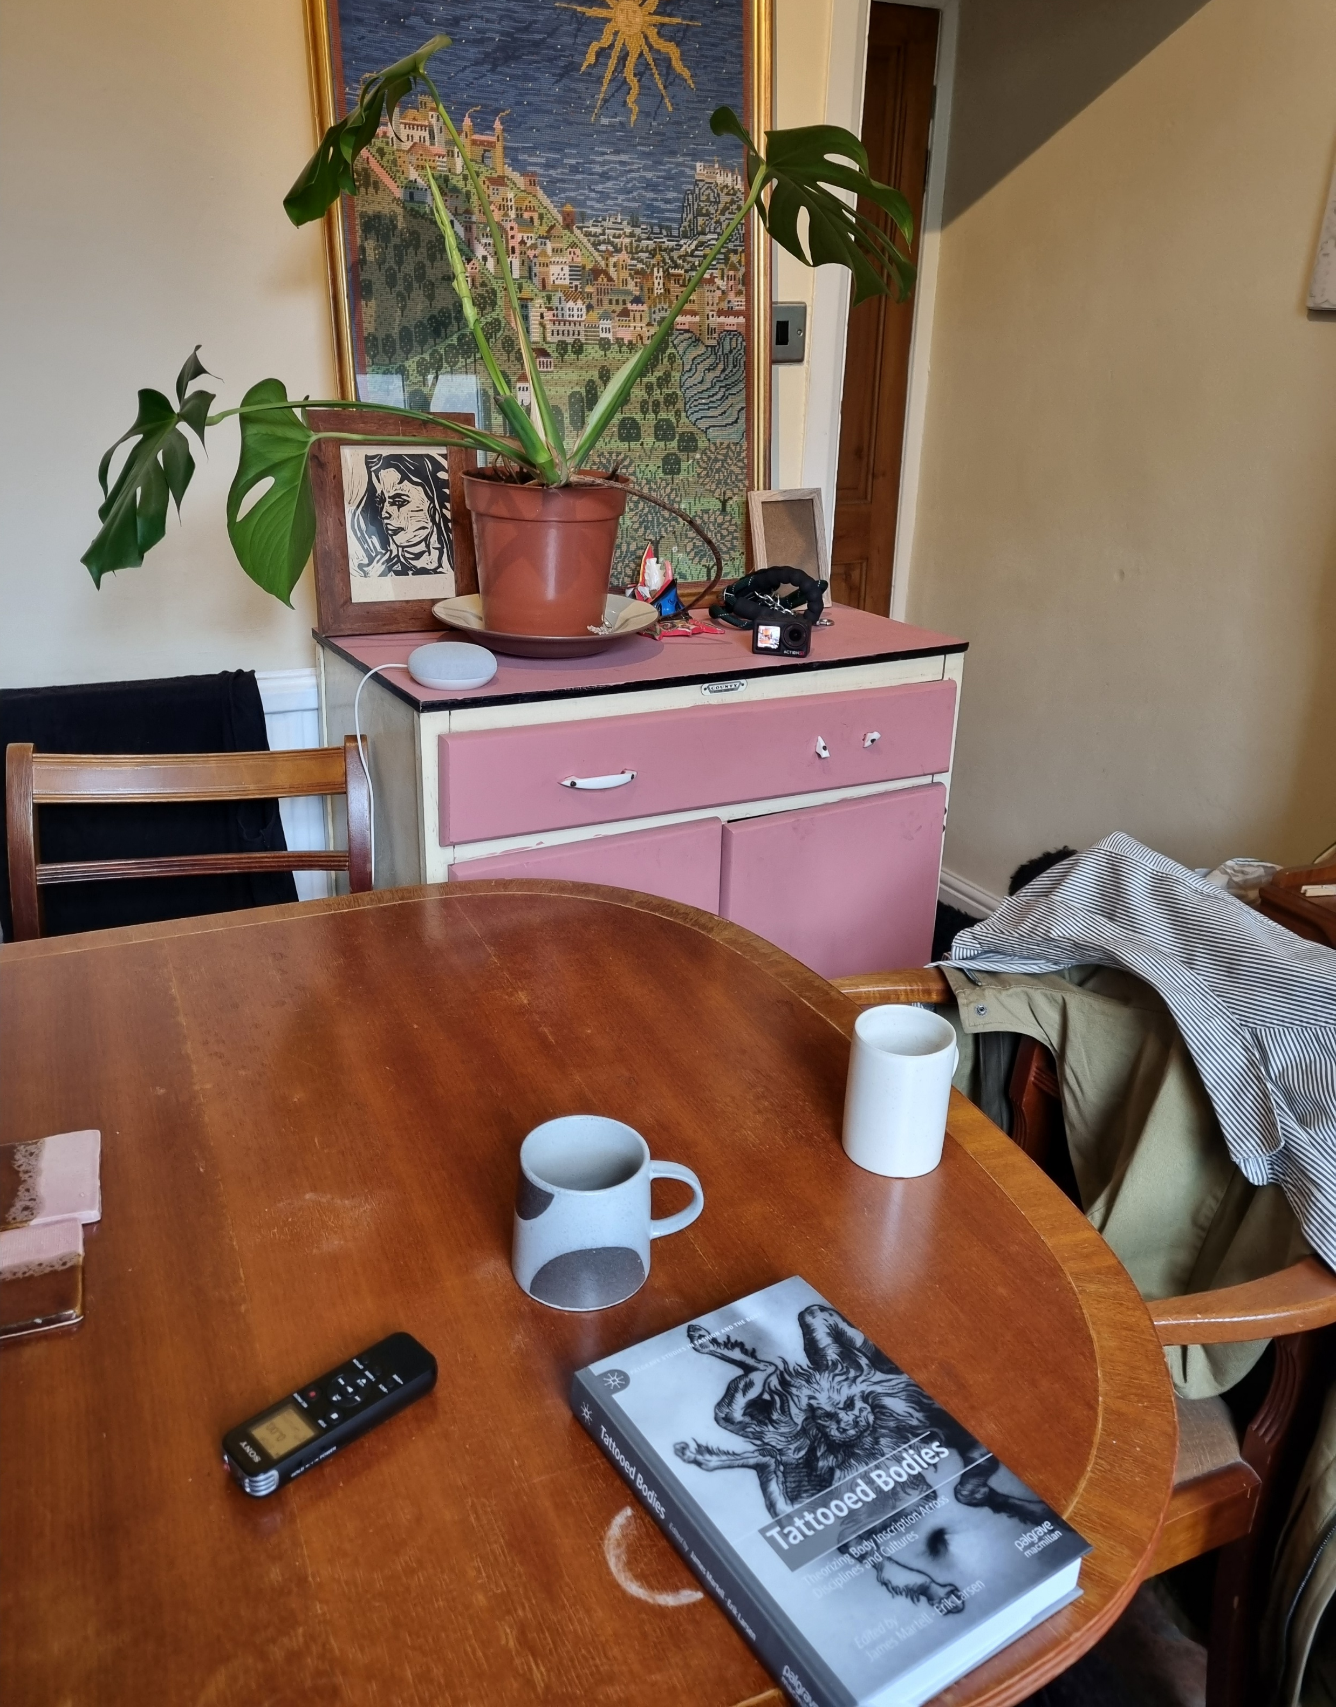
experience the everyday.

Slide 10
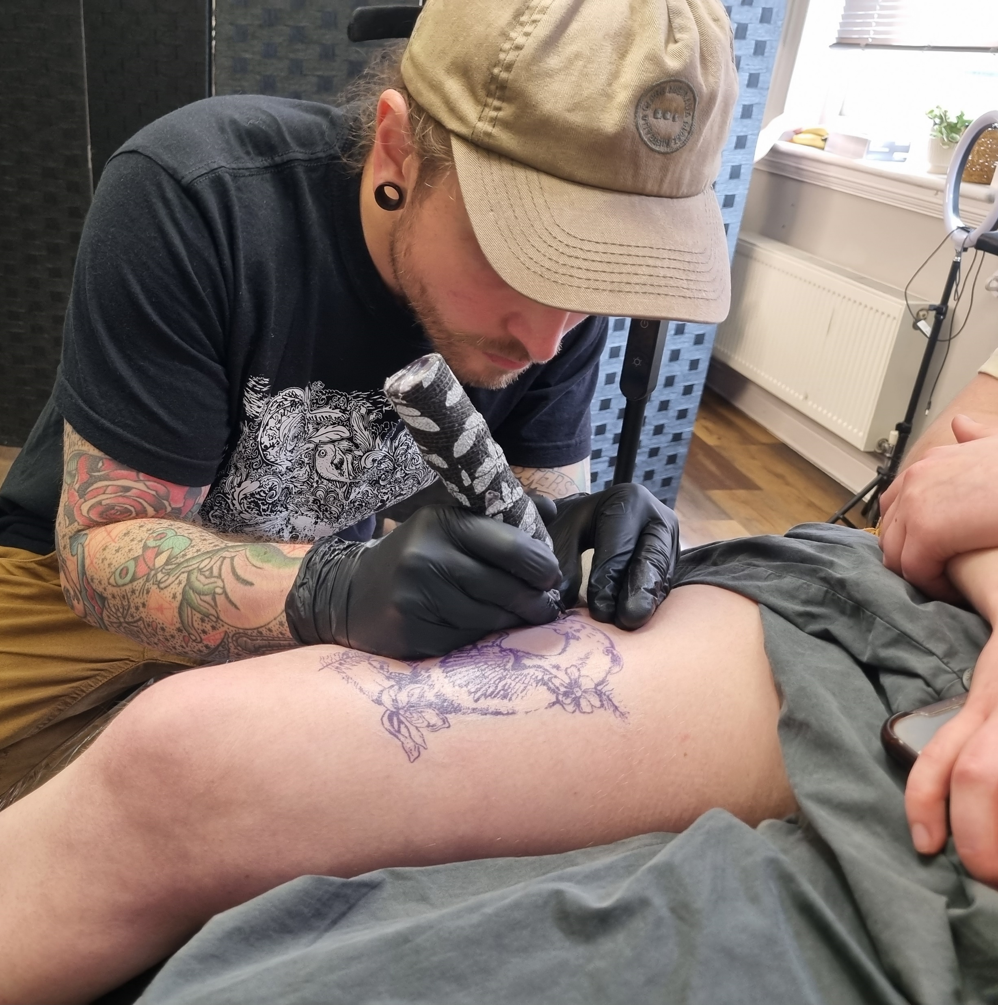
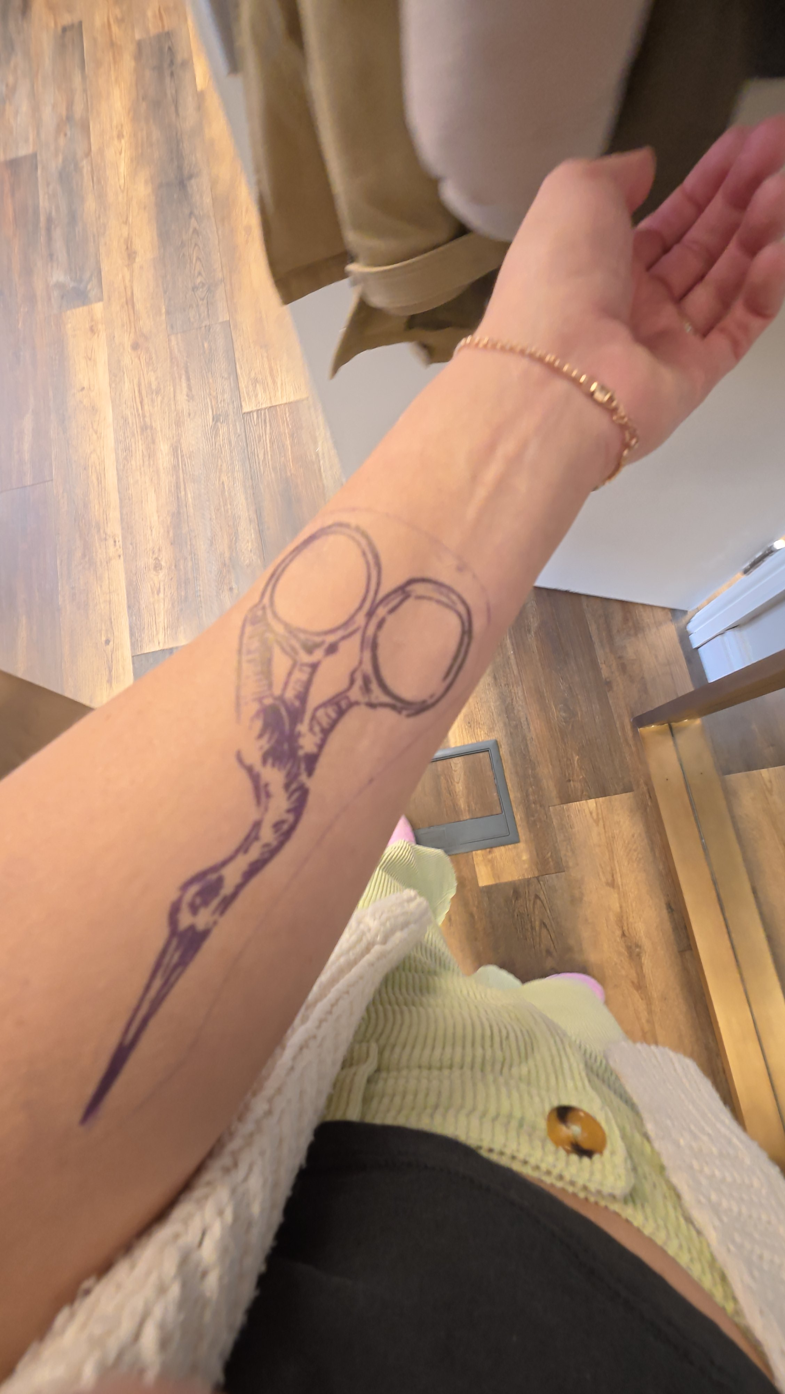
listen with the body.

Slide 11

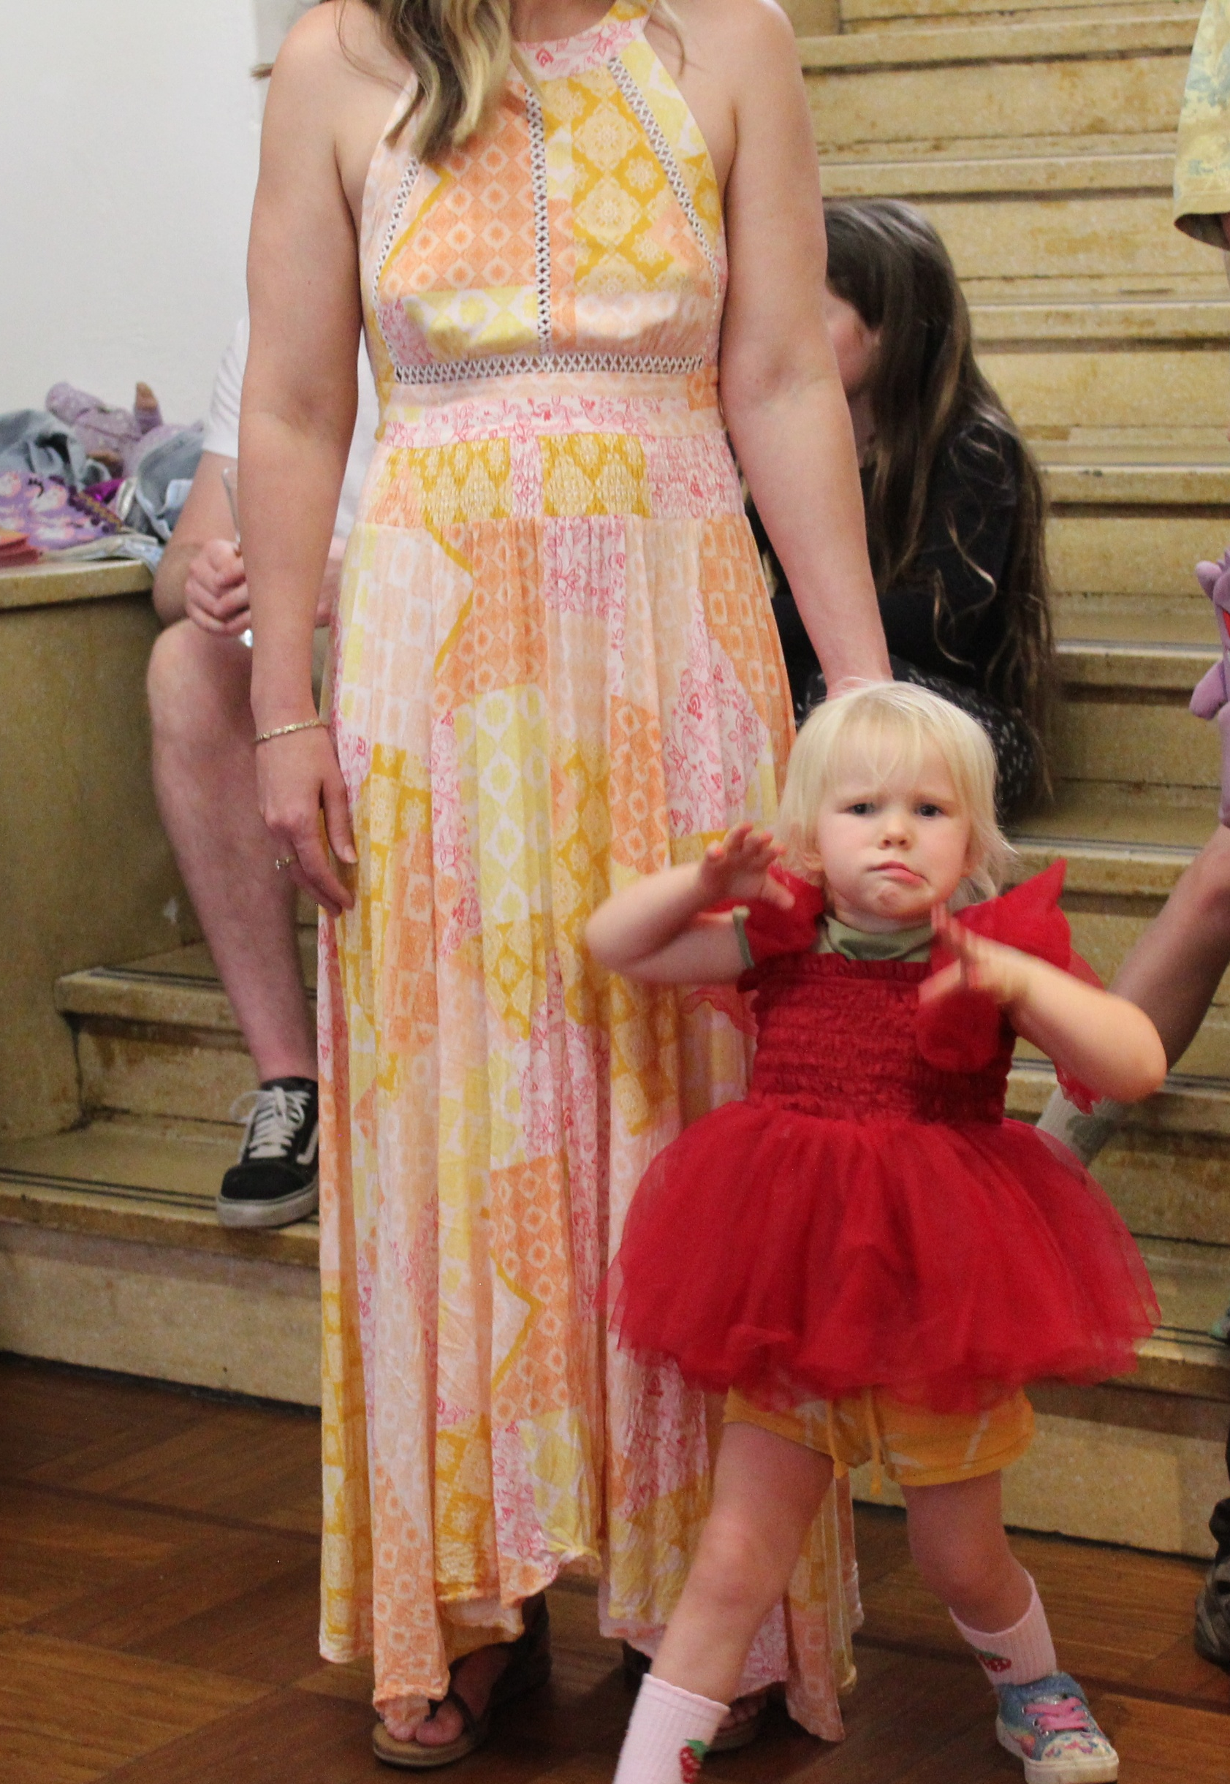
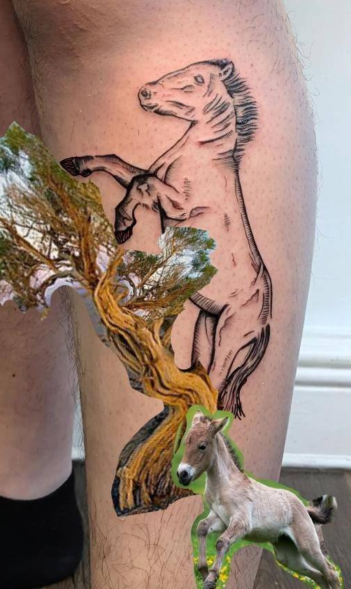
the rhythm of a voice note.

Slide 12
A blueprint.
How can we collaborate across disciplines and boundaries better?

Slide 13
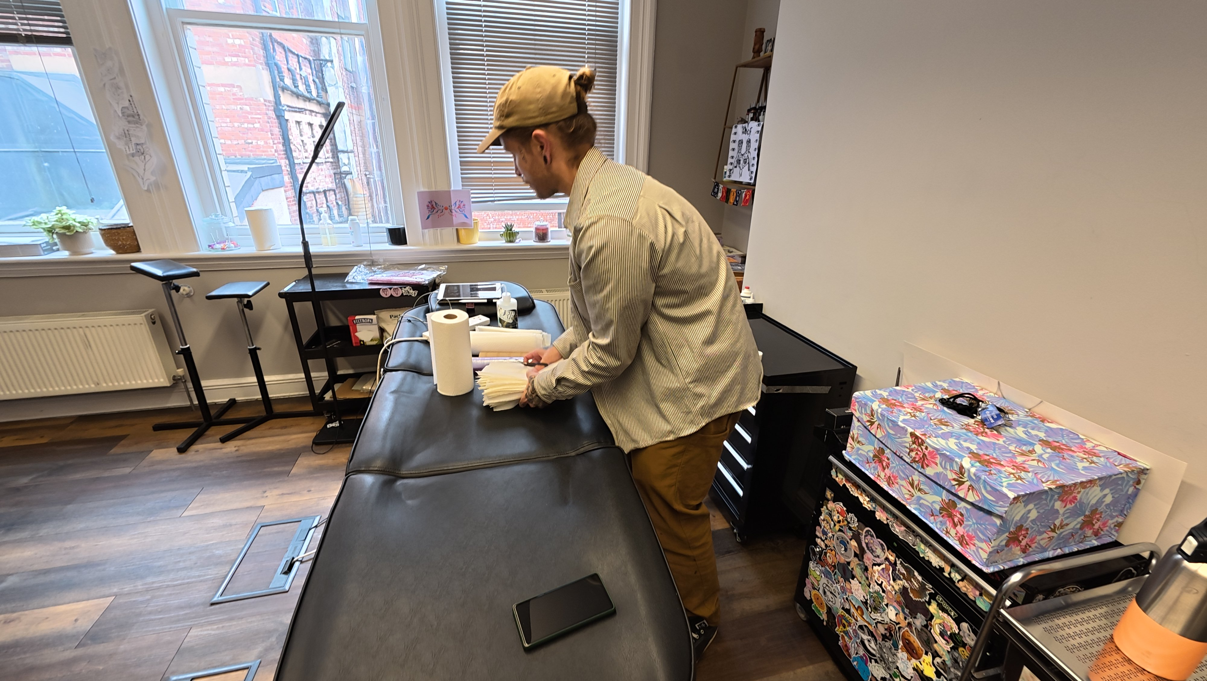
let go - involve the collaborator from the outset.
forget about pretence. be honest.
meet in person. walk in their shoes.
share experiences.
hold space.
listen deeply with the body as well as the mind.
value connection in and of itself.
give it time.

Slide 14
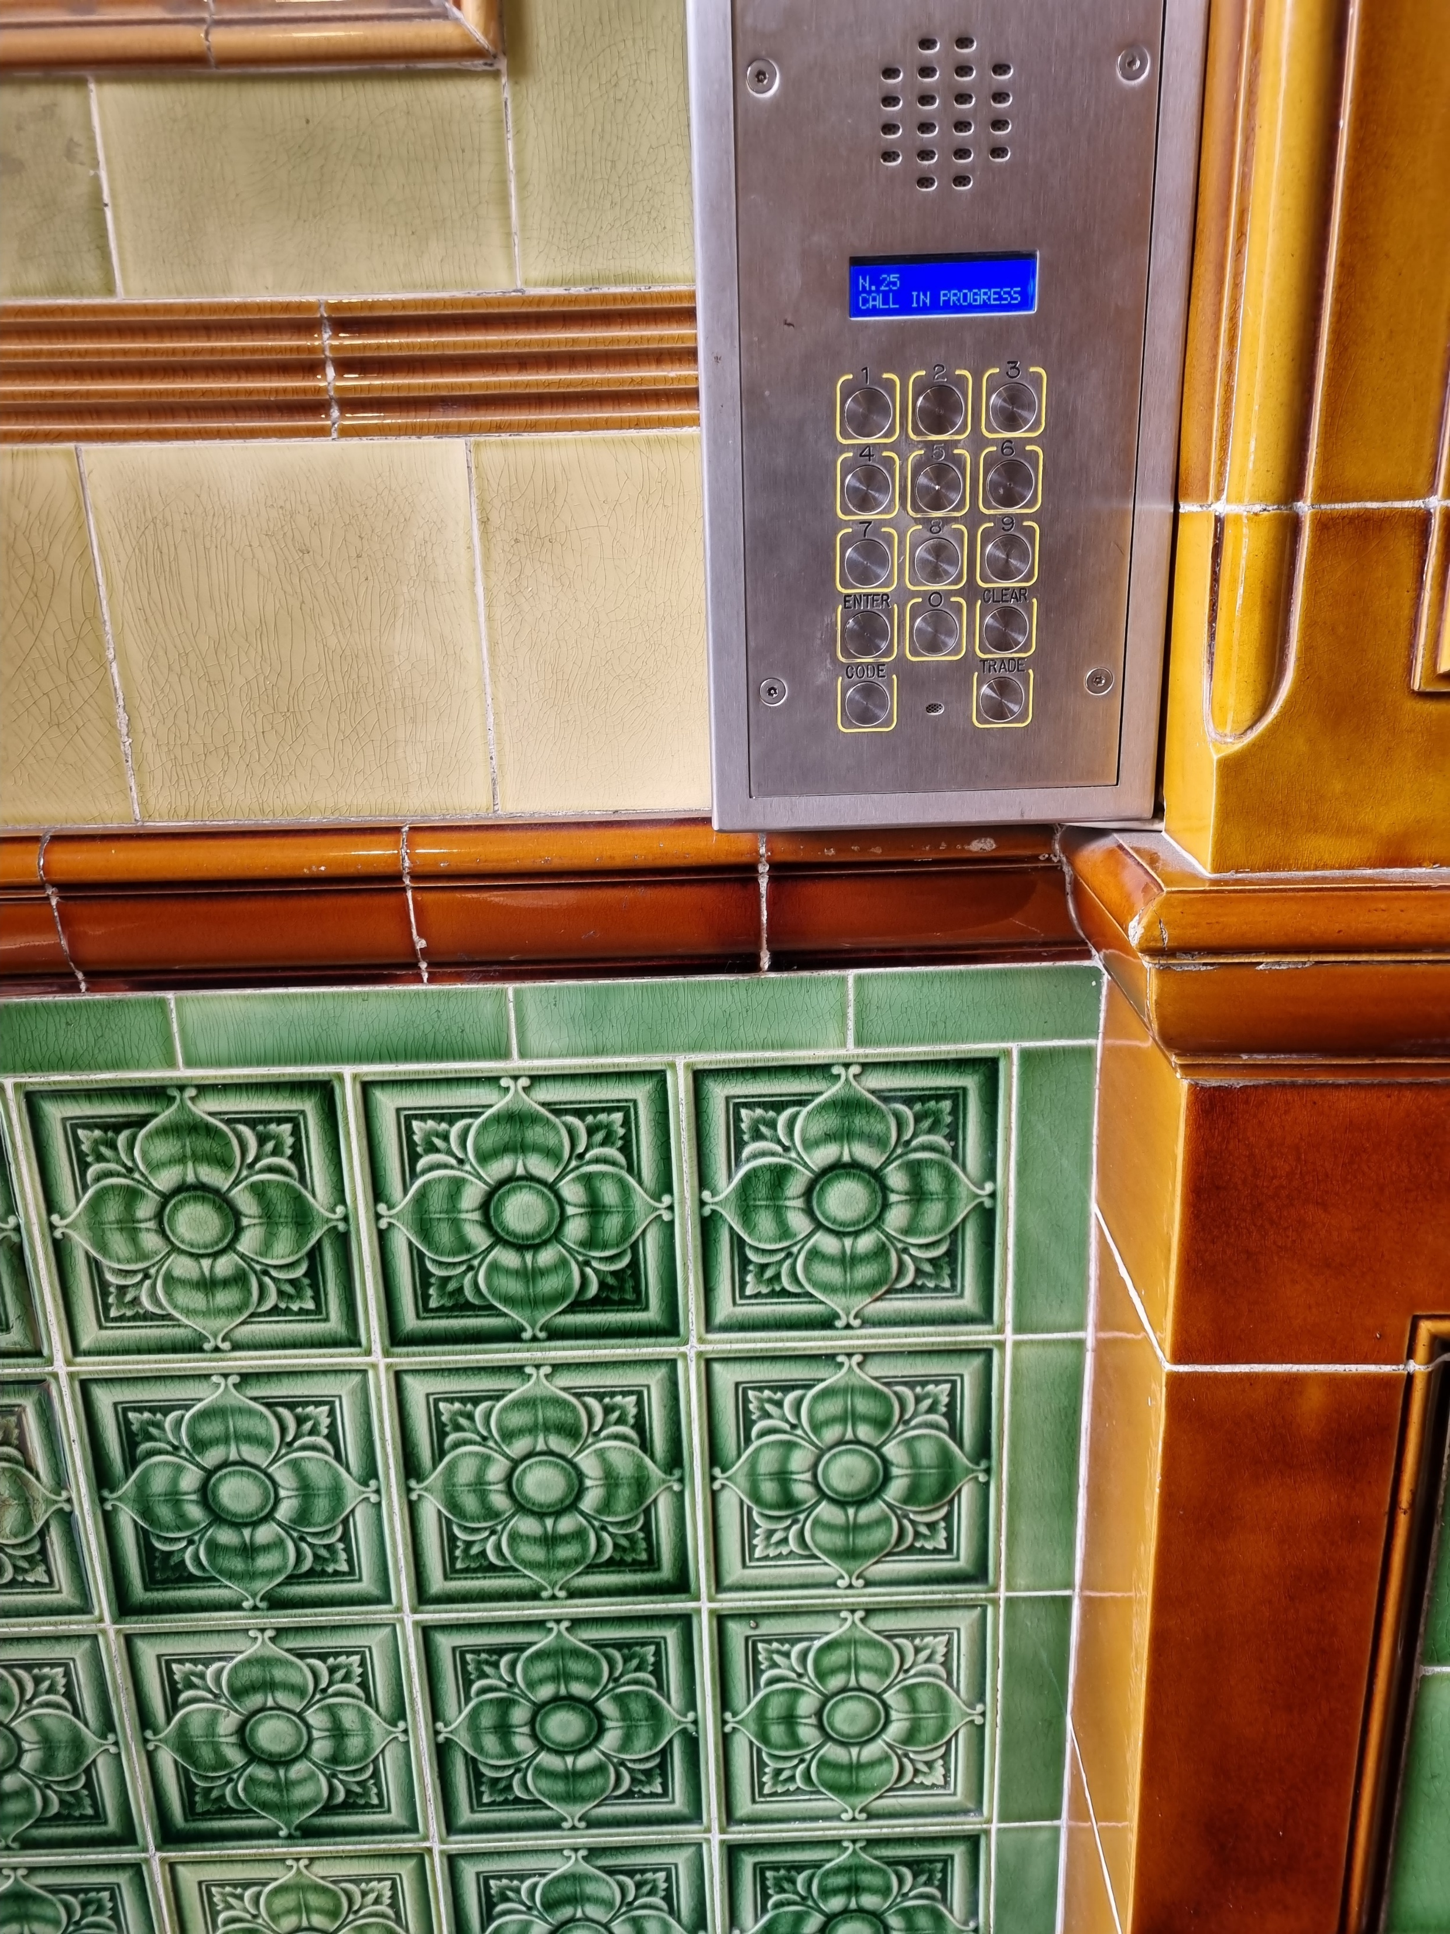
what now?
a tattooist methodology for interdisciplinary research collaboration.
marie.hadley@newcastle.edu.au
adammcdadeillustration@gmail.com
https://mariehadley.com/grey-lines-exhibition

